Slide 1

What is a Computer?
Understand what a computer is
Understand and identify hardware, input and output devices
Keywords:
Device, input, output, hardware, computer, peripherals, instructions, program

Slide 2

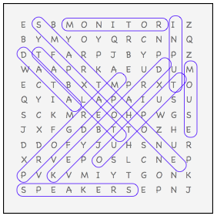
Word search answers
On word document –
Print

Slide 3
What is a Computer?

Slide 4
Computer definition
A computer is a device that processes information
Computers perform instructions (programs)
Computer receive information
Produce results in the form of information or signal.

Slide 5
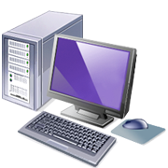
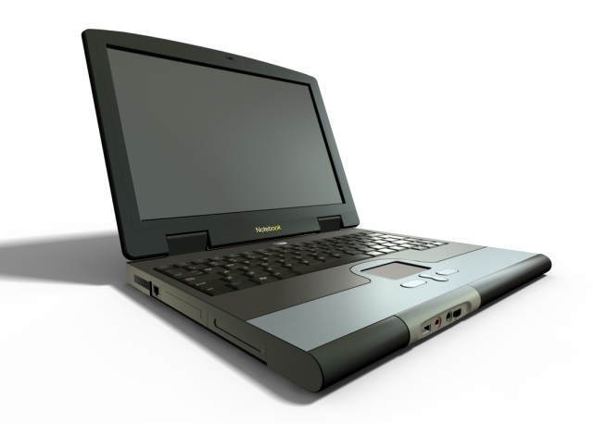
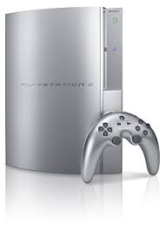
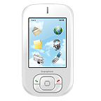
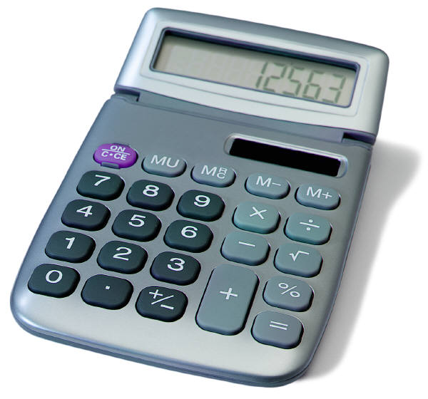
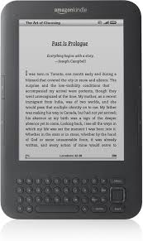
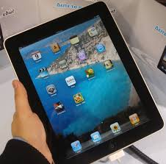
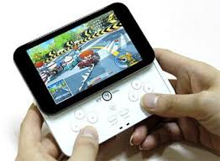
List all the computer devices you’ve used this week
and what you used them for.

Slide 6
List all the computer devices you’ve used this week
and what you used them for.
1.
2.
3.
4.
5.
6.
7.
8.

Slide 7
Discuss in pairs
With a partner discuss what is the same about the different devices and what is different?

Slide 8

Drag the labels onto the correct devices
Input and Output devices
Input
Output

Slide 9
Bob says “a keyboard is an input device.”
Is he correct?
Why?

Slide 10
Mary says “a printer is an input device.”
Is she correct?
Why?

Slide 11











Name : ______________________________
Input
Both
Output
Pick one of the items you have put in BOTH , Name the input and output of that device.
Device________________
Input________________
Output________________

Slide 12
Peripherals
Give me 2 examples of a peripheral
1.
2.

Slide 13
A teacher uses a projector to show you their presentations :
Is it an input device or output device?
Why?
Playing on a games console (PlayStation/Xbox):
What is an Input device used to play on it?
What is an output device you could use?
While putting your answers in this document you are using 2 input devices
What are they?

