Slide 1
Unit 3 - A Digital Portfolio
Project life cycle and portfolio structure

Slide 2
Last week
Project lifecycle
Planning your project

Slide 3
This week
Planning your project
Project timeline

Slide 4
Your portfolio
A series of web pages
Information about you
Achievements so far
Contact details
Projects completed this year

Slide 5
Project timeline
In groups discuss what you think a project timeline is and what details it contains

Slide 6
Project timeline
Used to try and predict the total time needed to complete a project
Tells you what you should be working on when
Helps you manage your time
Needs to identify the different project stages
Show order tasks should be completed in

Slide 7
How to plan
Use a Gantt chart
List tasks
Start date
End date
Time for each task

Slide 8
How to produce a Gantt chart
Use Excel see example below

Slide 9
Task Gantt chart exercise
Complete Gantt chart exercise details can be found on moodle or printed sheet

Slide 10
Page Types
Every digital portfolio should have the following page types
Home page
Section Pages
Context pages

Slide 11
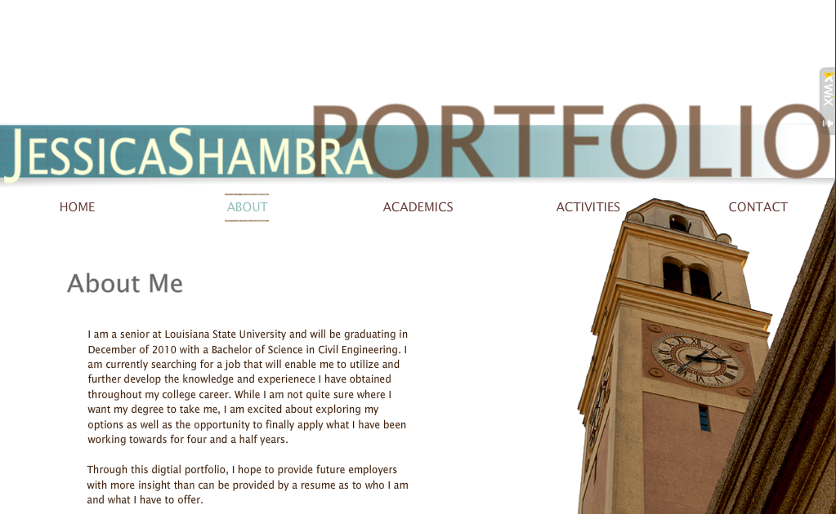
Home page
Contains
Brief introduction to portfolio
Controls navigation
Ability to access work from this page

Slide 12
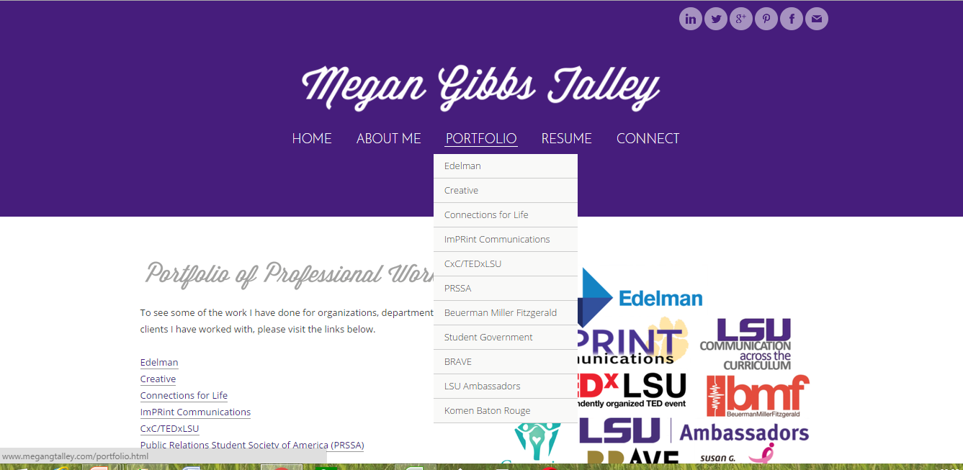
Section pages
Brief description of each section with links to other pages

Slide 13
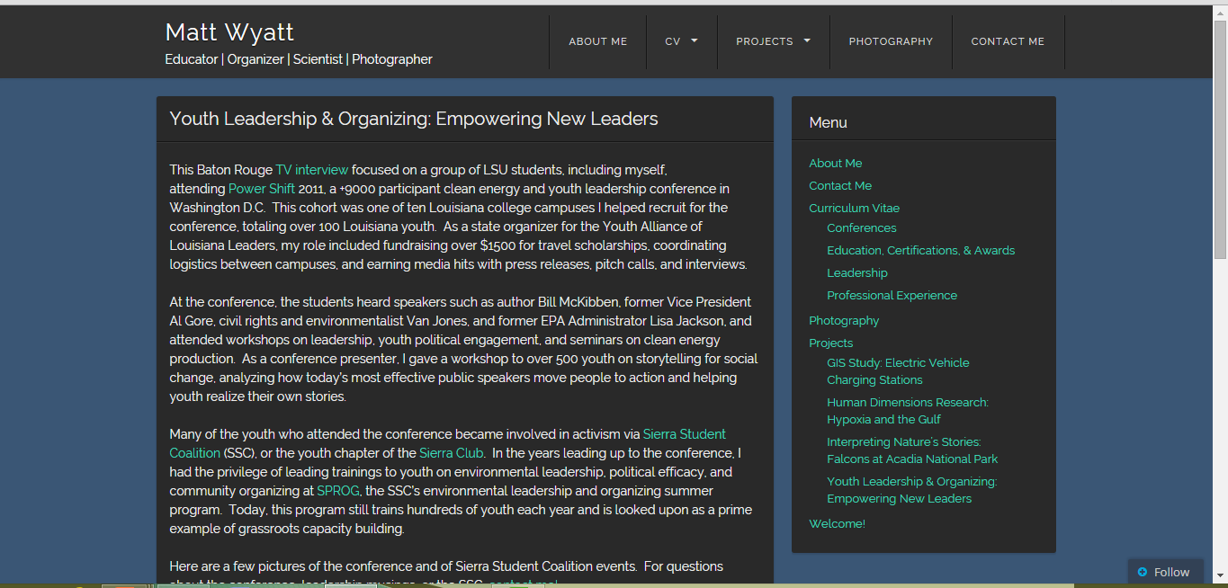
Context pages
Areas of portfolio that contain the work you have produced
Brief description of evidence plus links to evidence

Slide 14
Structure chart
Shows how the pages link together

Slide 15
Example structure chart
Home
About
Education
Projects
Contact
Unit Y
Unit x
Unit z

Slide 16
Task
Complete the following tasks
Decide on at least 8 pages for your digital portfolio and what type of pages they are
Draw a structure charts showing how the pages will fit together.
Send an email that contains these details plus a copy of your Gantt chart

