Slide 1
L3 COMPUTING
Level 3 Computing BTEC Extended Diploma
Unit 9
Lesson 3.1 – Impacts on business
Martyn Rosser

Slide 2
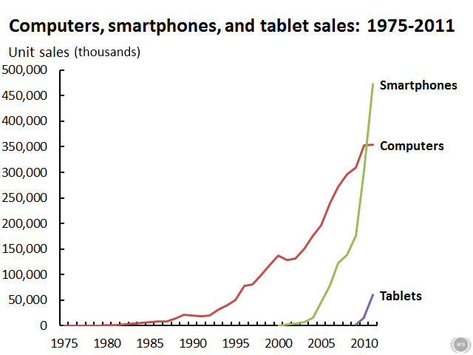
Starter:
Notes:
2003,1980, 1995, 2010

Slide 3
Starter: What should be done?
2 x timelines
Computer Spec for 1995 vs 2020
Notes on discussion on Artificial Intelligence
Notes:
2003,1980, 1995, 2010

Slide 4
Learning Objectives
Explain the impact of improvements in technology on an organisation
Consider the likely developments in computing over the next ten years

Slide 5
Supermarkets – 1995 vs 2020
Business Functions
Marketing
Stock Control
Customer Service
Admin
Shopping

Slide 6
Task 1
Pick a business of your choice:
Clothing
Sports
Manufacturing
Software/Games Developer
Restaurant/Hospitality/ Travel
Education/Health
Etc
For each function of the business produce a report explaining the impact of the improvements in computing on them.

Slide 7
Task 2
What are the next likely development sin Computing over the next ten years?
Make a list of the top ten most likely developments
Under each write a short paragraph explaining this development

