Slide 1
Unit B7 – Branding a Product
Creating Identity, Value, and Recognition in the Digital Marketplace

Slide 2
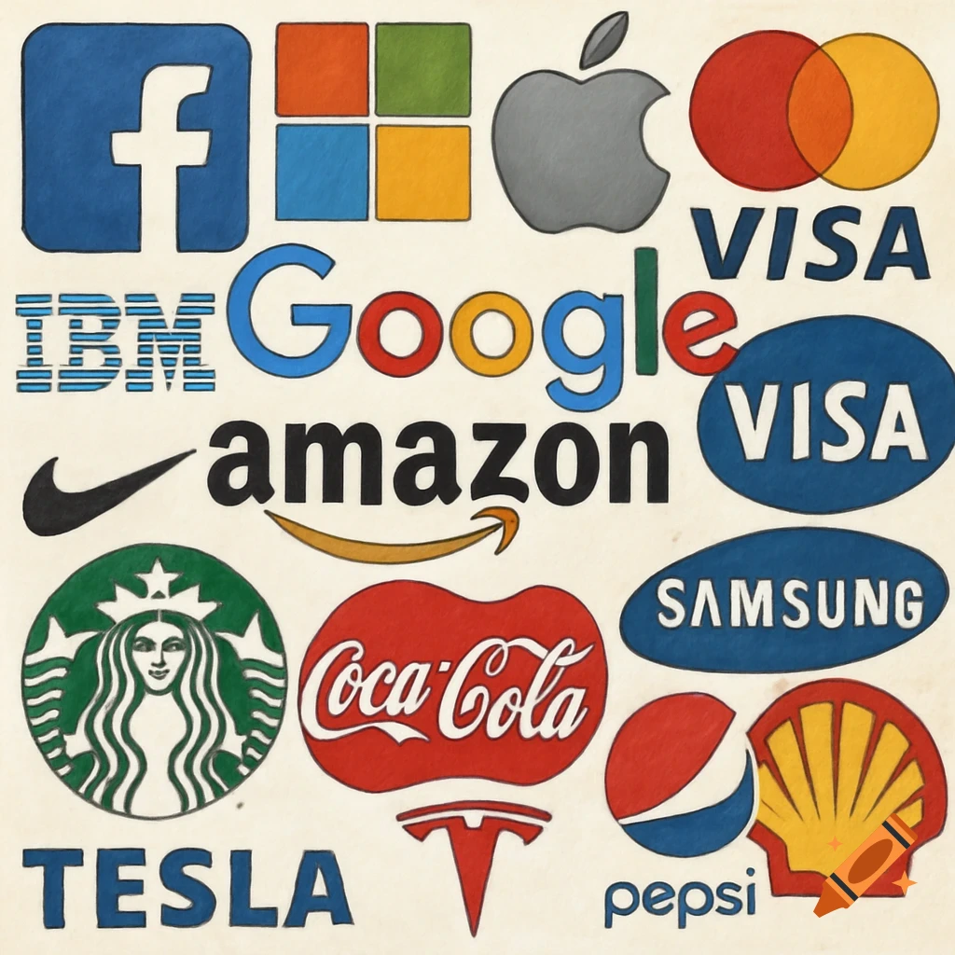
Unit B7: Branding a Product
Understanding the Power of Brand Identity

Slide 3
Learning Objectives
By the end of this session, you will be able to:
Define what a brand is and distinguish it from a product.
Identify the key components of a brand identity (Name, Logo, Tone, Values).
Evaluate the impact of branding on customer perception and market success.
Apply basic branding principles to a hypothetical product.

Slide 4
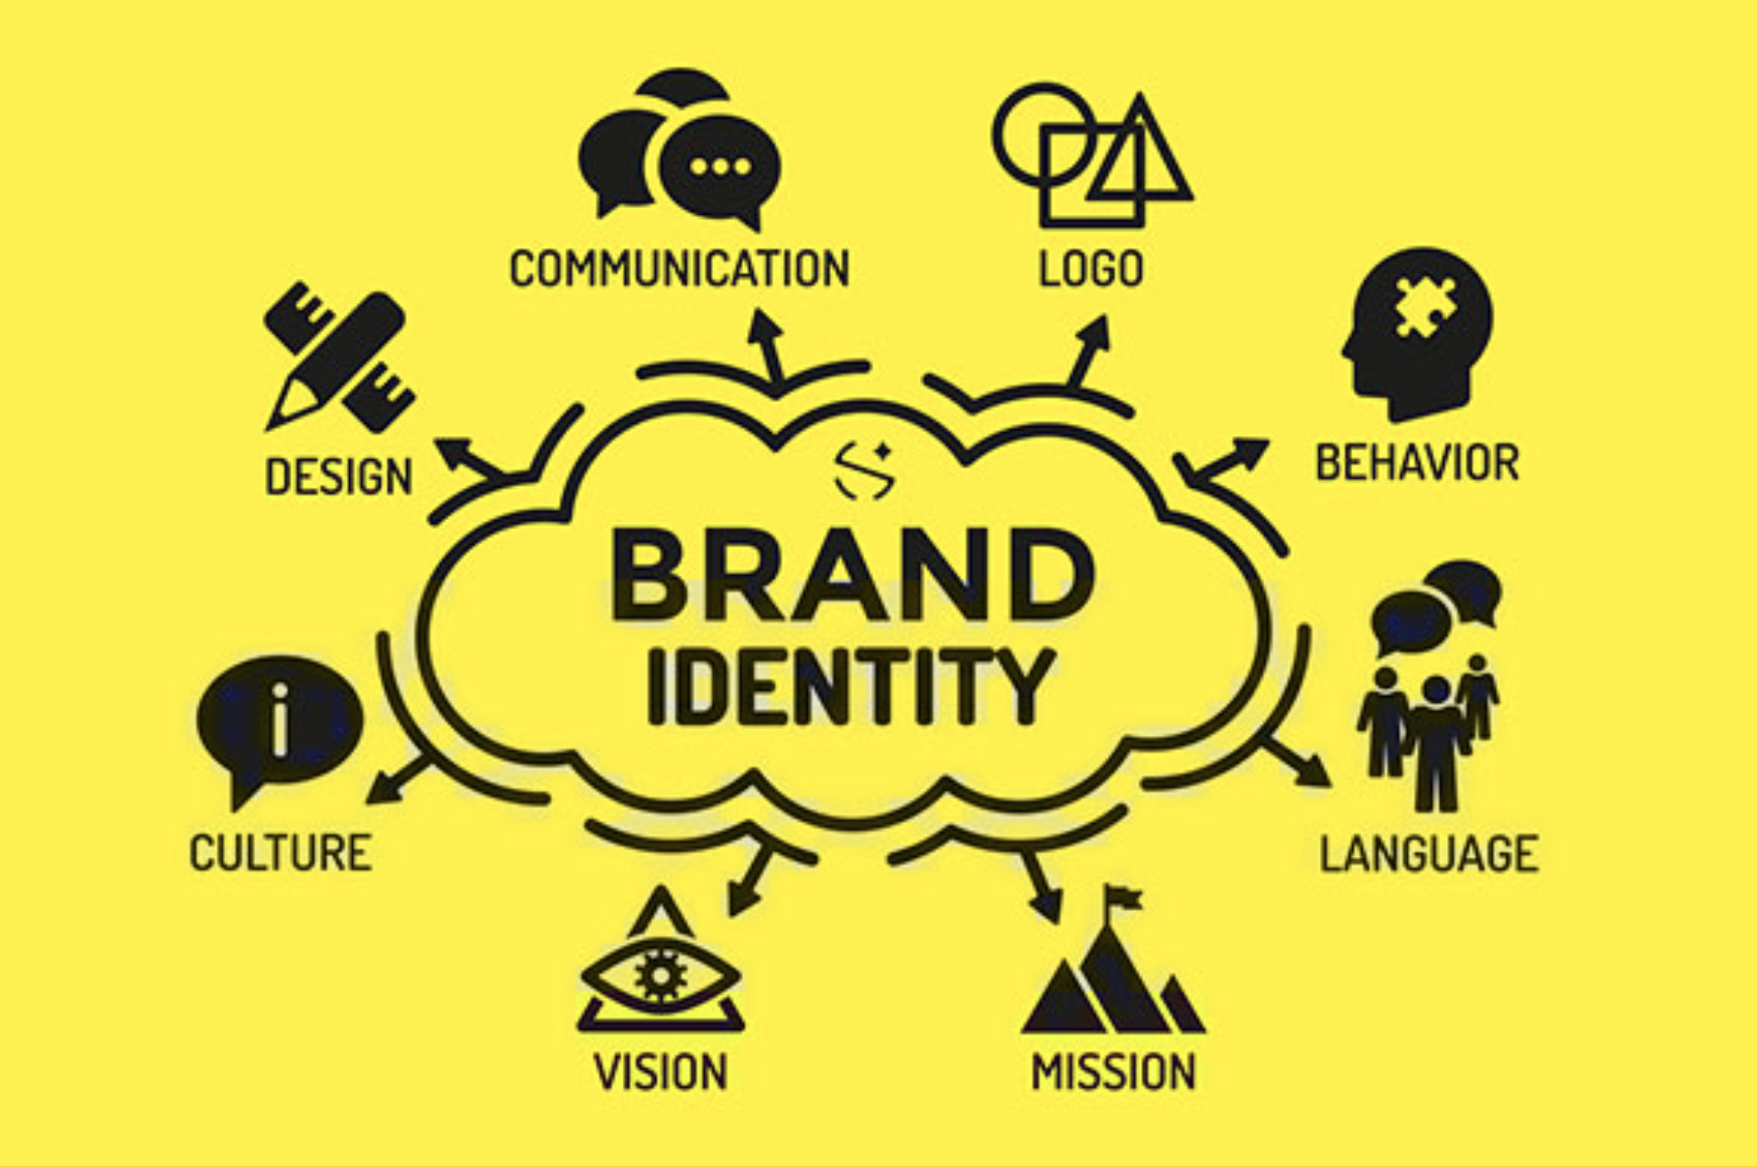
What is a Brand?
(The Core Concept)
Definition: A brand is not just a logo. It is the sum of all perceptions a customer has about a company or product.
The "Product" vs. "Brand" Distinction:
  Product: A tangible item or service (e.g., A soft drink, a pair of shoes, a subscription).
  Brand: The intangible reputation, emotion, and expectation (e.g., "Refreshing," "Athletic," "Luxury").
Key Quote: "A product is made in a factory; a brand is bought by a customer." – Walter Landor.
Visual: An iceberg. The tip is the "Product." The massive underwater section is the "Brand" (Values, Trust, History, Reputation).

Slide 5
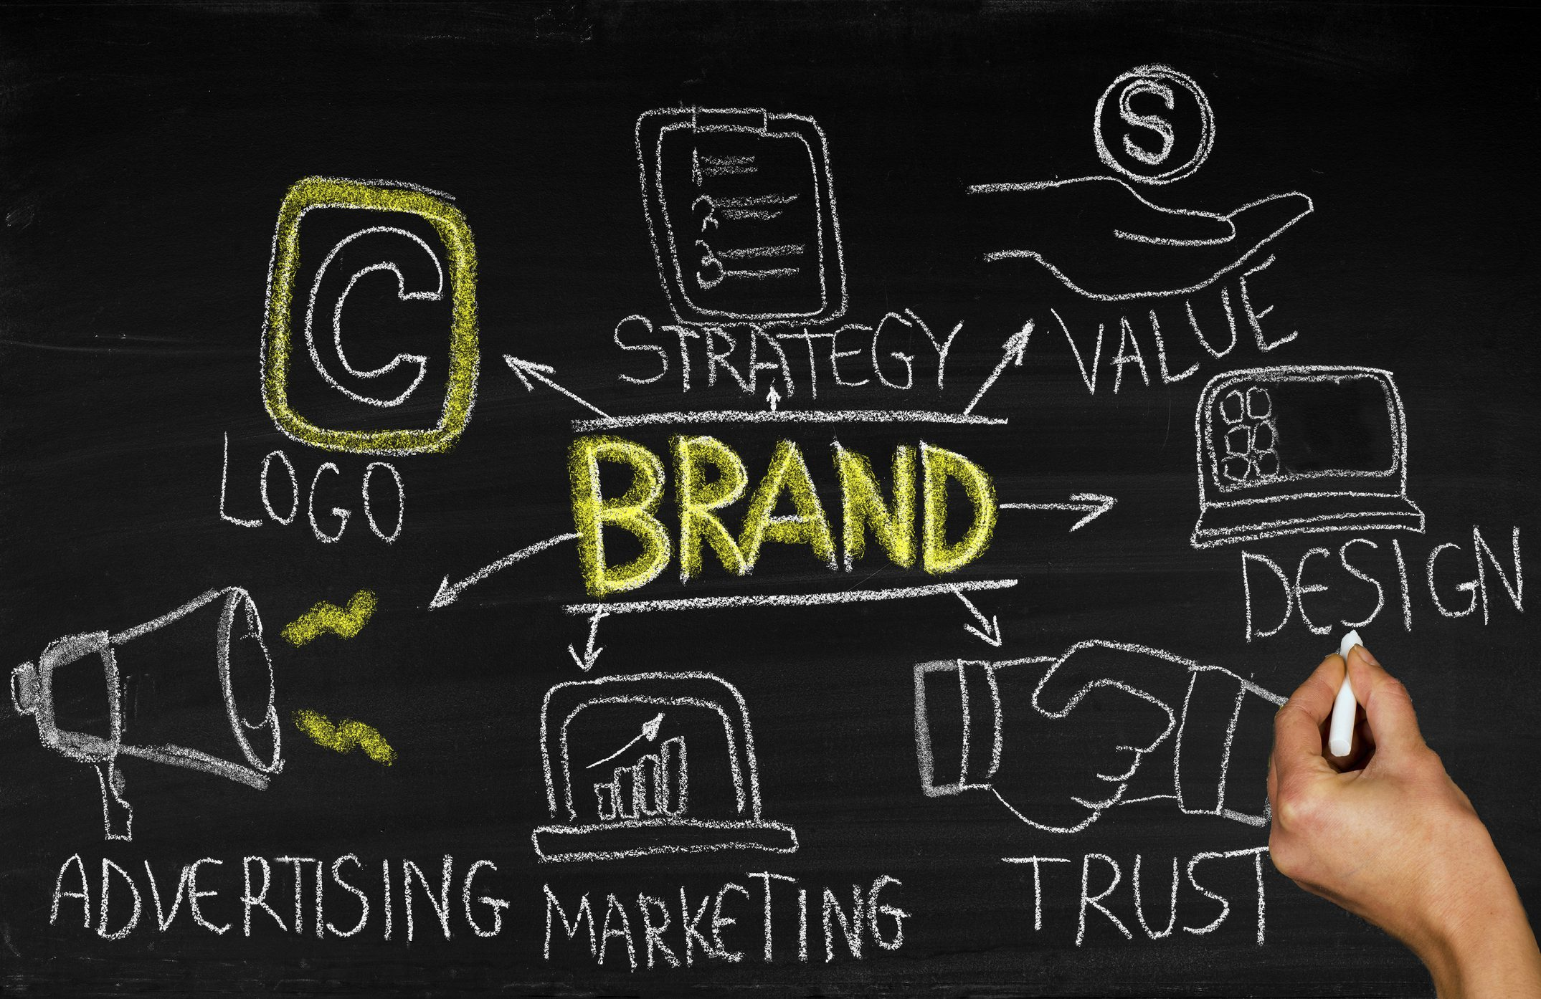
Why Branding Matters
Differentiation: In a crowded market, features are easily copied. Branding is unique.
Trust & Reliability: A strong brand signals safety and quality (e.g., Volvo, Johnson & Johnson).
Pricing Power: Strong brands can charge a premium (e.g., Apple vs. generic electronics).
Customer Loyalty: Customers buy into brands repeatedly based on positive associations (e.g., Starbucks, Lego).

Slide 6
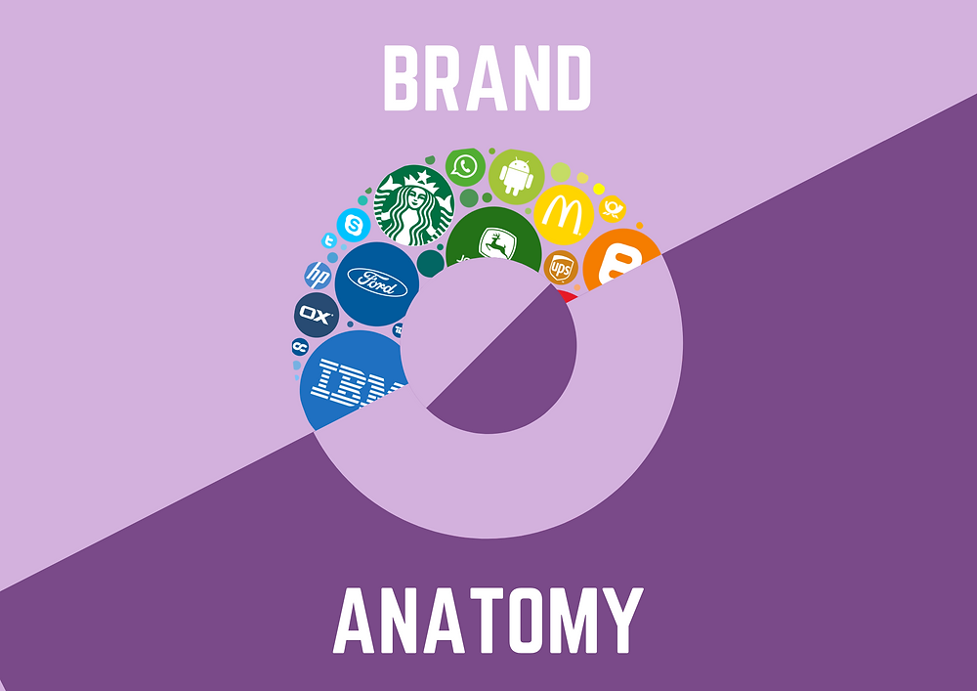
The Anatomy of a Brand
(The 5 Key Elements)
Brand Name: The verbal handle (e.g., "Nike," "Amazon").
Logo/Symbol: The visual mark (e.g., The Nike swoosh, the Amazon arrow).
Tagline/Slogan: The verbal hook (e.g., "Just Do It," "I'm Lovin' It").
Tone of Voice: How the brand speaks (e.g., Professional, Playful, Luxurious).
Brand Values: The core principles (e.g., Sustainability, Innovation, Community).

Slide 7
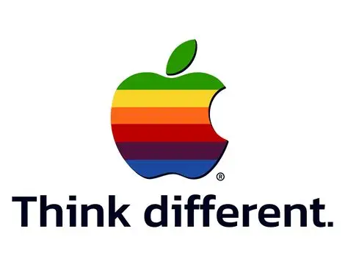
Branding Case Study – Apple Inc.
The Product: Computers, Phones, Watches.
The Brand:
  Minimalism (Design).
  Innovation (Think Different).
  Status (Premium pricing).
The Result: Apple is one of the most valuable brands in the world, not just a technology company.
Takeaway: They sell an identity, not just a device.

Slide 8
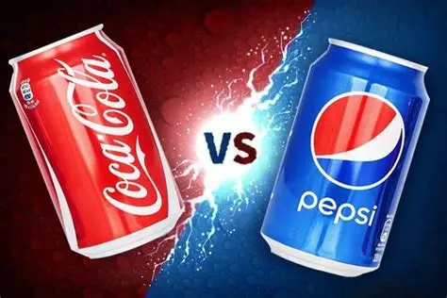
Branding Case Study – Coca-Cola vs. Pepsi
Coca-Cola:
  Brand: Classic, Timeless, Tradition, Happiness.
  Visuals: Red, script font, polar bears.
Pepsi:
  Brand: Youthful, Modern, Bold, Energy.
  Visuals: Blue, sleek font, celebrity endorsements.
Discussion: How does branding affect the target audience for these two similar products?

Slide 9
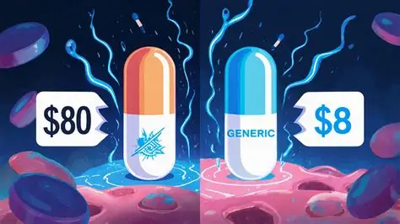
Activity 1 – Brand vs. Generic
Instruction: Compare the two items below. Describe the difference in perception.
Item A: A generic "Cola" from a supermarket own-brand label.
Item B: A "Coca-Cola" can.
Questions:
  Which one do you trust more?
  Which one are you willing to pay more for?
  What makes the difference?

Slide 10
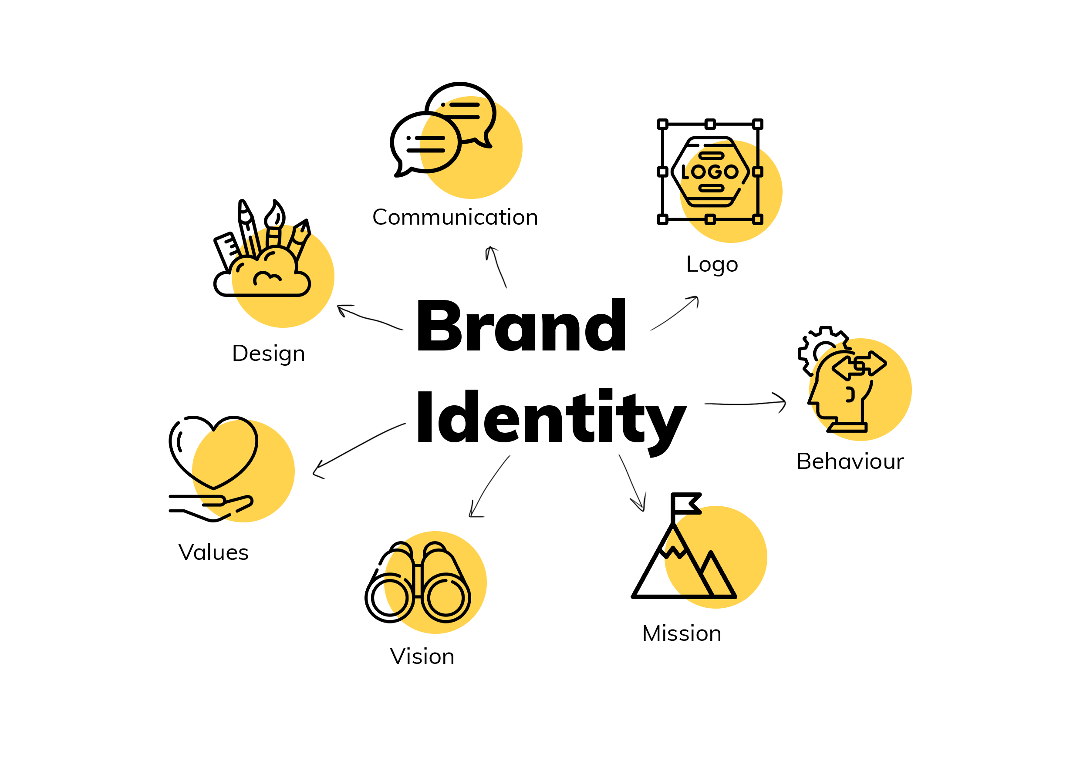
The Branding Process (Step-by-Step)
Market Research: Who is the target audience? (Families? Teens? Professionals?)
Define Positioning: Where do we fit? (Cheapest? Most Luxurious? Most Ethical?)
Create Identity: Name, Logo, Color Palette, Fonts.
Develop Messaging: Slogans, Website Copy, Advertising Tone.
Launch & Monitor: Release the product and gather feedback.
Evolve: Rebrand if necessary (e.g., Gap logo change, Old Spice rebrand).

Slide 11
Branding for Services (The "Invisible" Product)
Challenge: You can't touch a service like banking, insurance, or hospitality.
Solution: Brand the result, not the process.
  Instead of: "We have a call center."
  Brand: "We offer peace of mind, 24/7."
Visuals: Use abstract imagery (shields for security, hands for care, speed lines for efficiency).

Slide 12
Activity 2 – Create a Brand
Download and complete the Worksheet from www.icted.me.uk

Slide 13
Activity 2 – Create a Brand
Scenario: You are launching a new Energy Drink for university students.
Task:
Name: Create a catchy name.
Logo: Sketch a quick logo concept.
Tagline: Write a 3-5 word slogan.
Color: Pick a primary color and explain why.
Pitch: Present your brand to the class in 30 seconds.

Slide 14
Common Branding Mistakes
Over-Complication: If customers don't understand it, they won't buy it.
Inconsistent Visuals: Using different logos on different platforms.
Ignoring the Audience: A "fun" brand for a serious financial firm can confuse clients.
Copying Competitors: If you look like everyone else, you have no identity.

Slide 15
Q&A
"Can you think of a brand that recently changed its image? Did it work?"

