Slide 1
Unit 10 – Database Development: P1 Task
Introduction to key database development concepts
Notes:
---

Slide 2
Understanding Databases
Notes:
---
This slide references information from the following file: https://bradfordcollegeac-my.sharepoint.com/personal/m_bhatti_bradfordcollege_ac_uk/Documents/Microsoft%20Copilot%20Chat%20Files/Unit%2010%20Specification.pdf
What is a Database?, Common Uses of Databases

Slide 3

What is a Database?
Definition of a Database
  A database is an organized electronic collection of data that can be efficiently accessed and managed.
Use in Healthcare
  Hospitals use databases to store patient records, improving access to accurate and current medical information.
Role in Decision-Making
  Databases provide reliable data for informed decisions and support complex data interpretation and visualization.
Enhancing Productivity
  Databases automate repetitive tasks and maintain data accuracy through validation and structured formats.
Notes:
---
This slide references information from the following file: https://bradfordcollegeac-my.sharepoint.com/personal/m_bhatti_bradfordcollege_ac_uk/Documents/Microsoft%20Copilot%20Chat%20Files/Unit%2010%20Specification.pdf
A database is a structured collection of data that is stored electronically and can be accessed, managed, and updated efficiently. Databases are used by organisations to store large volumes of information in a way that allows for easy retrieval and manipulation. For example, a hospital may use a database to store patient records, including medical history, appointments, and prescriptions. This enables healthcare professionals to access accurate and up-to-date information quickly, improving patient care and operational efficiency. Databases are essential for managing data in various sectors such as education, finance, retail, and government. They support decision-making by providing reliable data, help in interpreting complex datasets, and allow for the presentation of information through reports and visualisations. The use of databases also enhances productivity by automating repetitive tasks and ensuring data accuracy through validation rules and structured formats.

Slide 4

Common Uses of Databases
Healthcare Data Management
  Databases in healthcare store patient details and treatment records, improving service delivery efficiency.
Retail Inventory Tracking
  Retail databases manage inventory and sales transactions to help track stock levels and analyse trends.
Employment and Payroll Systems
  Employment databases handle payroll and employee records ensuring accurate and timely salary processing.
Law Enforcement Databases
  Police databases track offenders, crimes, and officer assignments aiding public safety efforts.
Notes:
---
This slide references information from the following file: https://bradfordcollegeac-my.sharepoint.com/personal/m_bhatti_bradfordcollege_ac_uk/Documents/Microsoft%20Copilot%20Chat%20Files/Unit%2010%20Specification.pdf
Databases are widely used across different industries to manage and process information. In healthcare, databases store patient details, appointment schedules, and treatment records, enabling efficient service delivery. In retail, databases manage inventory, customer orders, and sales transactions, helping businesses track stock levels and analyse purchasing trends. Employment databases handle payroll, employee records, and departmental information, ensuring accurate and timely salary processing. Agencies use databases to manage client information, service bookings, and reservations. Libraries maintain databases of books, loans, and member details to streamline borrowing and returns. Police departments use databases to track offenders, crimes, and officer assignments, aiding in law enforcement and public safety. These examples illustrate how databases support organisational functions by improving data accessibility, enhancing decision-making, and ensuring operational efficiency.

Slide 5
Database Tools and Techniques
Notes:
---
This slide references information from the following file: https://bradfordcollegeac-my.sharepoint.com/personal/m_bhatti_bradfordcollege_ac_uk/Documents/Microsoft%20Copilot%20Chat%20Files/Unit%2010%20Specification.pdf
Key Tools and Techniques

Slide 6

Key Tools and Techniques
Table Structures and Fields
  Tables organize data into fields and records, defining data types and formats for accuracy and consistency.
Validation and Data Integrity
  Validation rules enforce data integrity by restricting inputs to acceptable formats and ranges.
Indexing and Relationships
  Indexes using primary and foreign keys speed up data retrieval and link related tables effectively.
Forms, Queries, and Reports
  Forms enable easy data entry, queries filter data, and reports present structured information clearly.
Notes:
---
This slide references information from the following file: https://bradfordcollegeac-my.sharepoint.com/personal/m_bhatti_bradfordcollege_ac_uk/Documents/Microsoft%20Copilot%20Chat%20Files/Unit%2010%20Specification.pdf
Databases incorporate various tools and techniques to manage data effectively. Table structures define how data is organised, with fields representing individual data elements and records representing complete entries. Field characteristics include data types (e.g., text, number, date), sizes, formats, and default values, which ensure consistency and accuracy. Validation rules enforce data integrity by restricting input to acceptable values, such as specific formats or ranges. Indexing, including primary and foreign keys, facilitates fast data retrieval and establishes relationships between tables. Forms provide user-friendly interfaces for data entry and navigation, while queries allow users to search and filter data based on specific criteria. Reports present data in a structured format, often including titles, layouts, and groupings for clarity. These tools and techniques work together to create functional and efficient database systems that meet user requirements and organisational goals.

Slide 7
Case Studies of Database Use
Notes:
---
This slide references information from the following file: https://bradfordcollegeac-my.sharepoint.com/personal/m_bhatti_bradfordcollege_ac_uk/Documents/Microsoft%20Copilot%20Chat%20Files/Unit%2010%20Specification.pdf
Example Database 1: Doctor’s Surgery, Example Database 2: Online Retail System

Slide 8
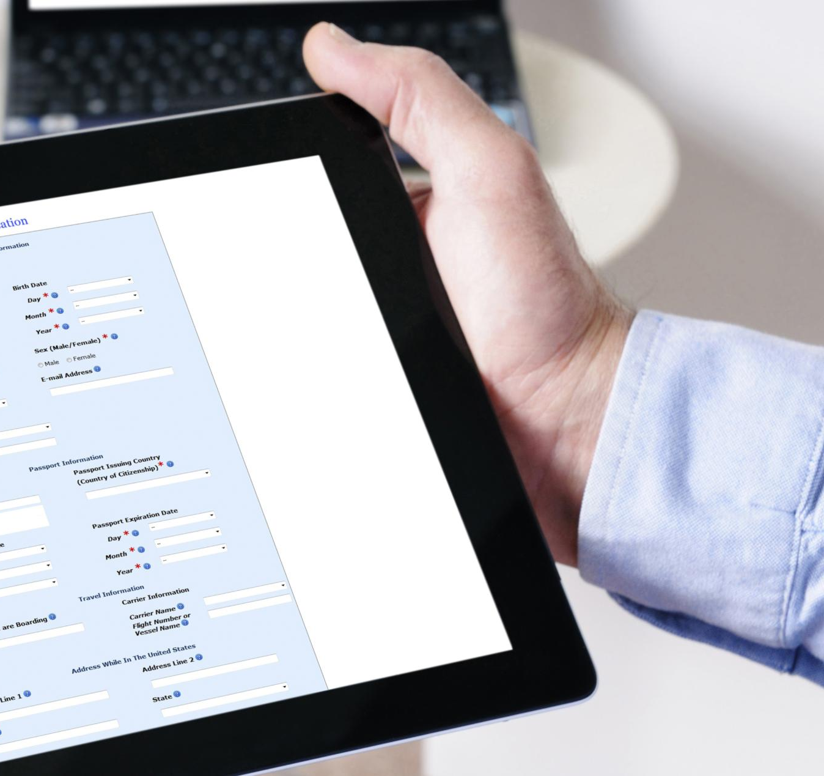
Example Database 1: Doctor’s Surgery
Core Database Components
  Includes tables for patient details, appointment schedules, and treatment records for comprehensive data management.
Data Entry and Queries
  Forms facilitate data entry, and queries retrieve specific information like upcoming appointments and patient conditions.
Reports and Validation
  Reports analyze trends such as missed appointments; validation rules ensure accuracy with mandatory fields and correct formats.
Table Relationships
  Linking patients to their appointments improves data organization and usability within the database system.
Notes:
---
This slide references information from the following file: https://bradfordcollegeac-my.sharepoint.com/personal/m_bhatti_bradfordcollege_ac_uk/Documents/Microsoft%20Copilot%20Chat%20Files/Unit%2010%20Specification.pdf
A doctor’s surgery database is designed to manage patient information, appointments, and medical history. The database typically includes tables for patient details, appointment schedules, and treatment records. Tools such as forms are used for data entry, allowing staff to add new patients and schedule appointments efficiently. Queries enable the retrieval of specific information, such as upcoming appointments or patients with particular conditions. Reports can be generated to analyse trends, such as the number of missed appointments in a given period. Validation rules ensure that data entered is accurate, such as correct date formats and mandatory fields. Relationships between tables, such as linking patients to their appointments, enhance data organisation and usability. This database improves productivity by automating administrative tasks, enhances accuracy through validation, and supports decision-making with reliable data outputs.

Slide 9

Example Database 2: Online Retail System
Core Database Components
  The database stores product, customer, and order data with detailed fields for effective management.
User Interaction Tools
  Forms enable easy data entry, and queries help staff find items and track orders efficiently.
Reporting and Validation
  Reports deliver insights on sales and inventory, while validation rules ensure data accuracy.
Data Relationships and Benefits
  Linking tables supports comprehensive analysis, boosting productivity and strategic decision-making.
Notes:
---
This slide references information from the following file: https://bradfordcollegeac-my.sharepoint.com/personal/m_bhatti_bradfordcollege_ac_uk/Documents/Microsoft%20Copilot%20Chat%20Files/Unit%2010%20Specification.pdf
An online retail system database manages product inventory, customer orders, and sales transactions. It includes tables for products, customers, and orders, with fields capturing details such as product names, prices, customer addresses, and order dates. Forms facilitate data entry for new products and customer orders, while queries allow staff to search for specific items or track order statuses. Reports provide insights into sales performance, inventory levels, and customer purchasing behaviour. Validation rules ensure data accuracy, such as correct pricing formats and mandatory customer information. Relationships between tables, such as linking orders to customers and products, enable comprehensive data analysis. This database enhances productivity by streamlining order processing, improves accuracy through structured data entry, and supports strategic decisions with detailed reports and analytics.

Slide 10
Analysis and Evaluation
Notes:
---
This slide references information from the following file: https://bradfordcollegeac-my.sharepoint.com/personal/m_bhatti_bradfordcollege_ac_uk/Documents/Microsoft%20Copilot%20Chat%20Files/Unit%2010%20Specification.pdf
Comparison of Two Databases, Evaluation and Recommendations

Slide 11

Comparison of Two Databases
Shared Database Features
  Both databases use tables, forms, queries, and reports to effectively manage and present data.
Distinct Focus Areas
  The surgery database manages patient care and appointments, while the retail system focuses on inventory and sales.
Data Privacy vs Efficiency
  Surgery database requires strict data privacy; retail system prioritises transaction efficiency and customer service.
Automation and Effectiveness
  Retail systems offer automation like real-time stock updates, enhancing effectiveness compared to surgery databases.
Notes:
---
This slide references information from the following file: https://bradfordcollegeac-my.sharepoint.com/personal/m_bhatti_bradfordcollege_ac_uk/Documents/Microsoft%20Copilot%20Chat%20Files/Unit%2010%20Specification.pdf
Comparing the doctor’s surgery database and the online retail system reveals both similarities and differences in their design and functionality. Both databases use tables, forms, queries, and reports to manage and present data effectively. They incorporate validation rules to ensure data accuracy and use relationships to link related information. However, the doctor’s surgery database focuses on patient care and appointment management, while the retail system emphasises inventory control and sales tracking. The surgery database may require more stringent data privacy measures due to sensitive medical information, whereas the retail system prioritises transaction efficiency and customer service. In terms of effectiveness, both databases serve their respective purposes well, but the retail system may offer more automation features, such as real-time stock updates and order confirmations. Understanding these differences helps in designing databases that meet specific organisational needs.

Slide 12

Evaluation and Recommendations
Doctor’s Surgery Database Strengths
  Excels in organising patient data and scheduling, ensuring efficient healthcare and data accuracy through validation.
Doctor’s Surgery Database Improvements
  Needs enhanced automation like appointment reminders and electronic health record integration for better workflow.
Online Retail System Strengths
  Effective inventory management and order processing with automation improving productivity and customer satisfaction.
Online Retail System Improvements
  Requires better security measures to protect customer data and enhance overall system safety.
Notes:
---
This slide references information from the following file: https://bradfordcollegeac-my.sharepoint.com/personal/m_bhatti_bradfordcollege_ac_uk/Documents/Microsoft%20Copilot%20Chat%20Files/Unit%2010%20Specification.pdf
Evaluating the two databases highlights their strengths and areas for improvement. The doctor’s surgery database excels in organising patient information and scheduling appointments, contributing to efficient healthcare delivery. Its use of validation and structured forms ensures data accuracy and usability. However, it could benefit from enhanced automation, such as reminders for appointments or integration with electronic health records. The online retail system is strong in managing inventory and processing orders, with effective use of queries and reports for business analysis. Its automation features improve productivity and customer satisfaction. Nonetheless, it may require better security measures to protect customer data. Recommendations for both databases include implementing macros for automated tasks, enhancing user interfaces for better navigation, and incorporating feedback mechanisms to refine functionality. These improvements would further align the databases with user requirements and organisational goals.

