Slide 1
Adult learner group 2
Lesson 4
Matthew Bentley
m.bentley@bradfordcollege.ac.uk

Slide 2
Objectives
Understand the importance of planning and being organised.
Identify any barriers to being organised.
Create a 7 day planner to organise our studies.

Slide 3


Slide 4
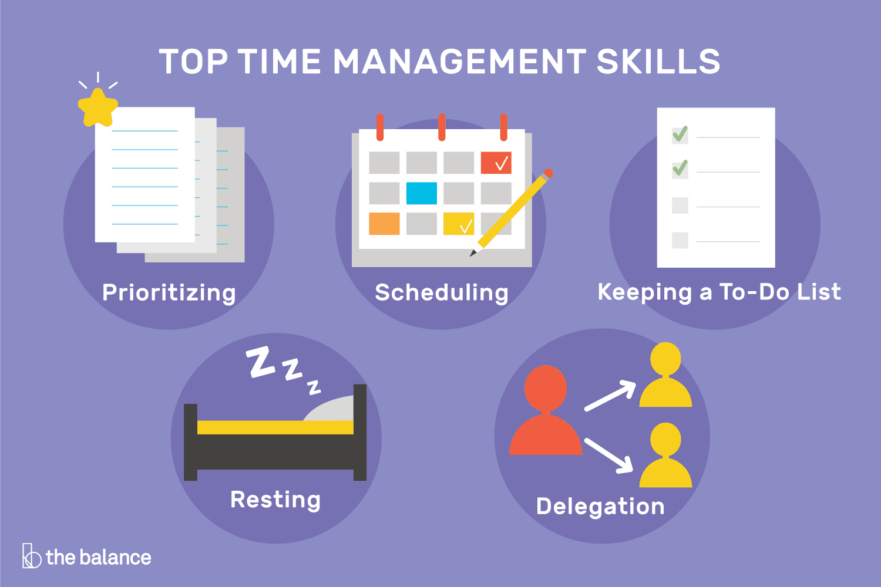

Slide 5
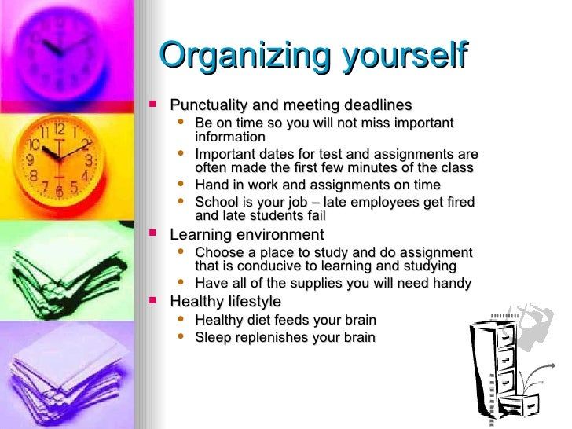

Slide 6
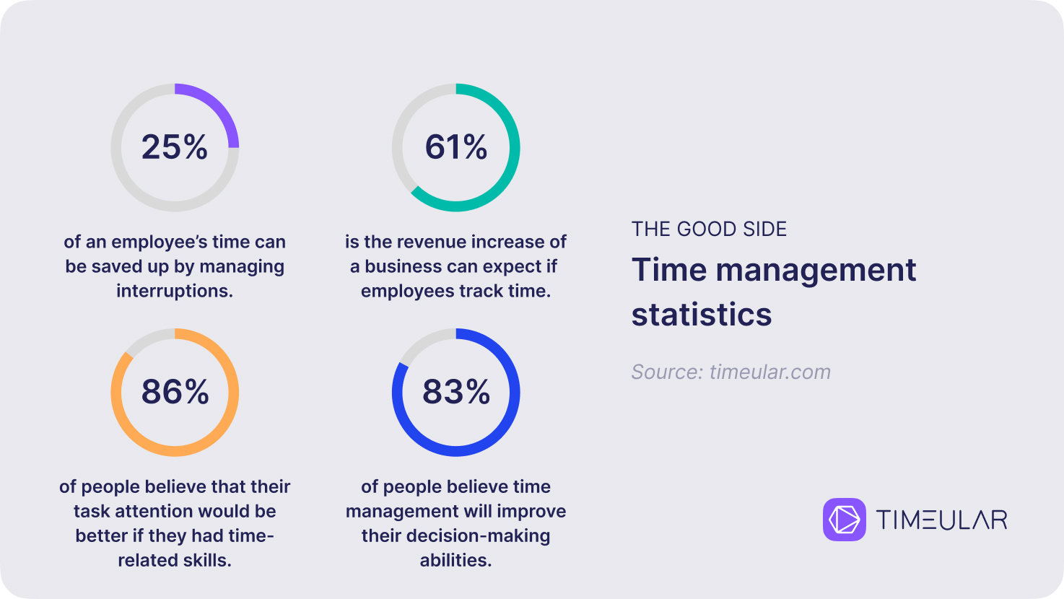

Slide 7
Class Task 1
Look at the provided user guide for week 4 and complete the following task:
Follow the user guide to create your own 7 day planner.
Can you then use a template to create a professional layout and format.
Your tutor will then discuss your work with you.
You can start with pen and paper first if you prefer.
Notes:
Establishing quality metrics ensures that project deliverables meet the required standards. It helps in maintaining consistency and meeting stakeholder expectations.

Slide 8

Thank You

