Slide 1

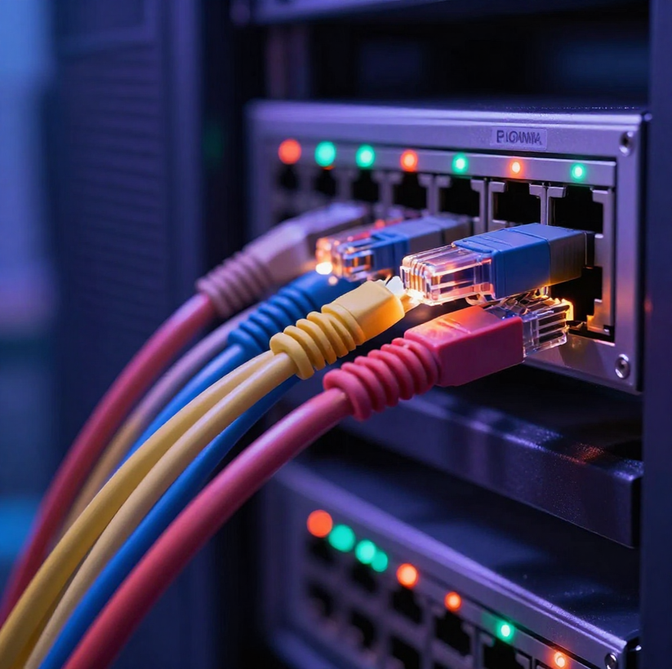



Unit 2: Technology Systems
Lesson 4: Data Transfer
Wired & Wireless Communication: Wi-Fi, Bluetooth, UTP, Optical Fibre, Coaxial

Slide 2
Retrieval Starter
Activate Prior Knowledge — No notes! 5 minutes
Network Types
Networking Concepts
Self-Mark Instructions
  What does LAN stand for?
  What does WAN stand for?
  What type of network connects a smartphone and smartwatch?
  Give ONE benefit of computer networking.
  What is synchronisation?
  Give ONE reason a travelling worker might use mobile broadband.
When the timer ends, swap books with a partner or check your own answers.
Be honest — mark carefully!
Answers revealed on the next slide.

Slide 3
Retrieval Starter — Answers
LAN, WAN & PAN
LAN = Local Area Network.
WAN = Wide Area Network.
PAN = Personal Area Network (e.g. smartphone & smartwatch).
Mobile Broadband & Self-Check
Mobile broadband provides internet connectivity when travelling away from fixed networks.
Check your answers — correct any mistakes now.
Networking Benefits & Synchronisation
Benefits: resource sharing, communication, data sharing.
Synchronisation = keeping data consistent and up to date across devices.

Slide 4

Today's Learning Objectives
By the end of this lesson, you will be able to:
Knowledge & Understanding
Explain what data transfer means
Distinguish wired vs wireless methods
Explain Wi-Fi and Bluetooth technologies
Identify UTP, Optical Fibre & Coaxial cable
Skills & Application
Compare benefits and drawbacks of each method
Recommend appropriate transfer methods for scenarios
Answer exam-style questions on data transfer

Slide 5
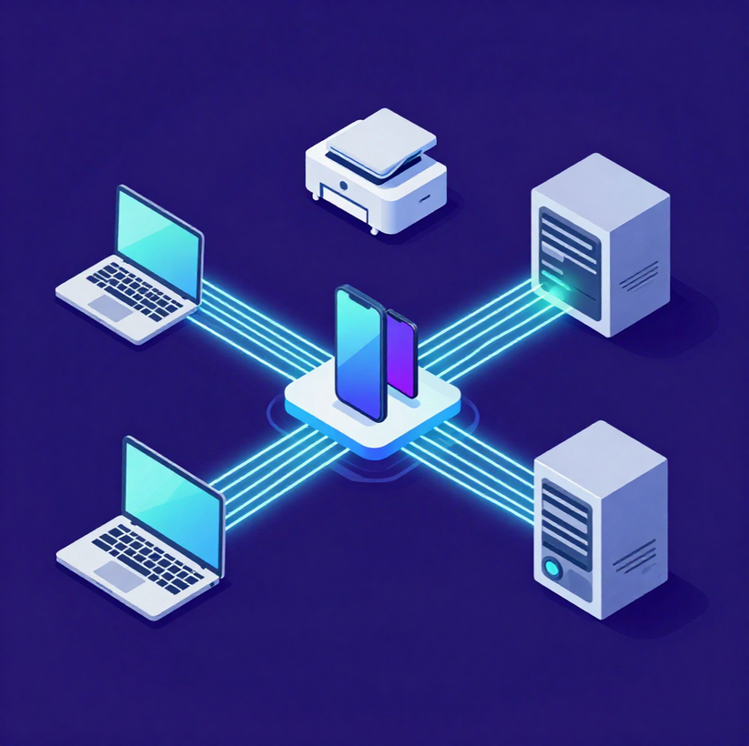
What is Data Transfer?
Data transfer means moving data from one device or location to another.
Examples: Laptop → Printer | Phone → Earbuds | Computer → Server | Router → Computer
Two main methods: Wired and Wireless

Slide 6
Think About Your Day
Quick Activity — 2 Minutes
Task
Identify
Share
Write down THREE examples of devices that exchange data in your daily life. Think about this morning — what devices communicated with each other?
For each example you wrote down, decide whether the data transfer was WIRED or WIRELESS. Be ready to explain your reasoning.
Your teacher will take a few answers aloud. Listen carefully — can you spot any transfers you had not thought of yourself?

Slide 7
Wired vs Wireless
Two Main Methods of Data Transfer
Wired Connections
Wireless Connections
Which to Choose?
Neither method is always better. The right choice depends on the user and purpose.
Fixed desktops → wired.
Mobile laptops → Wi-Fi.
Earbuds → Bluetooth. High-capacity building links → Optical Fibre.
Uses physical cables to transmit data. Methods include UTP (twisted copper pairs), Optical Fibre (light signals), and Coaxial cable (shielded copper). Reliable, fast, and secure — ideal for fixed devices.
Transmits data using radio waves or light — no cables required. Methods include Wi-Fi (wireless network access) and Bluetooth (short-range device links). Offers flexibility and mobility.

Slide 8
Wired or Wireless?
Quick Fire Activity
Classify Each Example
Instructions
Write W (Wired) or WL (Wireless) for each:
  Bluetooth headphones
  Ethernet cable to desktop PC
  Smartphone on Wi-Fi
Use mini-whiteboards or write answers.
Be ready to explain your choices. Time: 2 minutes.
Continue Classifying
  Fibre connection between buildings
  Bluetooth keyboard
  UTP cable

Slide 9
Wired or Wireless?
Answers & Key Point
Classification Answers
Key Point to Remember
  Bluetooth headphones — Wireless
  Ethernet cable to desktop PC — Wired
  Smartphone on Wi-Fi — Wireless
No method is inherently better. The right choice always depends on the user's needs and the purpose of the connection.
More Answers
  Fibre between buildings — Wired
  Bluetooth keyboard — Wireless
  UTP cable — Wired

Slide 10
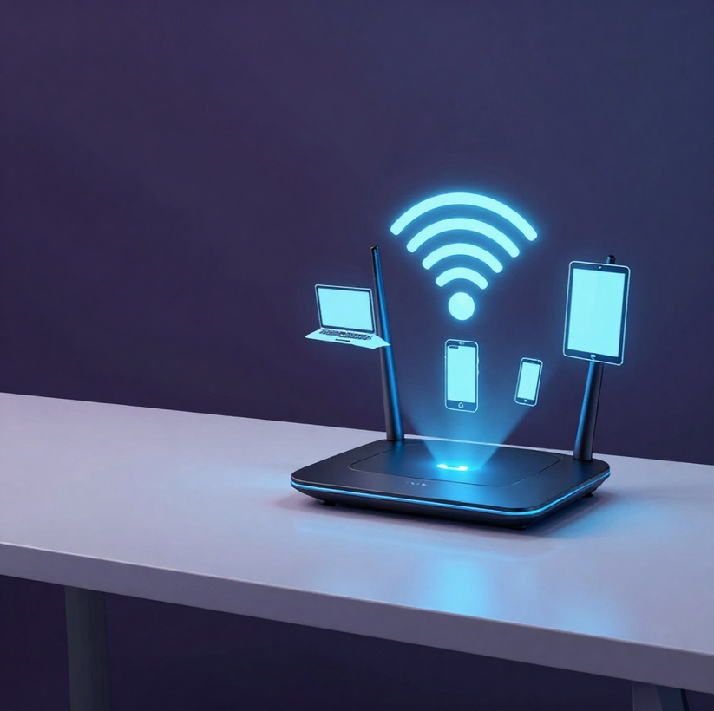
What is Wi-Fi?
Wi-Fi is wireless communication that allows devices to connect to a network without physical cables. Examples include laptops, smartphones, and tablets connecting wirelessly to a router or access point.
Key benefits: mobility within coverage area, convenience with no cables needed, supports multiple devices simultaneously, and reduces cabling requirements throughout a building.

Slide 11
Benefits of Wi-Fi
Mobility Within Coverage Area
Supports Multiple Devices Simultaneously
Users can move freely within the wireless coverage area without being restricted by physical cables.
A single Wi-Fi access point can connect many devices at once, supporting whole classrooms or offices.
No Cables Required
Eliminates the need for physical cabling, making it ideal for portable devices like laptops and tablets.

Slide 12
Drawbacks of Wi-Fi
Interference Reduces Signal Quality
Security Concerns Require Attention
Other wireless devices and physical obstacles such as walls can disrupt the signal, causing variable performance.
Wireless signals can be intercepted. Proper security measures such as encryption and strong passwords are essential.
Limited Range Affects Coverage
Signal strength weakens over distance. Moving away from the access point reduces speed and reliability.

Slide 13
Activity 2
Would You Use Wi-Fi?
For each scenario, decide if Wi-Fi is appropriate and explain why.
Time: 4 minutes
Scenarios A & B
Scenario C
Scenario D
A laptop that moves between rooms — does Wi-Fi suit this situation? Why?
A tablet that needs network access without using a cable — is Wi-Fi appropriate here?
A fixed workstation requiring a high-performance, reliable connection where cabling is practical — would you recommend Wi-Fi? Justify your answer.
A café providing guest network access for customers' phones and laptops — is Wi-Fi the right choice? Give a reason.
Remember: justify every decision!

Slide 14

What is
Bluetooth?
Bluetooth is a short-range wireless communication technology used to connect nearby devices without cables.
Examples include: phone → earbuds, laptop → wireless mouse, phone → car audio system, tablet → keyboard. Bluetooth is used to create Personal Area Networks (PANs) — small networks of personal devices.

Slide 15
Bluetooth: Benefits & Drawbacks
Benefits of Bluetooth
Key Exam Point
  Wireless and convenient for peripherals. Low power consumption. Widely supported across modern devices. Ideal for short-range personal device connections.
Bluetooth is best for Personal Area Networks (PAN) — short-range device pairing, not building-wide network access.
Drawbacks of Bluetooth
  Limited range (typically ~10m). Not suitable for large LANs. Variable performance with interference possible. Lower throughput than Wi-Fi.

Slide 16
Wi-Fi vs
Bluetooth
Comparing Wireless Technologies: Purpose, Range & Throughput
Wi-Fi
Bluetooth
Which to use?
Wi-Fi provides wireless network access over a broader coverage area. It supports higher throughput, making it suitable for laptops, tablets, and smartphones connecting to a local network or the internet. Ideal for multiple devices sharing a network connection.
Bluetooth enables short-range communication between personal devices. Lower throughput than Wi-Fi, but ideal for peripherals such as earbuds, mice, keyboards, and smartwatches. Used to form a Personal Area Network (PAN).
Wireless earbuds connecting to a smartphone → Bluetooth.
Laptop connecting to the college network → Wi-Fi.
Key rule: choose based on purpose and range.
Bluetooth = personal peripherals; Wi-Fi = network access.

Slide 17
Activity 3
Wi-Fi or Bluetooth?
Choose the most appropriate technology for each scenario. Write Wi-Fi or Bluetooth for each.
Scenarios 1–2
Scenarios 3–4
Scenarios 5–6
  Wireless earbuds connecting to a smartphone
  Laptop connecting to the college wireless network
  Wireless mouse connecting to a laptop
  Smartphone connecting to a home wireless network
  Smartwatch communicating with a smartphone
  Tablet accessing the network wirelessly

Slide 18
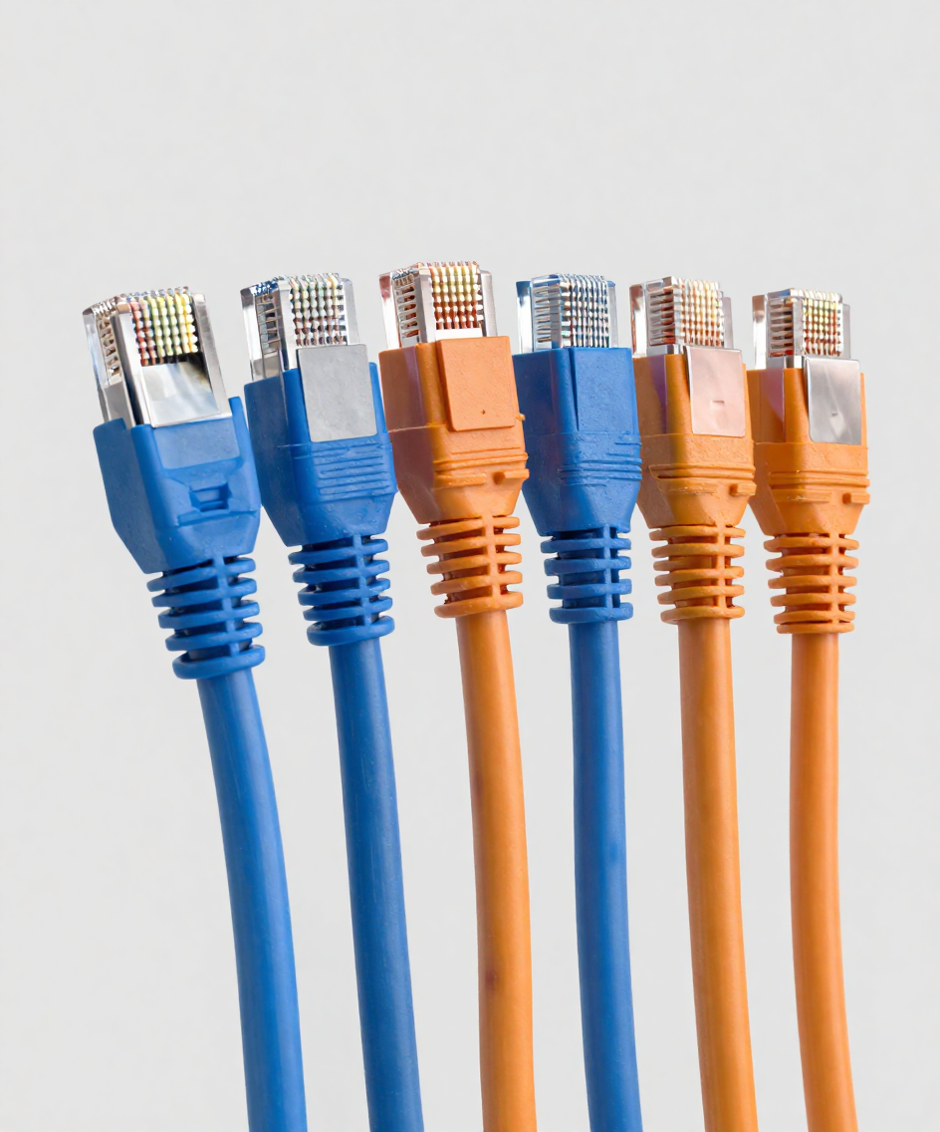
Moving to
Cabled
Connections
Transition: Wireless → Wired
We have covered Wi-Fi and Bluetooth. Now we explore cabled methods: UTP, Optical Fibre, and Coaxial — all named in the Unit 2 specification.

Slide 19
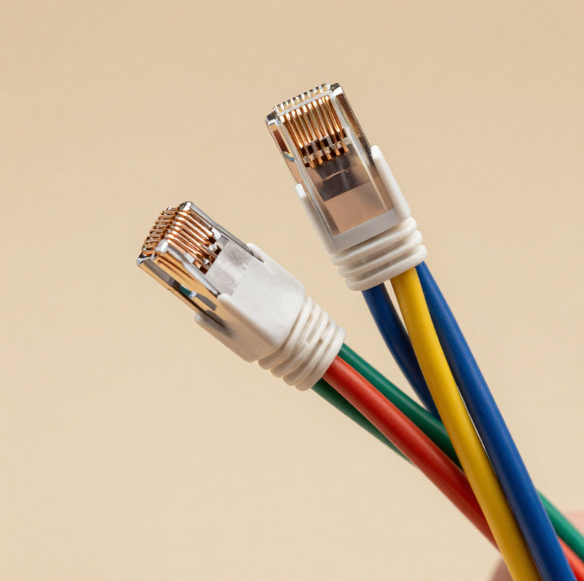
What is
UTP?
Unshielded Twisted Pair (UTP) cable contains pairs of copper wires twisted together. Twisting reduces electromagnetic interference between pairs. Commonly used for Ethernet LAN connections — e.g. desktop PC to switch, or network device to network device. Standard choice for LAN infrastructure in offices and classrooms.

Slide 20
UTP Cable: Benefits & Drawbacks
Benefits of UTP
Drawbacks of UTP
Common and widely available. Inexpensive compared to other cable types. Easy to install — no specialist tools needed. Suitable for offices and classrooms. Standard choice for Ethernet LAN connections.
Distance limits — signal degrades over long runs. Susceptible to electromagnetic interference (EMI). Not ideal for long-distance backbone connections. Less suitable where high bandwidth over distance is needed.
Exam Tip — User & Purpose
UTP is suitable for fixed desktop PCs in a computer room because it is inexpensive, easy to install, and provides reliable wired Ethernet connections within a building. Always link your answer to the scenario.

Slide 21
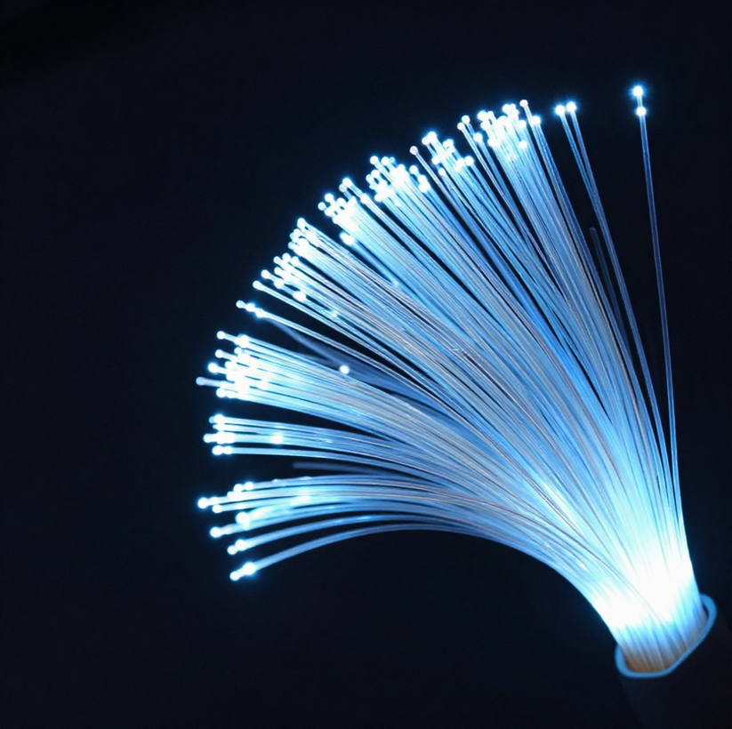
What is
Optical
Fibre?
Optical fibre cables carry data as pulses of light through thin glass or plastic fibres — not as electrical signals like copper cables. This allows for very high bandwidth, enabling large amounts of data to be transferred at high speed. Optical fibre is effective over long distances and is immune to electromagnetic interference (EMI), making it ideal for high-capacity links between buildings or across wide areas.

Slide 22
Optical Fibre: Benefits
High Bandwidth for Large Data Volumes
Immune to Electromagnetic Interference
Supports very high data transfer rates, making it ideal for transmitting large amounts of data quickly and efficiently.
Uses light signals, not electrical signals — unaffected by EMI. Example: high-capacity link between college buildings.
Effective Over Long Distances
Maintains strong signal quality over much greater distances than copper cables without significant degradation.

Slide 23
Optical Fibre: Drawbacks
Higher Cost of Equipment & Installation
Fragile & Not Always Necessary
Optical fibre cables, connectors, and network equipment are significantly more expensive than copper alternatives.
Fibre is more fragile than copper and is unnecessary for most individual desktop connections — suitability depends on user and purpose.
Requires Specialist Skills & Tools
Installation and maintenance require trained technicians and specialist equipment, increasing overall cost and complexity.

Slide 24
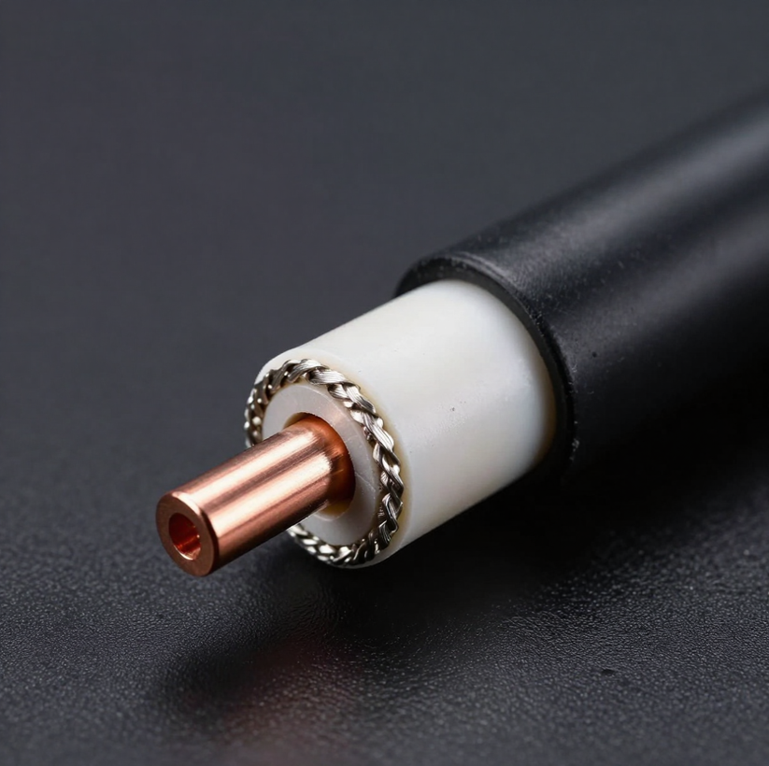
What is
Coaxial
Cable?
A coaxial cable carries data through a central copper conductor surrounded by insulation, a metallic shield, and an outer jacket. The shielding reduces electromagnetic interference. Historically used for networking, cable broadband, and TV signal distribution. You need to recognise its basic structure and understand its key uses.

Slide 25
Coaxial Cable: Benefits & Drawbacks
Benefits of Coaxial Cable
Key Exam Advice
Shielding reduces electromagnetic interference. Durable and robust construction. Effective signal and data carrier. Still used in cable broadband and TV distribution systems.
Focus on recognition and basic understanding. Always justify your choice: user and purpose determine the best medium. Do not spend excessive time on coaxial detail.
Drawbacks of Coaxial Cable
Bulkier and less flexible than UTP. Uses different connectors, less compatible with modern Ethernet. Less common for LAN endpoints in new installations.

Slide 26
The Big
Comparison Table
All Five Data Transfer Technologies — Essential Exam Knowledge
Wireless Methods
Wired — Copper
Wired — Fibre & Exam Tip
Wi-Fi — Wireless | Wireless network access for laptops, smartphones, tablets; broad coverage area.
Bluetooth — Wireless | Short-range personal device connection; earbuds, mice, keyboards, PANs.
UTP — Wired | Ethernet LAN connections; desktop PCs to network equipment in offices and classrooms.
Coaxial — Wired | Cable broadband and TV distribution; shielded central conductor reduces interference.
Optical Fibre — Wired | High-capacity links between buildings; long distance, high bandwidth, EMI immune.
★ Exam tip: Always state the method, wired/wireless, AND a specific typical use. Learn all five technologies for full marks.

Slide 27
Activity 4 —
Guess the
Technology
Read each clue and identify the correct data transfer technology. Write your answers before the reveal!
Clues 1 & 2
Clues 3 & 4
Clue 5
Clue 1: Transfers data using light rather than electrical signals.
Answer: ___________
Clue 2: Used for wireless earbuds connecting to a smartphone.
Answer: ___________
Clue 3: Contains twisted copper pairs and is commonly used for Ethernet LAN connections.
Answer: ___________
Clue 4: Allows laptops to connect wirelessly to a network.
Answer: ___________
Clue 5: Has a central conductor surrounded by insulation and shielding to reduce interference.
Answer: ___________
⏱ Think before you look — no notes needed!

Slide 28
Benefits & Drawbacks Challenge
Your Task
Technology — Drawback
Complete the table below. For each technology, write ONE benefit and ONE drawback. Avoid vague words like "good" or "fast" — explain WHY it is beneficial or what the limitation actually means.
Wi-Fi: signal weakens with distance and obstacles
Bluetooth: limited range, not suitable for large networks
UTP: susceptible to electromagnetic interference over long distances
Optical Fibre: expensive to install, requires specialist skills
Coaxial: bulkier and less flexible than modern alternatives
Technology — Benefit
Wi-Fi: mobility within coverage area, no cables needed
Bluetooth: low power consumption, convenient for personal peripherals
UTP: inexpensive and easy to install in offices
Optical Fibre: very high bandwidth, immune to electromagnetic interference
Coaxial: shielding reduces signal interference

Slide 29

You're the
Network
Engineer
Scenario Challenge
Bradford Digital Ltd needs to connect devices across their office. Recommend the best transfer technology from: Wi-Fi, Bluetooth, UTP, Optical Fibre, or Coaxial — and justify each choice.

Slide 30
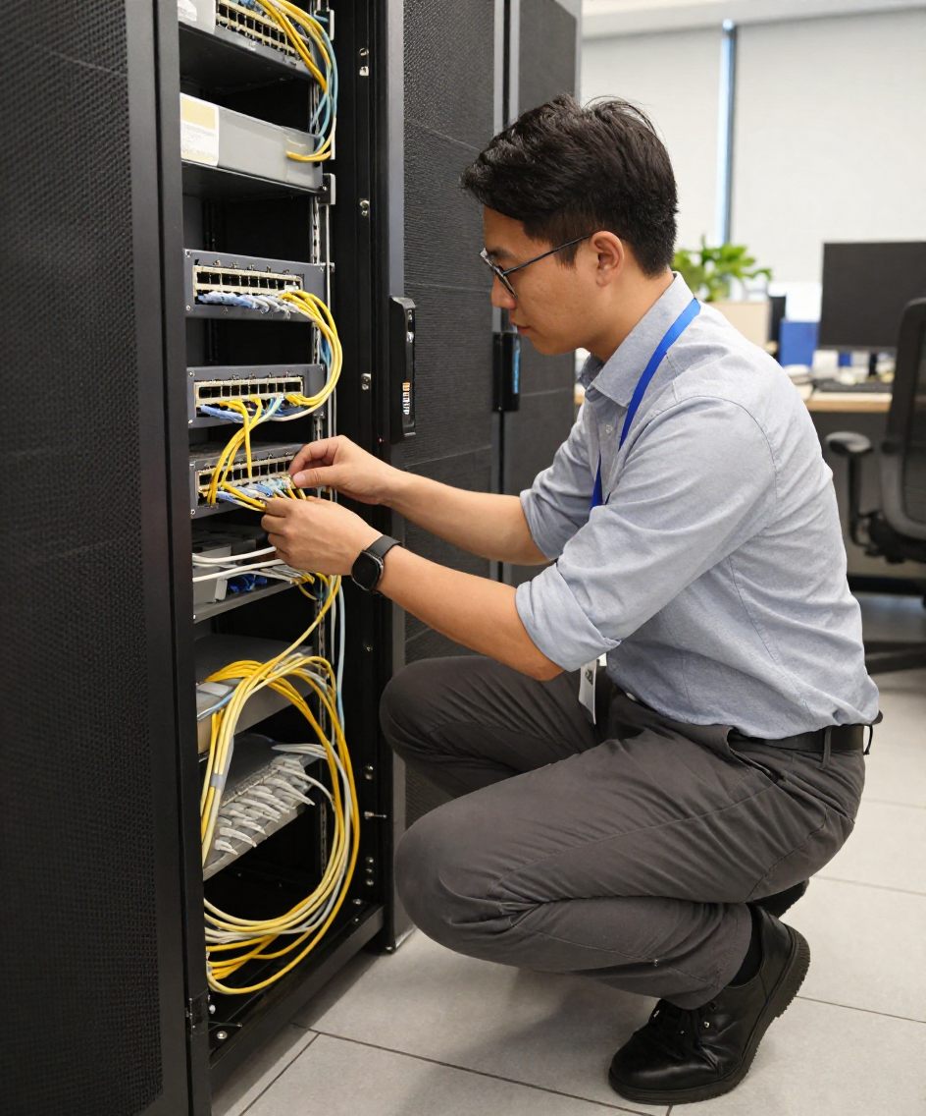
Network Engineer Scenarios
Bradford Digital Ltd — recommend a transfer technology and justify each choice.
Scenarios 1–3
Scenarios 4–5
  Fixed desktop PCs needing Ethernet connections in the office
  Mobile laptops requiring wireless connectivity across the building
  Smartphone connecting to wireless earbuds
  High-capacity link between buildings — interference is a concern
  Cable broadband system using shielded copper cable

Slide 31
Network Engineer — Model Answers
Scenario 1: Office Desktop PCs
Scenario 4 & 5: Buildings & Broadband
UTP — Unshielded Twisted Pair is commonly used for fixed Ethernet LAN connections; reliable and cost-effective for desktop PCs.
Optical Fibre — high bandwidth, EMI resistance, long-distance building link. Coaxial — shielded copper cable suited to cable broadband systems.
Scenario 2 & 3: Laptops & Earbuds
Wi-Fi — wireless mobility for laptops within the office. Bluetooth — short-range personal device connection for smartphone to wireless earbuds.

Slide 32
Activity 5 —
Spot the Mistake
Identify and correct the misconception in each student answer
Mistake 1
Mistake 2
Mistake 3
Student answer: "I would use Bluetooth to connect the two school buildings together."
What is wrong? Bluetooth has a very limited range and cannot connect buildings.
Rewrite it: Use Optical Fibre or UTP for building-to-building links, not Bluetooth.
Student answer: "Optical Fibre is always better than UTP."
What is wrong? "Always" is too absolute — UTP is cheaper, easier to install, and perfectly suitable for short-distance LAN connections.
Rewrite it: Optical Fibre is better for long distances and high bandwidth; UTP is more cost-effective for typical office/classroom LANs.
Student answer: "Wi-Fi and WAN are the same thing."
What is wrong? Wi-Fi is a wireless data transfer technology; WAN (Wide Area Network) is a network type covering large geographic areas.
Rewrite it: Wi-Fi is how data is transferred wirelessly; a WAN describes the scope of a network — they are different concepts.

Slide 33

Exam Technique — Recommend & Justify
Use this formula: Technology + relevant feature + scenario-specific benefit
Weak Answer
Strong Answer
"UTP because it is good."
Why this is poor:
• Too vague — no feature stated
• No link to the scenario
• Would not gain full marks
"UTP is suitable because it is commonly used for Ethernet LAN connections and provides reliable wired connections for fixed desktop PCs."
✓ Technology named
✓ Relevant feature stated
✓ Linked to scenario

Slide 34

Independent Exam Questions
Complete individually — approx. 8 minutes | Total: 11 marks
Questions 1–4
Questions 5–7
Q1: Name one wireless data-transfer technology. [1]
Q2: State what UTP stands for. [1]
Q3: Which technology is suitable for wireless earbuds? [1]
Q4: State one benefit of Wi-Fi for college laptops. [2]
Q5: State one benefit of optical fibre over copper for long-distance links. [2]
Q6: State one drawback of Bluetooth over large distances. [2]
Q7: Recommend a fixed wired medium for office PCs and justify your answer. [2]

Slide 35
Exam Practice Answers
Q1–Q3: Short Answer Questions
Q6–Q7: Justify & Recommend
Q1: Wi-Fi or Bluetooth
Q2: Unshielded Twisted Pair
Q3: Bluetooth
Q6: Bluetooth has limited range and is not suitable for connections over large distances.
Q7: UTP — commonly used for Ethernet LAN connections, providing reliable wired links for fixed desktop PCs within cable distance limits.
Q4–Q5: Developed Answers
Q4: Wi-Fi allows laptops to move around without cables within the coverage area.
Q5: Optical fibre offers high bandwidth, works over long distances, and is immune to electromagnetic interference.

Slide 36
Five Technologies,
Five Answers
Final Retrieval — Can you name each technology without notes?
Clue 1 & Clue 2
Clue 3 & Clue 4
Clue 5 & Key Tip
💡 Uses light to carry data at very high speed over long distances?
→ Optical Fibre
📶 Short-range wireless connection between personal devices?
→ Bluetooth
🔀 Contains twisted copper wire pairs used for Ethernet LAN connections?
→ UTP
📡 Provides wireless network access for laptops and smartphones?
→ Wi-Fi
🛡️ Shielded cable with a central copper conductor, used in broadband and TV distribution?
→ Coaxial
⭐ Challenge: Complete all five without looking at your notes!

Slide 37
Connect
Lesson 3 & 4
Network Scope meets Transfer Technology — Linking the Two Concepts
LAN
WAN
PAN
Local Area Network — covers a single building or site. Data can move using Wi-Fi (wireless) or UTP cable (wired). Both are common in schools and offices.
Wide Area Network — spans large geographic distances. Long-distance links often use Optical Fibre for high bandwidth and EMI resistance. Coaxial may also be used in broadband infrastructure.
Personal Area Network — connects personal devices over very short range. Bluetooth is the key transfer technology for PANs, e.g. phone to earbuds or smartwatch.

Slide 38
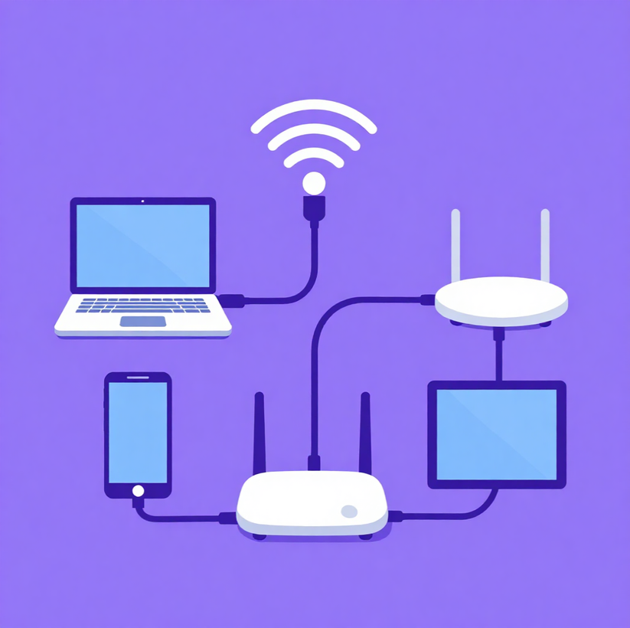
What Have We Learned?
Knowledge & Skills
Define data transfer and distinguish between wired and wireless methods. Explain Wi-Fi and Bluetooth technologies with benefits and drawbacks.
Compare & Recommend
Identify UTP, Optical Fibre, and Coaxial cables. Compare all five technologies and justify the most appropriate method for a given scenario.
Next Lesson
Computer Internals: Motherboard, CPU, ALU, and more. Consolidate today's transfer methods before we move on.

Slide 39
Homework
Which Connection?
Task — Choose the best technology: Wi-Fi / Bluetooth / UTP / Optical Fibre
  Wireless earbuds to smartphone
  Laptop connecting wirelessly at home
  Fixed desktop PC to Ethernet equipment
  High-capacity building link with interference concerns
Then pick ONE and write a sentence explaining why it is appropriate.
Use: Technology + relevant feature + scenario-specific benefit
Time
5–10 minutes

