Slide 1

Introduction To Skills Gap Analysis

Slide 2
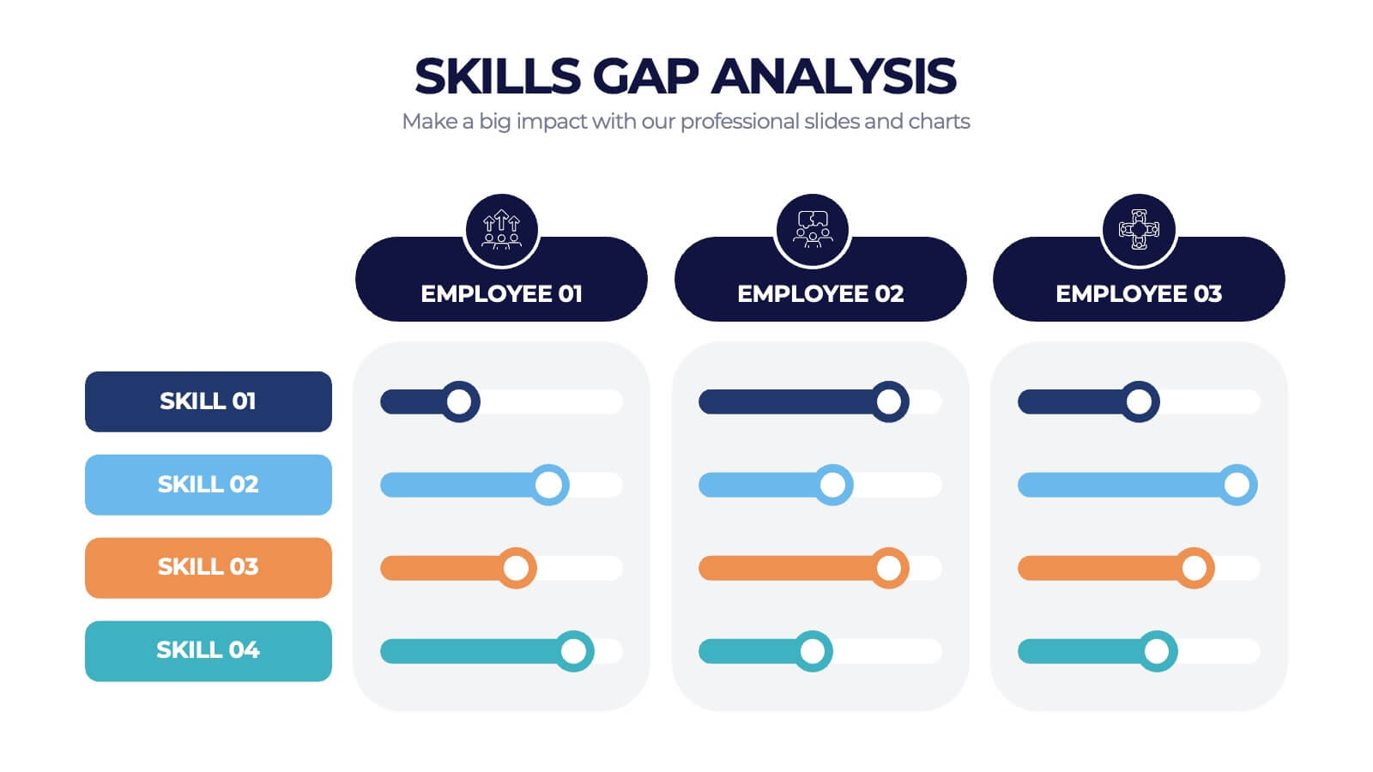
Introduction to Skills Gap Analysis
Skills Gap Analysis is a strategic tool used to identify the difference between the skills an individual currently possesses and the skills they need to achieve their goals. Understanding this gap allows for targeted development plans to bridge the disparity, enhancing both personal and professional growth.

Slide 3

What is Skills Gap Analysis?
Skills Gap Analysis involves assessing existing skills against required skills for a specific role or career objective. It identifies areas where skills are lacking and provides a roadmap for acquiring necessary competencies. This process is essential for effective workforce planning and personal development.

Slide 4

Importance of Skills Gap Analysis
Conducting a Skills Gap Analysis is crucial for staying competitive in today's job market. It helps individuals and organisations pinpoint skill deficiencies, enabling them to invest in relevant training and development efforts. This proactive approach ensures continuous improvement and career progression.

Slide 5
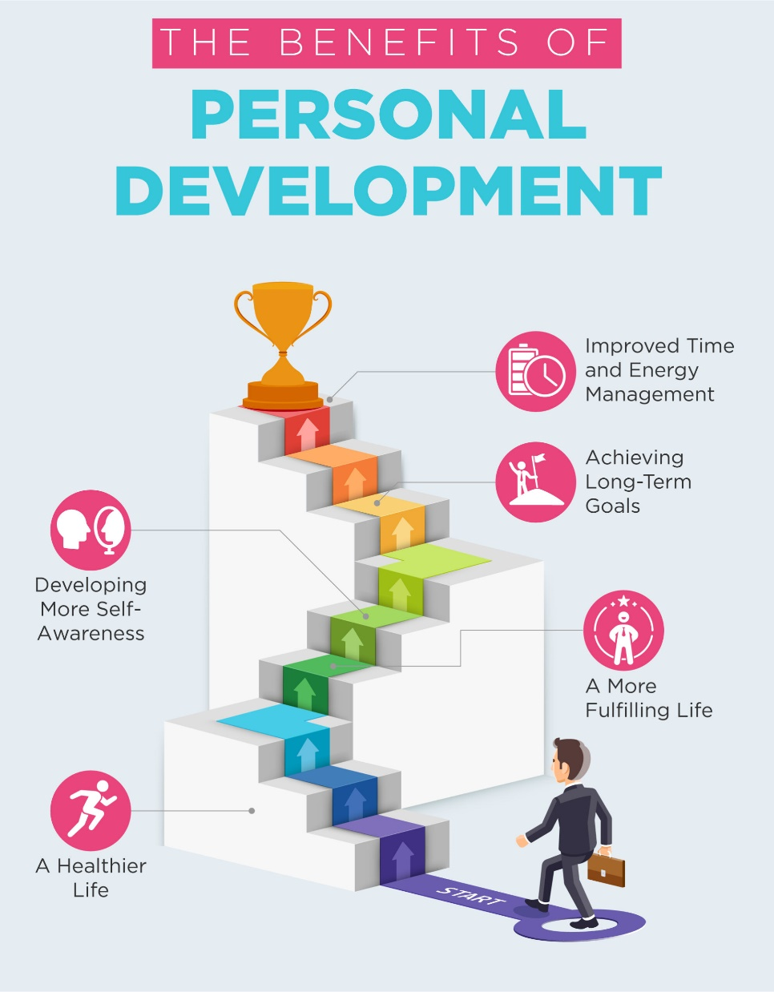
Benefits for Personal Development
Skills Gap Analysis can significantly aid personal development by highlighting areas for improvement and guiding learning efforts. By understanding their skill gaps, individuals can focus on acquiring targeted knowledge and competencies, thereby enhancing their employability and career prospects.

Slide 6
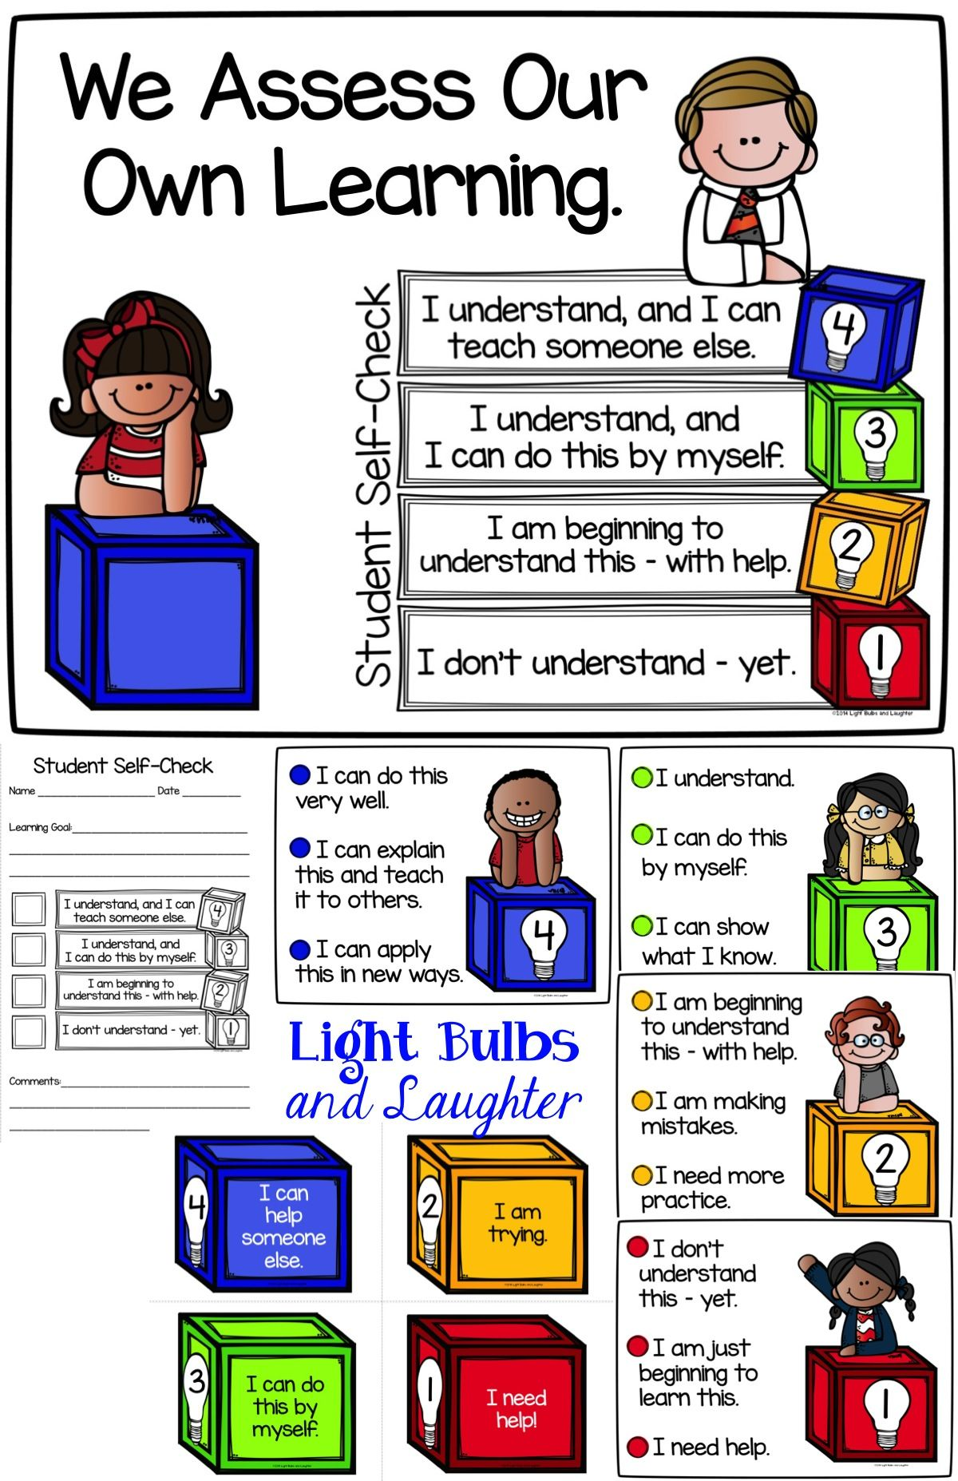
Self-assessment Tools
Various self-assessment tools are available to help individuals conduct a Skills Gap Analysis. These tools often include questionnaires, surveys, and online assessments that evaluate one's current skills. Utilising these tools provides a clear understanding of one's strengths and areas that need improvement.

Slide 7
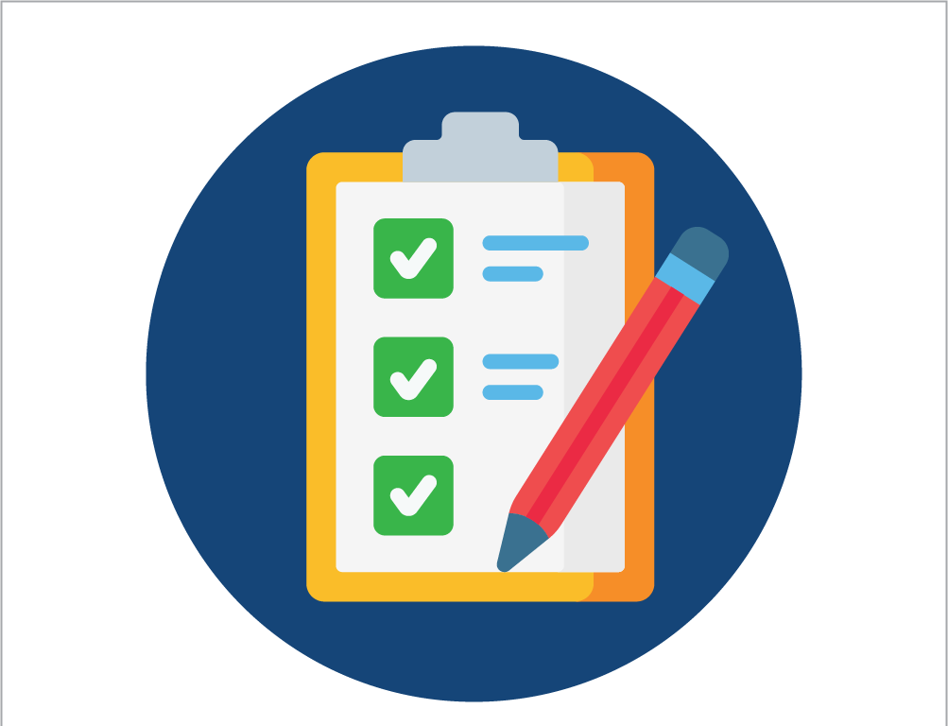
Steps to Conduct a Skills Gap Analysis
The process typically involves several steps: identifying required skills, assessing current skills, comparing the two to identify gaps, and developing an action plan to address these gaps. This methodical approach ensures a thorough and accurate analysis.

Slide 8

Evaluating Self-management
Evaluating self-management is a critical component of Skills Gap Analysis. It involves assessing one's ability to manage time, set goals, and stay organised. Improving self-management skills can lead to more efficient learning and professional growth.

Slide 9
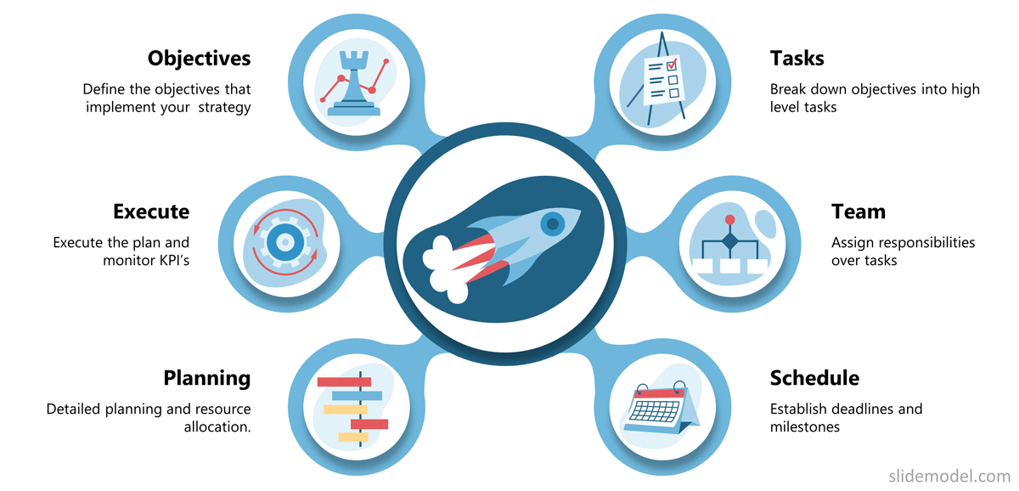
Developing an Action Plan
After identifying skill gaps, the next step is to create a detailed action plan. This plan should outline specific actions, resources needed, and a timeline for acquiring the required skills. Having a structured plan ensures that efforts are focused and progress is measurable.

Slide 10

Leveraging Learning Resources
Numerous learning resources are available to help bridge skill gaps, including online courses, workshops, books, and mentoring. Identifying and utilising these resources can accelerate the development process and ensure that learning is aligned with career objectives.

Slide 11

Continuous Improvement
Skills Gap Analysis should be an ongoing process. Regularly reassessing skills and updating development plans ensures that individuals remain adaptable and prepared for future challenges. Continuous improvement fosters long-term success and career fulfilment.

Slide 12

Thank You

