Slide 1
Task 1: Unit 10 – Database Development
Gareth Rimmer

Slide 2

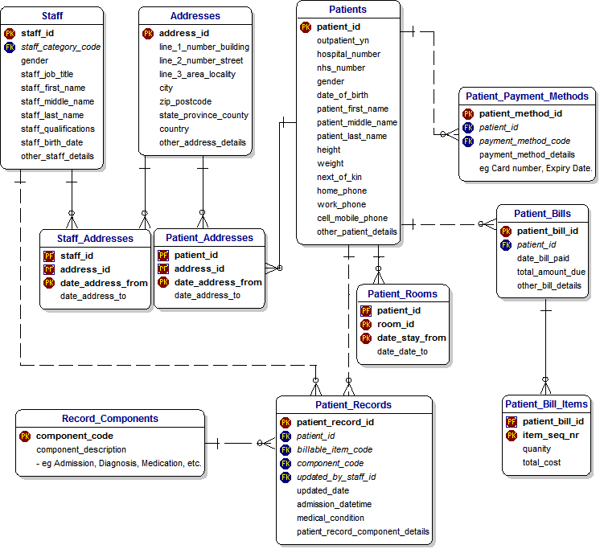
Overview of the Health Sector Database.
The databases within the health sectors i.e. doctors is compiled of patients, doctors' personal records etc. (see image aside).
It holds a vast information about the patients, doctors.
This information will include patients & addresses, medication information, payment information for the patients.

Slide 3
What are the benefits to the Health Sector for the Database?
There are many benefits of a Health Sector Database some of these are as follows:
All data for the patients are in the one place – this allows doctors, nurses or other medically trained personal to access a patients file with ease and not having to root through a folder for the relevant information.

Slide 4
What are the Constraints of the Databases?
The constraints of using the database within the Health Sector are as follows:
All the members of staff need to be trained to use it.
If any new GDPR or new regulations are introduced the database will need to be amended/updated.
Can be hacked from the outside world to gain staff or patients information/personal details.
If a patient or employee has changed any of there personal details and they have not informed the relevant person or department any correspondence will not be received by the patient or employee.

Slide 5
What Would the Organisation Use the Database for?
Patient Details
Medical History-Surgeries-Long Term Illness-Blood Tests
Medication-Vaccines-Flu Jabs
Appointments
Family History
Referrals
Practice management system
EHR
Costing system
Patient satisfaction
Ambulatory surgery
Radiology
Pathology
Financial system
HR system
A claims database (which isn’t theirs to manage but which needs to be integrated)

Slide 6
Strengths
The data can be accessed from various sites (offsite) from where you where born (only applies with people born in the UK) – this would be because if a patient or employee was to move home or anything from their original hospital then the new destination of the local NHS etc force can access their details without the hassle of having to create a new report/file for them.

Slide 7

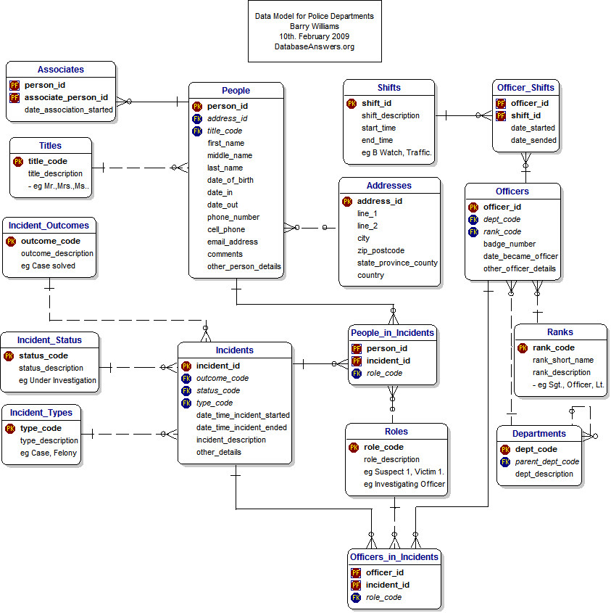
Overview of the Police Database.
The databases within the police/Emergency service industries is compiled of the officers/staffs personal details, incident number and type. (see image aside).
It holds a vast information about the offending person(s), staff members. This information will include staff ID & addresses, what incident has occurred (RTA, Burglary).
The PNC is a national database of information available to all police forces and law enforcement agencies throughout:
England
Scotland
Wales
Northern Ireland
the Isle of Man
the Channel Islands, and
the British Transport Police.

Slide 8
What Would the Organisation Use the Database for?
The following are some of the details held by PNC:
personal descriptions (not given by PNC bureau)
bail conditions (not given by PNC bureau)
convictions
custodial history
wanted or missing reports
warning markers
pending prosecutions
disqualified driver records
cautions
drink drive related offences
reprimands
formal warnings.
Vehicle information on the PNC
PNC also holds details of UK registered vehicles, these details are exactly the same as those held by the DVLA, and include:
vehicle details:
registration number
make
colour, and
modifications of vehicles as well as details of cherished transfers of registration plates
registered keeper details:
name
address, and
date since acquired
DVLA markers
police reports, and
vehicle insurance details
Computerised information on the PNC
The PNC holds details of people who are, or were, of interest to UK law enforcement agencies because they:
have convictions for criminal offences
are subject to the legal process, for example waiting to appear at court
are wanted
have certain court orders made against them
are missing or have been found
have absconded (escaped) from specified institutions
are disqualified from driving by a court
have a driver record held at the Driver and Vehicle Licensing Agency (DVLA)
hold a firearm certificate.

Slide 9
What are the Benefits to the Police Sector Database?
Improves speed of service for booking criminals in.
All the information for all employees, criminals is in one place/record.
It will be easier to amend when a new criminal is brought in or a new employee starts.
Can be a one-click system for more efficiency when looking at a criminal and employees files .

Slide 10
What are the Constraints of the Databases?
The constraints of using the database within the Policing Sector are as follows:
All the members of staff need to be trained to use it.
If any new GDPR or new regulations are introduced the database will need to be amended/updated.
Can be hacked from the outside world to gain peoples information/personal details.
Can be hacked from the outside world to gain peoples information/personal details.

Slide 11
Strengths
The data can be accessed from various sites (offsite) to where the original booking in was administered – this would be because if a criminal or employee was to move home or anything from their original police station then the new destination of the local police force can access their details without the hassle of having to create a new report/file for them.

Slide 12
Tools and Techniques of the Databases

Slide 13
Table Structures
A table stores all of the records for a particular category.
The table structures within the NHS (Health) Sector are patient's medication
The table structures within the Policing sector are I.D Numbers of the police officers
Field Characteristics
One piece of data or information about a person or thing.
The Field Characteristics within the NHS (Health) Sector are patient or employee address
The Field Characteristics within the Policing sector are a field containing previous convictions

Slide 14
Validation Rules
Validation rules prevent bad data being saved in your table. Basically, they look like criteria in a query.
The Validation Rules within the NHS (Health) Sector is a date entered in the wrong format for an admission of a patient
The Validation Rules within the Policing sector are
Indexing
Indexing is a way to optimize performance of a database by minimizing the number of disk accesses required when a query is processed.
An index or database index is a data structure which is used to quickly locate and access the data in a database table.
The Indexing within the NHS (Health) Sector are being able to search for a medication by typing in a little of the required name instead of search through the whole of the database
The Indexing within the Policing sector are looking up a criminals name

Slide 15
Records
A record is all of the data or information about one person or one thing.
The Records within the NHS (Health) Sector are employees' details
The Records within the Policing sector are criminals' previous convictions
Relationships
A situation that exists between two relational database table
The Relationships within the NHS (Health) Sector are
The Relationships within the Policing sector are

Slide 16
Forms
a form is a window or screen that contains numerous fields, or spaces to enter data.
The forms within the NHS (Health) Sector are when you would like to search for a patient or medication
The forms within the Policing sector are when you can search for a particular crime and how many occurrences it has happened.
Sorts
Sorting in database is like arranging rows in order based on a column(s). It may be in alphabetic order ,or numeric order, or order by date also.
The sorts within the NHS (Health) Sector are having doctors name sorted alphabetically ascending to descending.
The sorts within the Policing sector are police officers I.D. Numbers being sorted by officer's name or in numerical order

Slide 17
Queries
A query is a request for data or information from a database table or combination of tables.
The queries within the NHS (Health) Sector are
The queries within the Policing sector are

Slide 18
Productivity
NHS
The way the health sectors databases improve the productivity of the business/sector is by as follows:
Improves speed of service for the receptionist and doctors.
All the information for each patient is in one place/record.
It will be easier to amend or add new patients to the doctor's system.
Can be a one-click system for more efficiency.
POLICE
The way the Policing Database sectors databases improve the productivity of the business/sector is by as follows:
Improves speed of service for booking criminals in.
All the information for all employees, criminals is in one place/record.
It will be easier to amend when a new criminal is brought in or a new employee starts.
Can be a one-click system for more efficiency when looking at a criminal and employees files .

