Slide 1
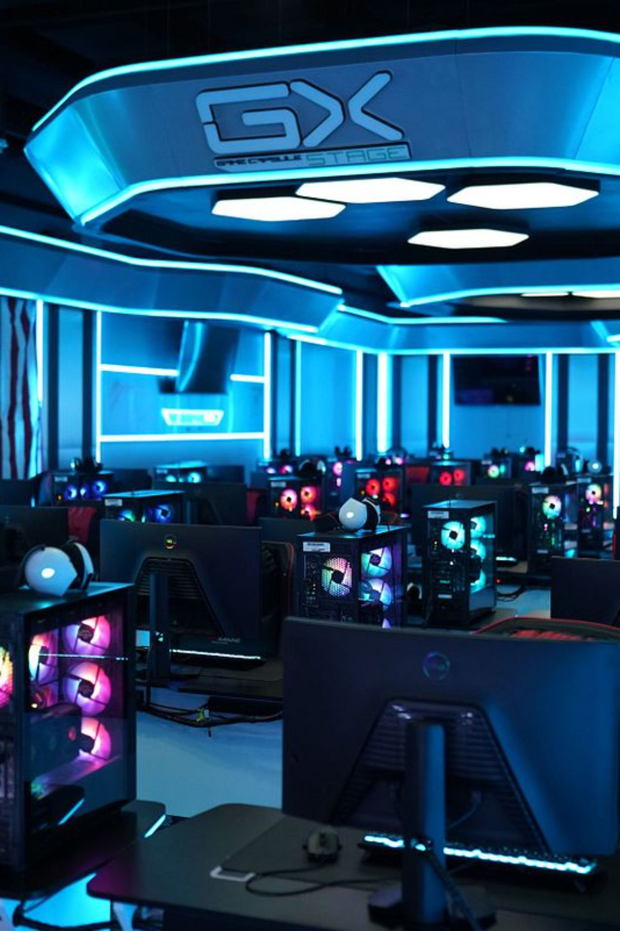
Assignment 1 Development Workshop
Strengthening Your Brand and Marketing Plan
Unit: Esports Branding & Marketing · Assignment 1 Progression Lesson
🎯 Improve Work
Progress towards M1 standard
🎨 Refine Branding
Strengthen your brand decisions
📊 Justify Marketing
Evidence-backed reasoning
✅ Complete Sections
Finish remaining work

Slide 2
Brand Review Challenge
Starter Activity — 10 Minutes
Take a moment to reflect on your esports brand. Answer the five questions below honestly — this will help you spot gaps before you dive into improving your assignment.
1
What is your esports brand called?
Is the name memorable, relevant, and easy to pronounce?
2
Who is your target audience?
Can you describe them in specific detail — age, platform, interests?
3
What makes your brand different?
What does your brand offer that competitors do not?
4
What colours and logo style have you chosen?
Do they communicate your brand values clearly?
5
Why would someone choose your brand over competitors?
Could a stranger understand your brand in 30 seconds?

Slide 3
Moving Beyond Description
What M1 Requires
Pass-level work describes your brand. Merit-level work justifies every decision with business reasoning linked to your audience. The difference is not how much you write — it is how deeply you think.
Pass Level (P1)
Merit Level (M1)
Describe your brand
Explain your logo
Identify your target audience
Explain marketing methods chosen
Justify every branding choice
Explain why decisions were made
Explain why alternatives were rejected
Link decisions to audience needs
Demonstrate clear business reasoning
❌ Weak: "I used blue because it looks nice."
✅ Strong: "I selected blue because research shows it creates trust and professionalism, which directly appeals to competitive esports players seeking credible brands."

Slide 4
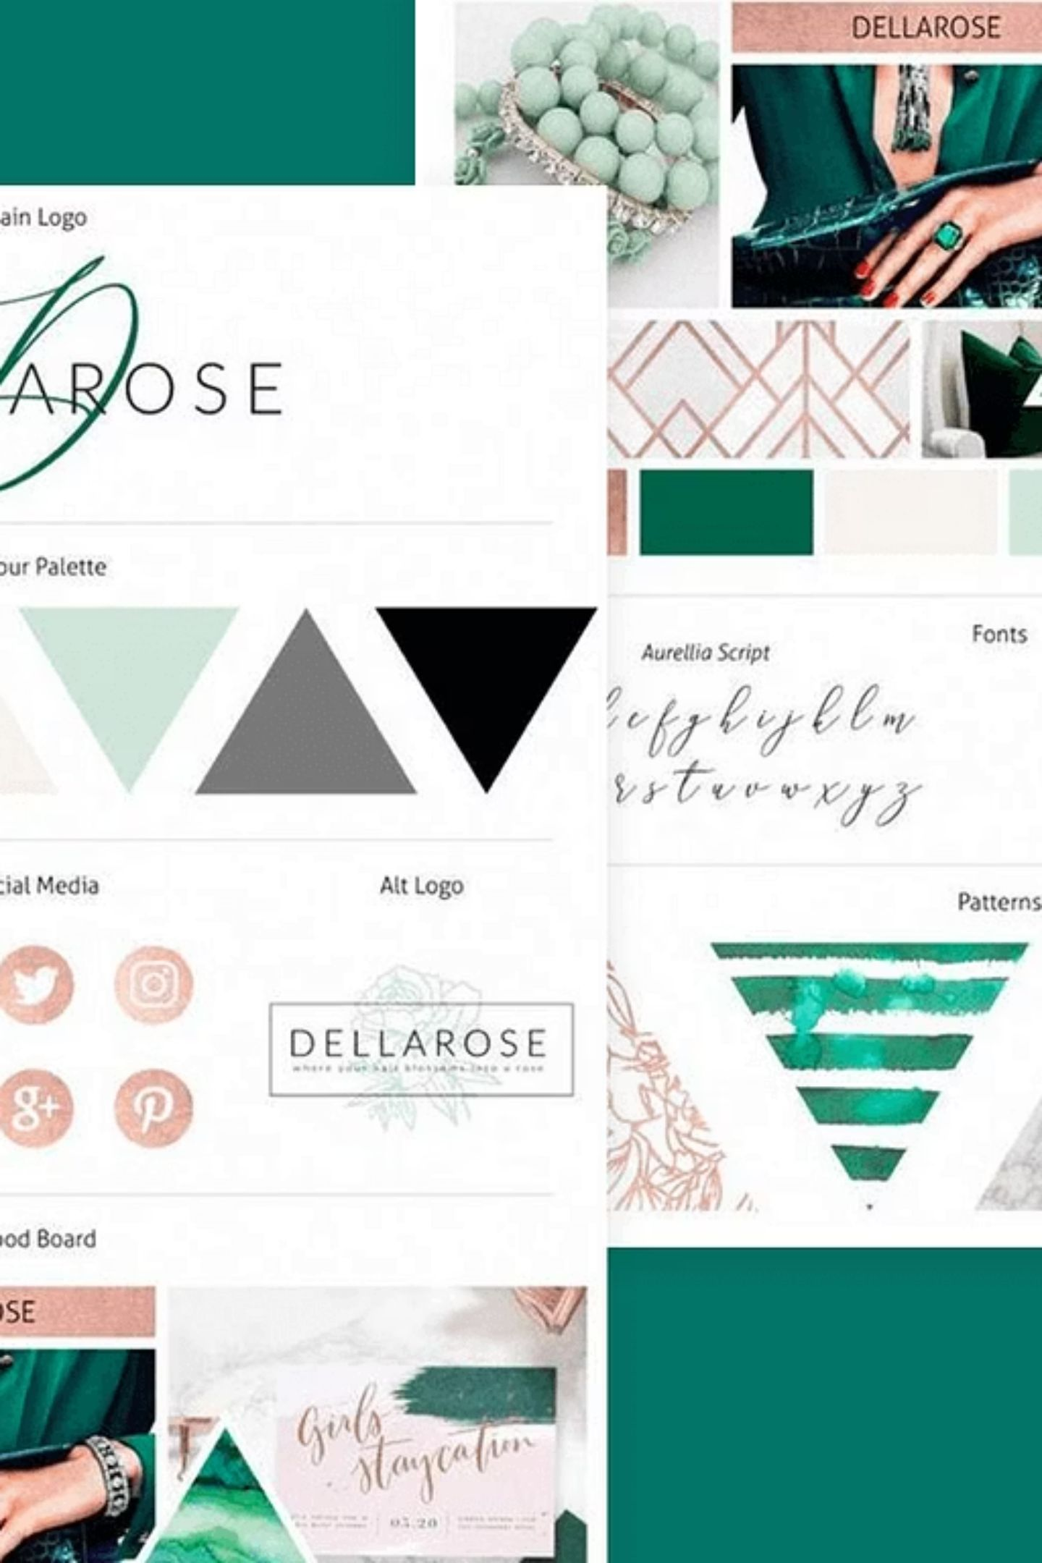

Evaluate Your Brand
Brand Evaluation Check
Use the questions below as a self-audit. Identify any weaknesses and make improvements before submitting. Honest evaluation now will strengthen your M1 justifications significantly.
Brand Name
Is it memorable and distinctive?
Is it relevant to esports culture?
Is it easy to pronounce and spell?
Logo Design
Is it unique and original?
Is it instantly recognisable?
Does it scale well for social media?
Colour Scheme
Does it attract your target audience?
Does it communicate your brand values?
Is it consistent across all materials?
For every weakness you identify, write a sentence in your assignment explaining what you will improve and why — this itself demonstrates analytical thinking.

Slide 5
Know Your Audience
Strengthening Audience Analysis
For M1, a vague audience description is not enough. You need to demonstrate detailed, researched knowledge of exactly who you are targeting — their demographics, habits, and digital behaviour.
Demographics to Include
Interests & Habits
Age & Gender
Location
Games Played
Social Platforms
Be specific — not just "teenagers" but a precise age range with context.
Where does your audience live? Does this affect platform choice or timing?
Which titles does your audience compete in or watch?
Twitch, TikTok, Discord, Instagram — where are they most active?
Esports Engagement
Income Level
Do they watch professional events? Stream themselves? Participate in tournaments?
This influences what products or sponsorships resonate with them.
❌ Weak: "Gamers aged 16–25"
✅ Strong: "Competitive FPS players aged 16–25 who actively use Twitch, Discord and TikTok, and regularly watch professional esports events such as the Valorant Champions Tour."

Slide 6
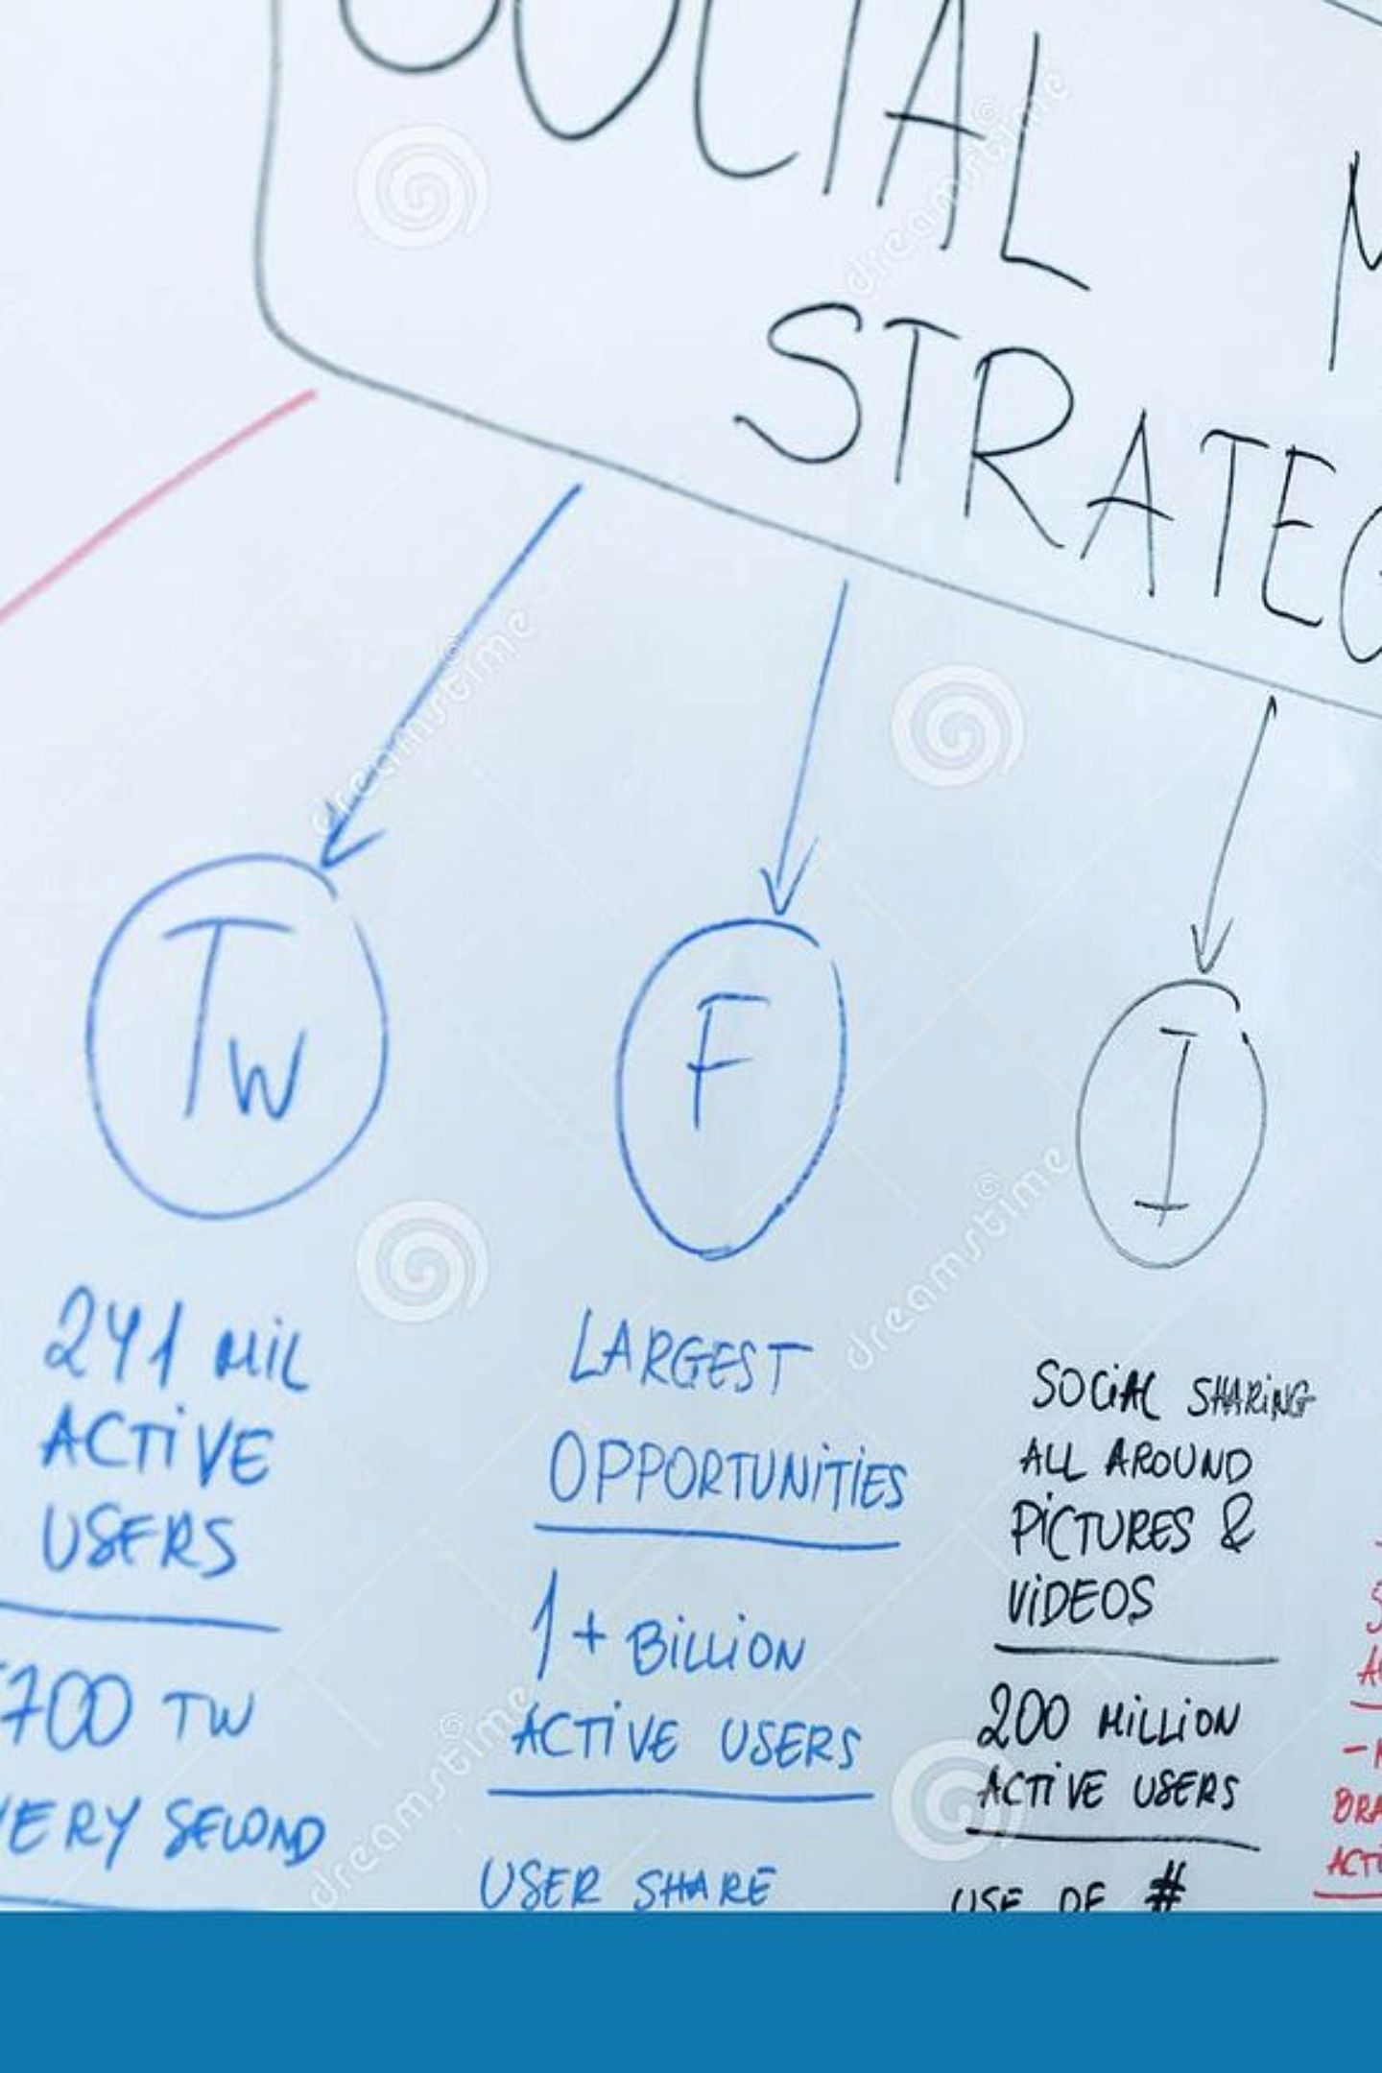





Why Will Your Marketing Work?
Marketing Justification
For every marketing method you include in your assignment, you must answer four key questions. Simply naming a platform is a Pass response — justifying your choice with evidence-backed reasoning is what earns M1.
Why this platform?
What features make it suitable for your brand and content type?
Why this audience?
How does this platform reach your specific target demographic?
Why this timing?
When is your audience most active and receptive to content?
Why is it effective?
What evidence or reasoning supports this method's success?
Instagram Example: Visual platform → Popular with 16–25 demographic → Supports branded content and Reels → Ideal for short esports highlight promotion and brand awareness campaigns.

Slide 7
M1 Improvement Workshop
Independent Assignment Improvement Task
Use this dedicated work time to revisit your Assignment 1 and apply the M1 criteria. Your target is to add at least three detailed justifications — each one explaining a decision, the reasoning behind it, and how it serves your audience.
1
2
3
Brand Justification
Audience Analysis
Marketing Rationale
Explain every branding choice — name, logo, colours, and values — with clear reasoning linked to your target audience.
Expand your audience profile with demographics, interests, gaming habits, and preferred platforms. Use specific details.
For each marketing method, justify why it suits your brand and audience. Reference platform features and audience data.
4
5
Competitor Research
Evidence & Screenshots
Compare your brand to at least two competitors. Explain what makes your brand different and why that matters.
Include screenshots, references, and sources to support your decisions. Evidence turns description into analysis.

Slide 8

Common Issues Found Last Lesson
Teacher Feedback — How to Fix Them
These are the five most common weaknesses spotted in student work so far. Review each one carefully and check whether any apply to your own assignment.
🔴 Describing, Not Analysing
🔴 No Explanation for Branding Choices
🔴 Weak Audience Research
Saying what you did is not enough — you must explain why you did it and what impact it has on your brand or audience.
Generic descriptions like "young gamers" are insufficient. Your audience section needs specific, researched detail to meet M1.
Every design decision — colour, font, logo style — needs a justification rooted in branding principles or audience research.
🔴 Insufficient Competitor Comparison
🔴 Limited Evidence or Screenshots
Simply naming competitors is not analysis. Compare their branding, audience, and strategy against your own choices.
Claims without evidence are descriptive at best. Include screenshots, references, and sourced data throughout your work.
The single most powerful question you can ask yourself throughout your assignment: "Why did I make this decision?"

Slide 9
Before Submitting Today
Progress Checkpoint
Work through this checklist before you submit. You should be able to answer YES to every statement. If you cannot, use the remaining lesson time to address those gaps.
✅ Clear Brand Identity
✅ Justified Design Decisions
Your brand has a distinct name, logo, colour scheme, and set of values that work together cohesively.
Every design choice is explained with reasoning that connects back to your audience or brand strategy.
✅ Detailed Target Audience
✅ Justified Marketing Methods
Your audience profile includes age, location, interests, gaming habits, and preferred social platforms.
Each platform or method is chosen with a clear rationale — not simply listed.
✅ Competitor Research Included
✅ Evidence & Screenshots Added
You have compared your brand to competitors and explained how yours is positioned differently.
Supporting evidence is embedded throughout, demonstrating research and analysis rather than opinion.

Slide 10
Assignment 1 Help & Tasks
Stay-On-Board Reference — Keep Working
Use this slide as your ongoing guide. For every section of your assignment, make sure you are addressing all the tasks below — and always apply the M1 framework to every decision you document.
🎨 Branding
👥 Audience Analysis
📣 Marketing Plan
⬆️ M1 Framework
Brand name with justification
Logo design and reasoning
Colour scheme explained
Brand values articulated
Age range and gender
Interests and lifestyle
Gaming habits and titles played
Platforms used regularly
Social media channels chosen
Content strategy outlined
Promotional methods justified
WHAT did you choose?
WHY did you choose it?
HOW does it help your audience?

Slide 11

Need Help? Here's What to Do
Support & Success Criteria
01
02
Ask the Teacher
Use the Checklist
Do not sit with a question unanswered — raise your hand or approach the desk for direct support.
Compare your work against the progress checkpoint on the previous slide and identify exactly what is missing.
03
04
Add Justification
Explain, Don't Describe
Go back through your assignment and add more reasoning and evidence wherever you have simply described rather than analysed.
For every statement you make, ask yourself — have I explained why? If not, add that reasoning now.
✅ Clear Brand
✅ Detailed Audience
✅ Justified Decisions
✅ Marketing Analysis
✅ Evidence Included
✅ Progress Towards M1
Continue working on Assignment 1 until the end of the lesson. Every minute counts — use the time wisely to push your work from Pass to Merit.

Slide 12

From Pass to Merit
The gap between Pass and Merit is not about working harder — it is about thinking deeper. Every design choice you make should have a reason. Every reason should be written down. Every piece of writing should be backed by evidence.
Think Critically
Justify Everything
Question every decision you have made in your assignment.
No choice should be unexplained — link all decisions to your audience.
Aim for M1
You have the knowledge — now demonstrate it with confidence and depth.

