Slide 1

Assignment 1 — M1 Completion Workshop
UNIT 13: WEBSITE DEVELOPMENT
A focused 2-hour workshop to improve and complete your M1 evidence independently. By the end of this lesson, you should have a nearly completed M1 section.

Slide 2

Today's Focus
You Have Already…
Today's Goal
Identified features on two websites
Looked at presentation
Looked at usability
Looked at accessibility
Looked at performance
Turn your existing work into stronger M1 evidence. Use this session to develop, expand, and complete each section of your review.
By the end of the lesson, your M1 section should be nearly complete.

Slide 3
Starter — Check Your Progress
Open your Assignment 1 work from last lesson. Rate each section using the traffic light system below, then identify which area needs the most work today.
🟢 Complete
🟠 Needs Improvement
🔴 Not Completed
This section is finished and well evidenced.
Started but requires more detail or evidence.
This section still needs to be written.
Check: Presentation · Usability · Accessibility · Performance — for both Website 1 and Website 2. Include screenshots and a comparison between the two sites.

Slide 4




Description Is NOT Enough
Too Descriptive ❌
Stronger Review ✅
The website has a navigation bar at the top of the page.
The website uses a navigation bar at the top of the page. This improves usability because important sections can be accessed quickly without users having to search through multiple pages, making navigation more efficient.
This only tells us what is there — it does not explain how or why it matters.
WHAT
HOW
Identify the feature
Explain how it works
WHY
IMPACT
Justify its purpose
Effect on the user

Slide 5
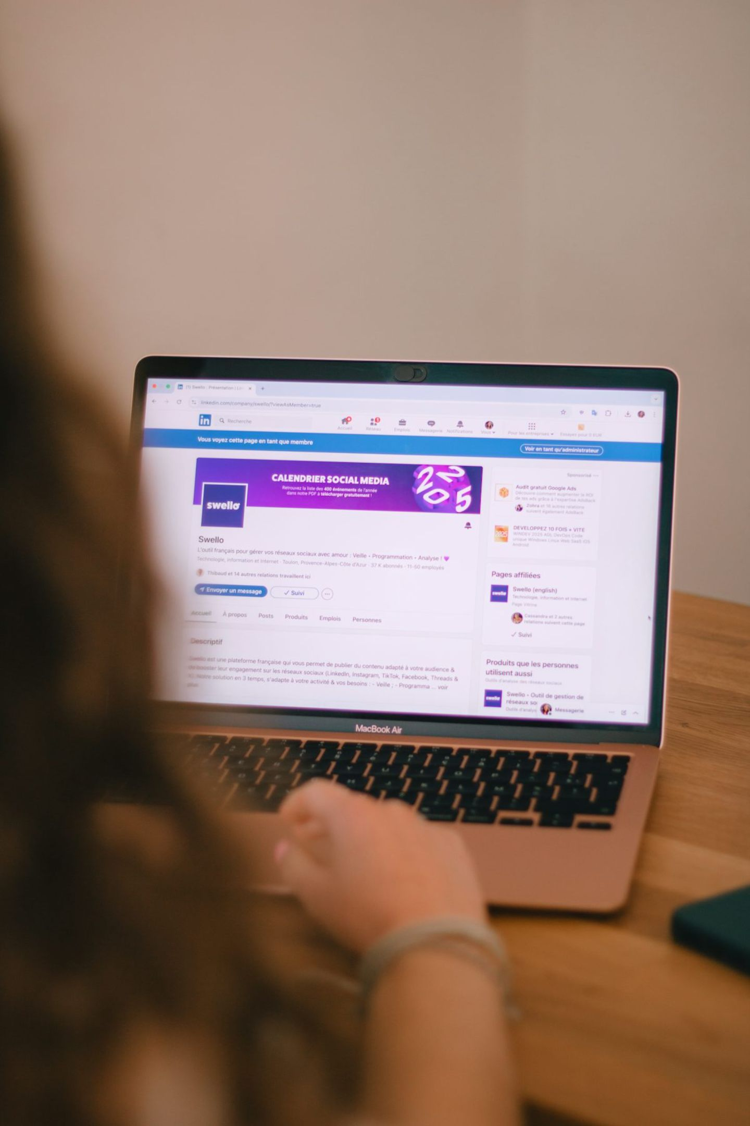
Explain the Impact on the User
For every feature you discuss, think about the user. Ask yourself these questions:
Presentation
Usability
Accessibility
Does it look professional? Is information visually clear? Does it support the brand?
Does it make something easier? Does it save time? Does it make navigation clearer?
Does it help different users access content? Is information easy to see and understand?
Performance
Does the website respond effectively? Does content load efficiently? Does it work across devices?

Slide 6
Adding Evidence
Don't Just Make a Statement — Show Evidence
Your Task
Feature: Navigation menu
Evidence: Insert a screenshot showing the navigation menu.
Add relevant screenshots to your M1 work. Under each screenshot, add a caption:
Figure 1: Navigation system on Website 1
Then explain why that feature is effective.
The navigation menu provides clear access to the main sections of the website. This improves usability because users can move directly to the content they require. The consistent position also makes the website easier to understand when moving between pages.

Slide 7

Compare Your Two Websites
You've reviewed both websites — now start making connections between them. Write four comparison paragraphs: Presentation, Usability, Accessibility, and Performance.
Useful Sentence Starters
Example Comparison
Both websites use… · Website 1 is more effective because… · In comparison, Website 2… · One major difference is… · Website 2 provides stronger accessibility because…
Both websites use navigation menus, but Website 1's navigation is more effective because its categories are clearly organised and easy to locate. Website 2 requires users to open additional menus, which could make finding information less efficient.

Slide 8
Main Assignment Workshop
Continue writing your M1 section. Work through this order:
01
02
Website 1
Website 2
Presentation · Usability · Accessibility · Performance
Presentation · Usability · Accessibility · Performance
03
04
Comparison
Evidence
Compare how effectively the two websites use their features.
Add screenshots and examples where appropriate.
⭐ Stretch: For each area, identify something that could be improved on each website.

Slide 9
Final Quality Check
Before you say M1 is finished, confirm every box below is ticked.
Coverage — Both Websites
Quality Checks
Presentation reviewed
I explain why features are effective
Usability reviewed
I discuss the impact on users
Accessibility reviewed
I use specific website examples
Performance reviewed
I have included appropriate screenshots
Websites compared
I write in paragraphs, not bullet points

Slide 10

🚨 Help Slide — Paragraph Formula
1
Identify
One feature used on the website is…
2
Explain
This feature allows the user to…
3
Review
This improves usability/presentation/accessibility/performance because…
4
Impact
The benefit to the user is…
5
Judgement
Overall, this feature is effective because…
🎯 Today's Target: Don't just tell me WHAT the website does — tell me HOW it helps, WHY it helps, and WHAT impact it has on the user.

