Slide 1
UNIT 1: ESPORTS GAMES, TEAMS & TOURNAMENTS
A1 – GENRES OF ESPORTS GAMES

Slide 2
UNIT SUMMARY
In this unit you’ll investigate different genres of Esports games and the professional teams that play them.
You will study the online and live tournaments and leagues in which these Esports team compete.
Esports is organised, competitive, human versus human video gaming where people play against each other online and at live spectator events. It is played by both amateurs and professionals and is open and inclusive to all.
The Esports industry is growing exponentially around the world. At the professional level, leading global teams and players can earn significant sums in wages and prize money each year.
In this unit you will investigate the different types of esports games giving examples of specific games in each genre. You will explore the professional esports teams that play these games and how they focus on physical and mental health as well as their game play.
You will also explore the national and international tournaments and leagues in which they compete.
This unit will provide you with the foundation knowledge and understanding of esports games and their competitive structure and organisation that will allow you to progress on to further study linked to esports or into roles within the esports industry.

Slide 3
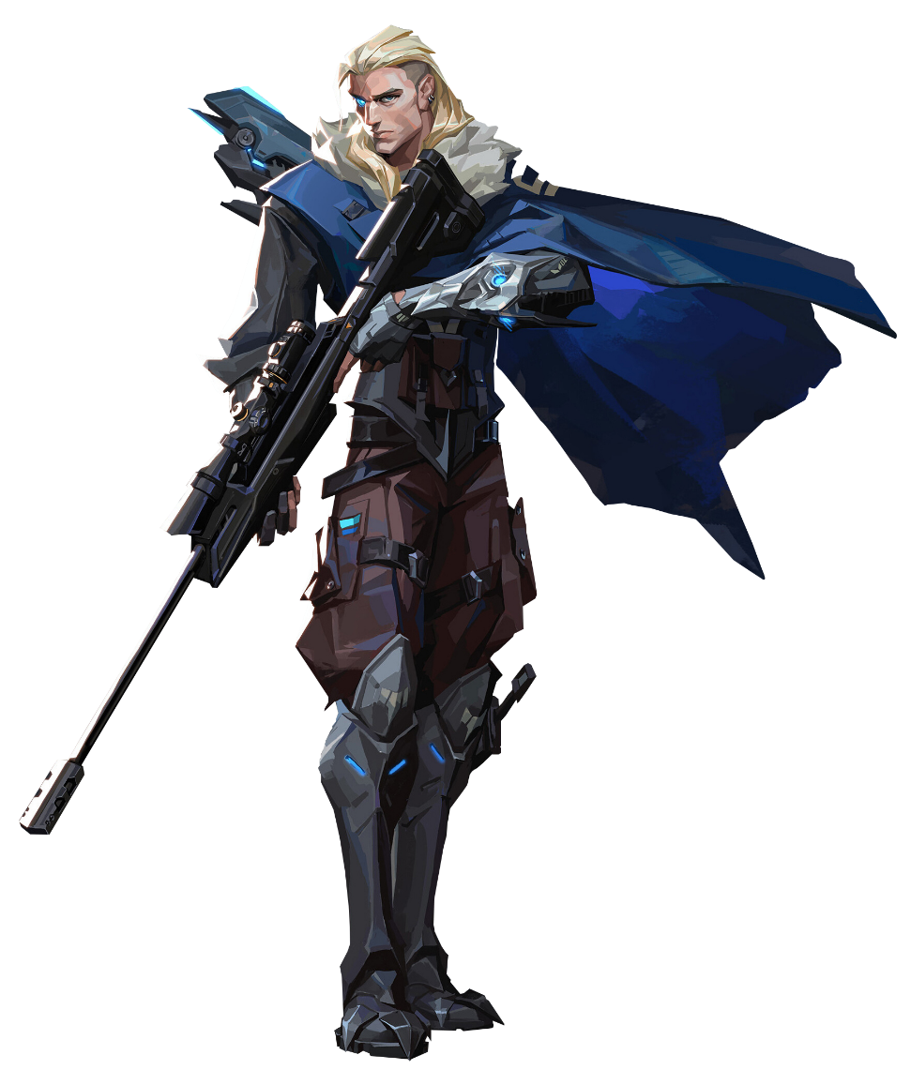

LEARNING OBJECTIVES
In this unit you will:
A Investigate different genres of Esports games
B Explore different professional Esports teams
C Examine Esports tournaments and leagues.

Slide 4
WHAT IS A GENRE?
A genre is defined in the dictionary as:
“A style, especially in the arts, that involves a particular set of characteristics”
In Esports terms this means there are games that have characteristics that define them from other games which make them different.

Slide 5


WHAT IS AN ESPORTS GAME?
An Esports game is one that can be played in a competitive setting either as a team or one person.
In each game there will be a “win” condition (rules and objectives that define a win) and can have prizes for winning teams or individuals
The rules and objectives are usually set by the “publishers” who own the game, and each game and genre can and will have different rules and objectives
Each genre of game may also have different win conditions and regulations on how teams and/or individuals should play.
WHEN IS A VIDEO GAME CLASSED AS AN ESPORT?
“Esports (or electronic sports) is a term used to describe competitive video gaming. It’s different from standard video gaming in that Esports is competitive (human-vs-human) and usually has an engaging spectator element to it, like traditional sports. Esports tournaments usually consist of amateur or professional gamers competing against one another for a cash prize.”

Slide 6
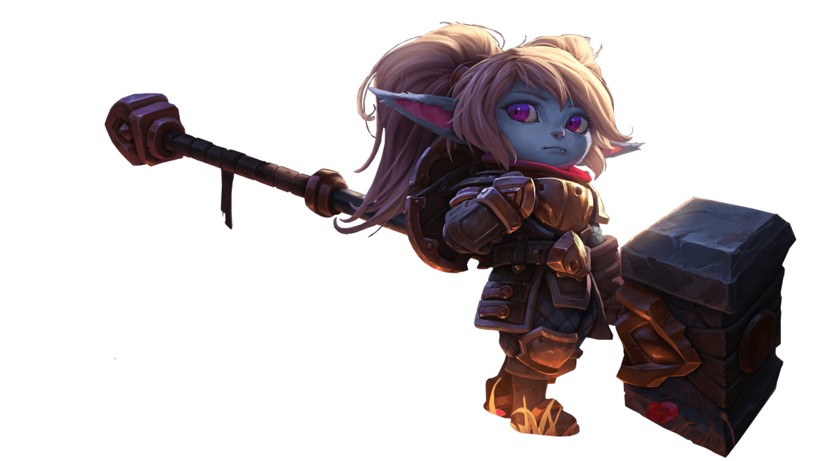
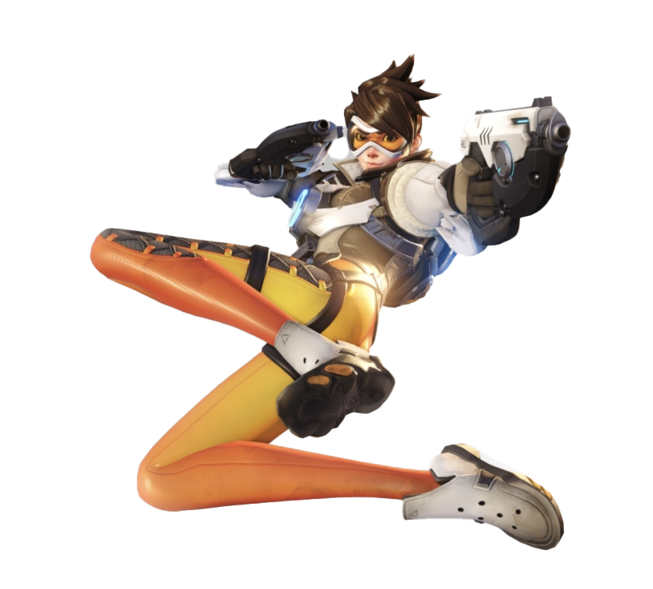
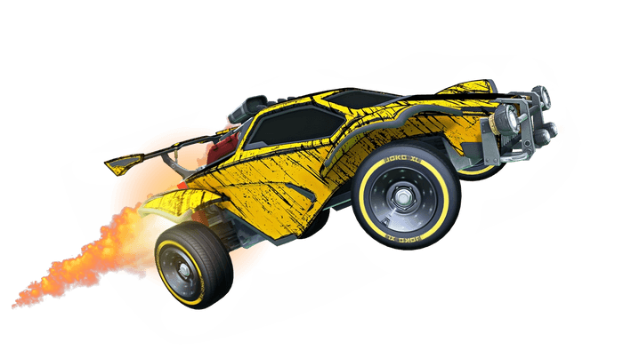
TYPES OF ESPORTS GENRES AND ESPORTS GAME EXAMPLES
Multiplayer Online Battle Arena (MOBA): League of Legends,DOTA2
First Person Shooter (FPS): Overwatch, CS:GO, Call of Duty
Battle RoyalE: Fortnite, PUBG
Real Time Strategy (RTS): Starcraft II, Warcraft III
Fighting Games: Street Fighter, Sumer Smash Bros
Sports Based Games: EAFC (ex FIFA), NBA 2K, Rocket League

Slide 7
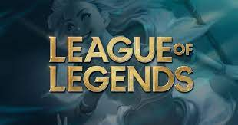
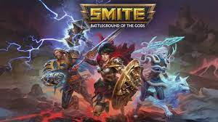
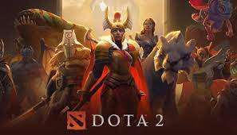
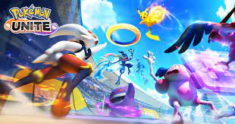
WHAT IS A MULTIPLAYER ONLINE BATTLE ARENA (MOBA)?
“online real-time strategy video game in which two teams of characters compete head-to-head with the goals of protecting their home base and destroying the towers, turrets, or other structures of the opposing team’s stronghold (often used attributively).”
Usually, these games are in teams made up of five people per team and each game will have a specific rule set or win condition (how to win the game).
This genre is one of the most popular with 2 out of the top 4 most popular games in 2020!!!
TYPES OF MOBA GAMES
League of Legends
DOTA 2
Smite
Pokemon Unite

Slide 8

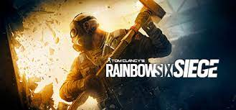
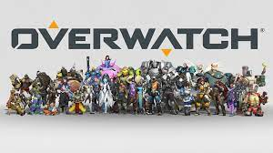
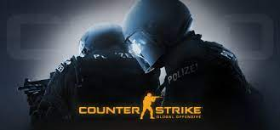
WHAT IS A FIRST PERSON SHOOTER (FPS)?
“First-person shooters (FPS) are a genre of shooting games in which players see the world through the eyes of their on-screen character. In an FPS game, players can typically see their weapon of choice floating around on the screen in front of them. (Unlike in third person shooter (3PS) games, where players can see their character on the screen.)”
This genre of games although sounding similar to MOBAs in focusing on skill, aim and game awareness, does not have the same focus on map structures. Although there is some debate as to whether some games fit into both MOBA and FPS as they have elements of both!
This genre is popular with CSGO one of the longest running FPS games in its 19 year streak.
TYPES OF FPS GAMES
Valorant
Rainbow Six Siege
CS:GO
Overwatch

Slide 9

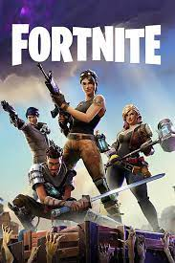
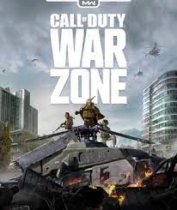
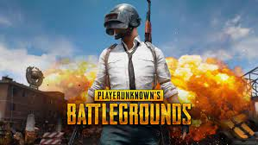
WHAT IS A BATTLE ROYALE?
A battle royale game is a genre which is usually played as an individual but can be played as a small team.
“Battle royale video games are multiplayer games that involve a large number of gamers, typically around 100, controlling characters who parachute onto a virtual map, where they will battle until there is only one person left standing”.
‘Battle Royale’ comes from the 1996 novel & 2000 film by Koushun Takami. Set in a school and all the students had to battle to the death with one winner! This concept makes the base storyline for Hunger Games.
These games are very popular with Apex Legends (10 million) and Fortnite (15 Million) players worldwide in 2022.
TYPES OF BATTLE ROYALE GAMES
Apex Legends
Fortnite
Call of Duty Warzone
PUBG

Slide 10


WHAT IS A REAL TIME STRATEGY GAME?
“Real-time strategy (RTS) refers to a time-based video game that centres around using resources to build units and defeat an opponent. Real-time strategy games are often compared to turn-based strategy games, where each player has time to carefully consider the next move without having to worry about the actions of his opponent. In real-time strategy games, players must attempt to build their resources, defend their bases and launch attacks while knowing that the opponent is scrambling to do the same things”
Although these games are known generally the amount of FTS games within Esports is very limited with Starcraft and Warcraft III being the most popular.
TYPES OF RTS GAMES
Starcraft
Warcraft

Slide 11
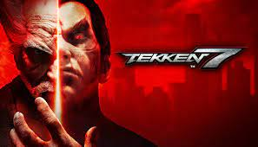
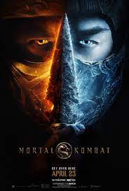

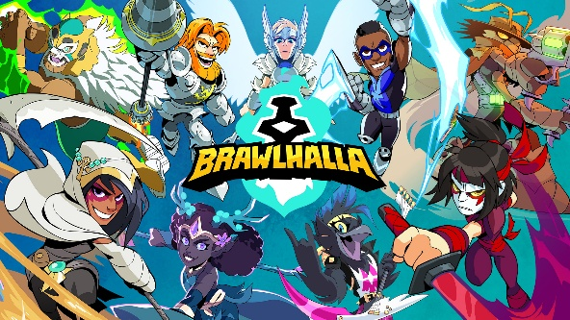

WHAT IS A FIGHTING GAME?
The fighting game genre refers to a game where a player controls a character that fights against another.
“Fighting games are a form of action game in which two on-screen characters engage in one-on-one combat. Fighting games frequently feature unarmed fighting, such as boxing or martial arts, but can also include fighting with weapons like swords or guns.”
These games are one of the most popular in Esports without the coverage and sponsorship worldwide but still have a huge following and claim to be one of the first Esports genres created.
TYPES OF FIGHTING GAMES
Tekken
Super Smash Bros
Mortal Kombat
Street Fighter
Brawhalla

Slide 12



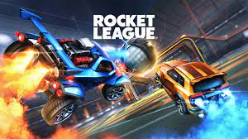
WHAT IS A SPORTS BASED GAME?
The sports-based game genre refers to a game that has its roots in traditional sports such as football or basketball and has a huge crossover with traditional sports teams such as Manchester City who have a EAFC, e-Football and Pro Soccer teams.
Players will control either a human or car (in the case of F1) avatar to compete in real life situational competitive gaming with similar rules and regulation to the real life sport.
** Rocket League is more of a fantasy based game that is both cars and football combined.**
TYPES OF SPORTS BASED GAMES
EAFC (ex FIFA)
Rocket League
E-Football
NBA 2K

