Slide 1
UNIT 2: ESTABLISHING AN ESPORTS ORGANISATION
A1 – TYPES OF GLOBAL SPORTING ORGANISATIONS

Slide 2
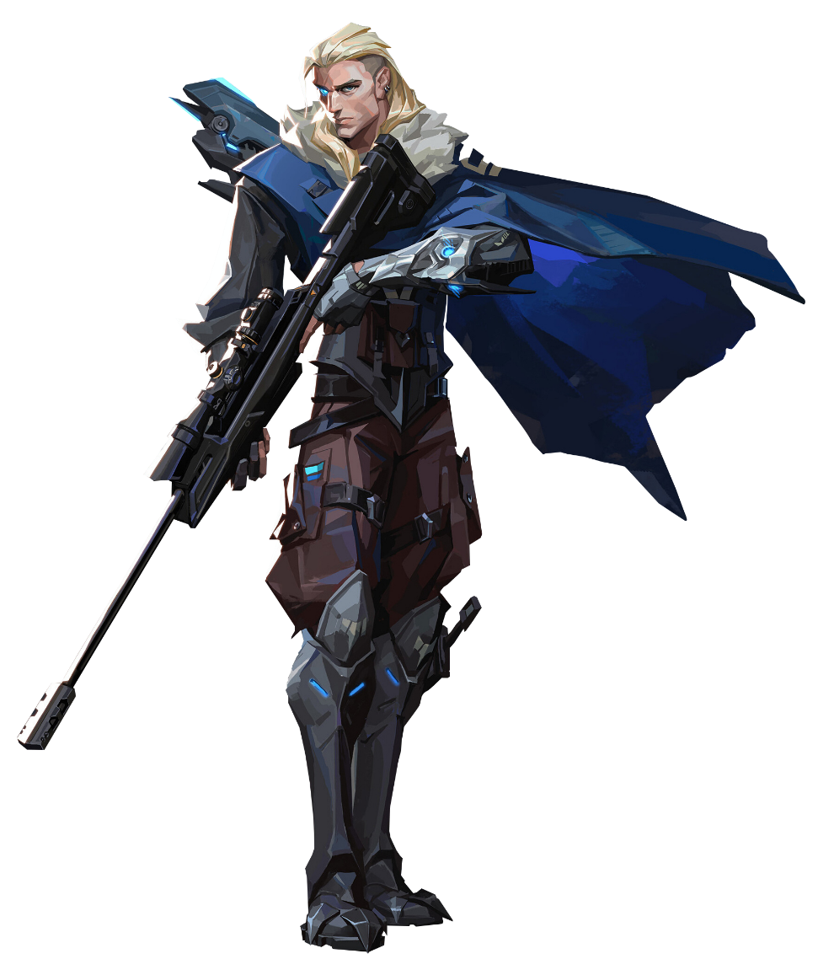
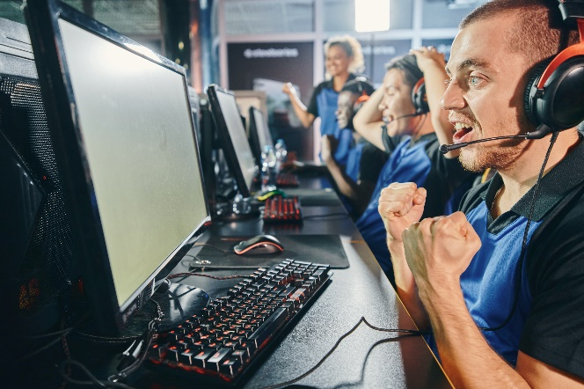
LEARNING OBJECTIVES
In this unit you will:
A Investigate a global sporting organisation
B Develop a brand for an esports organisation
C Design a logo and merchandise for an esports organisation
D Create a plan to promote the brand.

Slide 3

WHAT IS AN ORGANISATION?
An organisation is defined in the dictionary as:
“A group of people who work together in an organised way for a shared purpose.”
Examples of this is a potilical party, a business, a charity, a club or a government.

Slide 4
DIFFERENT TYPES OF GLOBAL ORGANISATIONS
There are a number of different types of global sporting organisations and are are usually structured on the sport they govern, the region they operate, or their function.
International Sports Federations (IFs): These are international organisations recognised by the International Olympic Committee (IOC) to administer one or more sports at world level. They establish rules, host tournaments and events, and promote their respective sports e.g. the Fédération Internationale de Football Association (FIFA) is the IF that governs football globally.
International Governing Bodies for a Single Sport: These organisations govern a specific sport worldwide, setting rules, arranging world championships, and promoting their sport. An example is the International Cricket Council (ICC), which governs cricket globally.
International Multi-Sport Organisations: These organisations oversee multiple sports, usually through organising multi-sport events. The International Olympic Committee (IOC), which oversees the Olympic Games, is an example of this type of organisation.
Continental Sports Organisations: These organisations oversee sports at the continental level. They often host continental championships and work under the umbrella of international sports federations. The Union of European Football Associations (UEFA) is an example that oversees football within Europe.

Slide 5
DIFFERENT TYPES OF GLOBAL ORGANISATIONS
Anti-Doping Organisations: These organisations work to prevent and control doping in sports. The World Anti-Doping Agency (WADA) is a prominent example of this type of organisation. They create anti-doping standards, monitor doping control programs, and maintain a list of banned substances.
Athletes' Associations and Unions: These are organisations that represent the interests of athletes, often dealing with matters like contracts, wages, and working conditions. The International Professional Surfers (IPS) is an example, which was the first surfers' union, representing professional surfers' interests.
Disabled Sports Organisations: These organisations are committed to providing sporting opportunities for athletes with disabilities, promoting inclusivity in sports. The International Paralympic Committee (IPC) is an example that oversees the Paralympic Games.
Sports Aid and Development Organisations: These are organisations that use sports as a tool for social and economic development or humanitarian aid. Examples include organisations like Right to Play or PeacePlayers, which use sports to teach life skills and foster peace and development in areas affected by conflict.

Slide 6
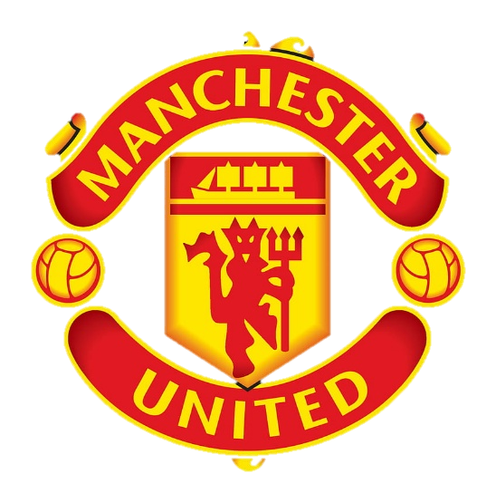
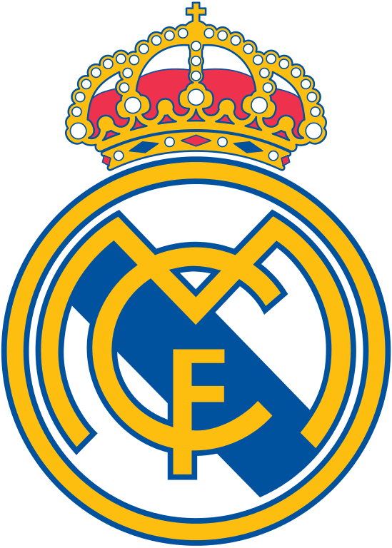


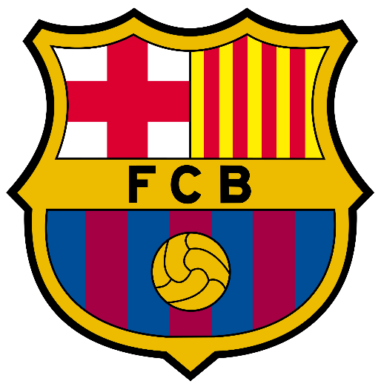
BIG GLOBAL SPORTS TEAMS
The "largest" sports team organisations can depend on various factors and this changes year on year, but here are five of the most globally prominent and financially strong sports team organisations:

Slide 7



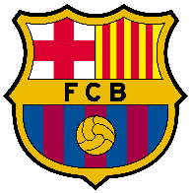
BIG GLOBAL SPORTS TEAMS
Dallas Cowboys (NFL, American Football): The Dallas Cowboys, based in Texas, USA, are consistently ranked as one of the most valuable sports franchises worldwide. Owned by Jerry Jones, they play in the USA National Football League (NFL).
New York Yankees (MLB, Baseball): The New York Yankees, one of the most successful teams in Major League Baseball (MLB), have a significant fan base and high revenues. They're known for their many World Series titles.
Manchester United (Premier League, Football): A major English football club, Manchester United is known worldwide and has a massive global fan base. They compete in the Premier League and have a history rich with success.
Real Madrid (La Liga, Football): Real Madrid, based in Spain, is another global football powerhouse with high revenues and a significant fan base. They compete in La Liga and have had significant success in the UEFA Champions League.
FC Barcelona (La Liga, Football): Another Spanish team, FC Barcelona, rivals Real Madrid in terms of global recognition, fan base, and revenue. They're known for their strong performance in La Liga and the UEFA Champions League.

Slide 8
CASE STUDY: DALLAS COWBOYS
The Dallas Cowboys are one of the most iconic franchises in the National Football League (NFL), and a prime example of a successful global sporting organisation.
Organisation Structure: Owned by Jerry Jones since 1989, it’s a family thing! Jerry is the owner and general manager, his daughter Charlotte Jones is the Executive Vice President/Chief Brand Officer, and his son Stephen Jones is the Chief Operating Officer, Executive Vice President, and Director of Player Personnel. The organisation is divided into several key departments including football operations, business operations, marketing, sales, community service, media and communications, and more. Each of these departments have their respective heads who report to the upper management.
Marketing: Dallas Cowboys has a strong brand presence in the market. They have an iconic logo (the "lone star" logo) that is instantly recognisable and is heavily incorporated into their marketing strategy. They’re also known for their cheerleading squad, the Dallas Cowboys Cheerleaders, who have their own branding and marketing opportunities.
Events: The team hosts regular home games at the AT&T Stadium in Arlington, Texas, which is a state-of-the-art venue known for its colossal HD video screen. They also hold yearly training camps and fan events, such as meet and greets and charity functions.

Slide 9
CASE STUDY: DALLAS COWBOYS
Social Media: Dallas Cowboys has an active social media presence, with official profiles on platforms like Facebook, Twitter, and Instagram. They share news, photos, videos, player profiles, game schedules, and promotional content, engaging regularly with their fanbase.
Business Objectives: Their objectives are like any professional sports team: to win championships, increase fanbase, and grow the business profitably. They also aim to be leaders in community service and contribute positively to society
Business Environment: The Cowboys operate in a highly competitive environment, both on and off the field. They compete with other NFL teams for players, fans, and corporate sponsorships. However, their brand strength, coupled with a consistent strategy for fan engagement, merchandise sales, and partnerships, has led them to be named the most valuable sports team in the world multiple times.
Meeting Customer Needs: Dallas Cowboys meet the needs of their customers (fans) by providing high-quality entertainment, maintaining a strong connection with the community, and offering a wide range of merchandise. They also aim to provide a high-quality experience at their home stadium, with regular improvements and updates.
Turnover & Brand Awareness: According to Forbes, the Dallas Cowboys were valued at $5.7 billion in 2020, making them the most valuable sports team globally. Their brand is internationally recognised, and they have a wide range of merchandise for fans, helping to increase both turnover and brand awareness.

Slide 10

CASE STUDY: DALLAS COWBOYS
Filling a Gap in the Market: When the Dallas Cowboys were established in 1960, there was a significant market demand for an NFL team in the Southwest, which they filled. They've since grown to have one of the largest fanbases in the NFL.
Meeting Social Aims: The Cowboys are also active in their community through the Dallas Cowboys Football Club and Dallas Cowboys Cheerleaders. They focus on youth health and education, military support, and many other causes.
Meeting Charitable Aims: The Gene and Jerry Jones Family Foundation and the Dallas Cowboys are dedicated to making a lasting impact on the community, with significant contributions to education, scientific research, and the homeless, among other charitable causes.
In conclusion, the Dallas Cowboys organisation has effectively used branding, marketing, customer engagement, and a winning tradition to become one of the most successful and recognisable franchises in all of sports.

Slide 11
CASE STUDY: MANCHESTER UNITED
Manchester United is one of the most successful and globally recognised football clubs in the world.
Organisation Structure: Manchester United is a public limited company listed on the New York Stock Exchange, with the Glazer family holding the majority of the shares. The structure of the organisation is hierarchical, with the Board of Directors at the top, followed by executive management. The Board includes the owners, the club's Chief Executive Officer, and independent directors. Executive management, headed by the CEO, is responsible for the day-to-day operations of the club. The team manager reports to the Board and is responsible for player recruitment and on-field performance.
Marketing: Manchester United has a strong global brand presence. The club lot of big money sponsorship deals and partnerships with global companies such as Adidas, Chevrolet, and AON. They leverage their iconic logo, rich history, and global fanbase in their marketing strategies.
Events: Besides their regular home and away matches in various competitions, Manchester United holds events like pre-season tours, fan festivals, and charity matches. They also have a museum and stadium tour that attracts fans from around the world.

Slide 12
CASE STUDY: MANCHESTER UNITED
Social Media: Manchester United has a strong social media presence across various platforms such as Facebook, Twitter, and Instagram. They engage with their global fanbase through match updates, behind-the-scenes content, and player-focused stories.
Business Objectives: Their objectives, similar to any professional sports team, are to win trophies, expand their global fanbase, and grow the business profitably. They also have social objectives, like fostering community development and promoting inclusivity.
Business Environment: Operating in the very competitive environment of Premier League football, Manchester United competes for top talent, fans, and sponsorship deals. However, their rich history, large fan base, and strong brand have kept them at the forefront of world football.
Turnover & Brand Awareness: As of 2021, Forbes estimates Manchester United's value at $4.2 billion. Their brand is globally recognised, and they have extensive merchandise available to fans around the world.

Slide 13

CASE STUDY: MANCHESTER UNITED
Meeting Social Aims: The Manchester United Foundation works in some of the most disadvantaged areas of Greater Manchester, providing programs to inspire young people to build a better life for themselves and improve the communities they live in.
Meeting Charitable Aims: Through the Manchester United Foundation, the club supports a wide range of charitable activities, including children's health and well-being, education, and community cohesion.
In conclusion, through successful on-field performance, strategic marketing, and robust community engagement, Manchester United has built a strong global brand and business operation.
The club's history, combined with its modern approach to fan engagement and business management, makes it a compelling case study in global sporting organisations.

Slide 14

CASE STUDY: OPTIC GAMING
Optic Gaming is one of the most recognised esports organisations in the world, known for its success in the Call of Duty esports scene.
Organisation Structure: Optic Gaming has gone through various changes in its structure over the years. It was originally founded by OpTic "KR3W" in 2006 and later led by OpTic "H3CZ" Rodriguez. After a period under the Infinite Esports & Entertainment company, which made some unpopular changes, it returned under the leadership of H3CZ in 2020. Today, the organisation includes a management team, coaches, players, and content creators.
Marketing: Optic Gaming leverages its brand name, successful history, and its popular content creators in its marketing efforts. Their marketing also extends to collaborations with other brands and sponsorship deals.
Events: Optic Gaming participates in various esports events, primarily in the Call of Duty League. They also host various live streams and content creation events.
Social Media: Optic Gaming maintains a robust online presence, with active accounts on platforms like Twitter, YouTube, Twitch, and Instagram. They engage with their fans through match updates, player streams, content videos, and behind-the-scenes content.

Slide 15
CASE STUDY: OPTIC GAMING
Business Environment: Optic operates in the competitive environment of esports,
Business Objectives: Optic Gaming's main objectives are to win esports championships, grow their fanbase, and expand their brand. This is achieved through their competitive teams and the content created by their members.
Meeting Customer Needs: Optic Gaming meets the needs of its fans by providing high-quality competitive play. Release of engaging content from its team members, and interaction through social media platforms.
Meeting Social Aims: While Optic Gaming may not have explicitly outlined social aims, they contribute to the community through their content, providing entertainment and promoting the esports industry.
Meeting Charitable Aims: Optic Gaming has participated in charity streams and events, using their platform to raise funds for various causes.

Slide 16

CASE STUDY: OPTIC GAMING
Turnover & Brand Awareness: Although specific financial figures are not public, Optic Gaming has established a globally recognised brand with substantial merchandise sales and sponsorships contributing to its revenue.
Meeting Charitable Aims: Optic Gaming has participated in charity streams and events, using their platform to raise funds for various causes.
Optic Gaming's rise and sustained success is a testament to their understanding of the esports market, not only in the competitive scene but also in the realm of content creation and fan engagement.
Their brand is one of the most recognisable in esports, showing how a well-executed brand strategy can lead to global recognition in this relatively young industry.

Slide 17









TYPES OF ESPORTS ORGANISATIONS
Broadly speaking there are three types of esports organisations:
AMATEUR
SEMI-PROFESSIONAL
PROFESSIONAL

Slide 18
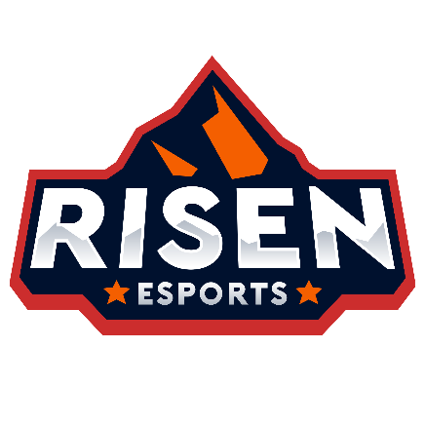

TYPES OF ESPORTS ORGANISATIONS: AMATEUR
These are teams comprised of players who typically participate in esports as a hobby rather than as a career.
They may participate in local or online tournaments and may win prize money, but it's not their primary source of income.
They may not have sponsorships or official training schedules, and they often self-fund their gaming endeavours.
In the UK, an example would be Endpoint, which began as an amateur team before advancing to more professional leagues.
Globally, numerous small amateur teams participate in open qualifiers for games like Dota 2 or League of Legends, striving to make a name for themselves.

Slide 19

TYPES OF ESPORTS ORGANISATIONS: SEMI-PROFESSIONAL
These teams are somewhere between amateur and professional status. Players on these teams often aspire to play professionally, and they might earn a partial income from esports, but they may still have other jobs or studies.
They might have some sponsorships or partnerships and typically have more structure than amateur teams, with regular training schedules and coaching.
They may play in regional leagues or second-tier professional leagues. An example from the UK is CTRL Esports and MnM Gaming, semi-pro teams that competes in several games.
Globally, an example might be the many teams that compete in the Overwatch Contenders league, a step below the fully professional Overwatch League.

Slide 20
TYPES OF ESPORTS ORGANISATIONS: PROFESSIONAL
These are teams where the players are salaried, and esports is their full-time job.
They are fully funded by team owners and sponsors, have rigorous training schedules, and employ a support staff that could include coaches, analysts, psychologists, and more.
They compete in top-tier leagues and tournaments and often live together in team houses or training facilities. Two prominent UK-based professional teams are Fnatic and Guild.
Globally, well-known professional teams include Team Liquid (US), Fnatic (UK), G2 Esports (Germany), and T1 (South Korea).

Slide 21

ORGANISATIONS: SPORTS PARTICIPATION
Covering the 12 months from May 2021 to May 2022, this report provides an update on the sporting and physical activity behaviours of adults in England.
It also highlights the contribution made by volunteers, and the impact of taking part in sport and physical activity on wider outcomes such as mental wellbeing and community development.
The latest increase of more than 500,000 takes us to just over 29 million regularly active adults, the highest activity levels ever recorded.

Slide 22


HOW DOES THAT FIGURE COMPARE TO ‘GAMING’?
In 2022, the number of video game users in the UK jumped from 33 million to over 39.9 million.
With over 50 percent of the population embracing gaming as a form of fun, entertainment, or distraction, the UK's video game market has come to be valued at 5.3 billion British pounds.
HOW MANY ‘PROFESSIONAL SPORTS PEOPLE’ ARE THERE IN THE UK?
There are over 17,500 professional sportsmen and women in Britain and the PPF is dedicated to promoting, protecting and developing their collective interests.
HOW MANY ‘PROFESSIONAL ESPORTS PLAYERS’ ARE THERE IN THE UK?
3,686 people play esports professionally in the UK. Like the US, London Pro gamers specialise in a few of the most popular video games. Fortnite, Call of Duty, FIFA, Counter-Strike, League of Legends, and PUBG are a few of the most popular games in the UK.

Slide 23



GOVERNEMENT AGENCIES
Works with the Department of Education and/or Department of Health
Increases participation/get people involved
Funds Sport England/UK sport
Promotes lifelong involvement amongst 14–25 year olds
Contributes to the ‘school games programme’
Provides more opportunities to play (competitive) sport
Promotes major sporting events throughout the UK

Slide 24

UK SPORT: ROLE
Working in partnership with the Home – Country Sports Councils (e.g. Sport England) to lead sport in the UK to world class success.
Supporting teams and individuals to compete for the UK or Great Britain at the summer and winter Olympics and Paralympics and equivalent world level events:
Providing funding and expertise/services to the National Governing Bodies (NGBs) of sports to employ and develop the specialist workforce and the tools that support the UK’s best athletes to win medals
Providing funding for individuals’ training, competition and living expenses
Leads a world-class anti-doping programme to ensure drug free sport
Distributes Lottery and Government funding
FUNCTIONS

Slide 25

SPORT ENGLAND: ROLE
Working to get more people in England playing sport regularly and to develop sporting talent.
Creating an environment in which more people in England aged 14 and above choose to play sport regularly
Providing funding in four-year cycles to 46 National Governing Bodies (NGBs) to increase participation in their sports, and helping them to raise commercial funding and in-kind support for their activities
Grant funding projects in educational settings, including supporting extra-curricular sport in individual schools, competition between schools through the School Games and sport and universities.
FUNCTIONS

Slide 26







AIMS OF SPORTS DEVELOMENT
Increase participation (e.g. For particular target groups)
Progression in sport (e.g. Develop elite athletes)
Promotion of values through sport (e.g. Fair play, teamwork, tolerance and respect, inclusion, citizenship)
Support social policy (e.g. Anti-discrimination, crime reduction, health initiatives (e.G. Obesity))
POSSIBLE MEASURES OF SPORTS DEVELOPMENT?
Levels of Performance (quality)
Levels of Participation
Impact on Society

Slide 27




PURPOSE OF MEASUREMENT
Measuring success (more...)
Justifying funding (more...)
Identifying areas of strength and weakness (fewer barriers...)
Give examples of best practice (promotes sport...)

Slide 28
LEADERSHIP AND GOVERNANCE OF TRADITIONAL SPORT
The leadership and governance of traditional sport has developed over time and is organised and structured through the work of local, national and international bodies.
Most countries organise and structure traditional sport in a similar way. Each sport has a national association, or governing body, which is responsible for the development of that sport from community participation through to elite, high performance level. This includes running competitions and leagues and the development of young talented athletes. These national sports associations are usually funded by the national government.
Each national governing body normally belongs to a regional organisation, which is affiliated with a global governing body. For example, The Qatar Football Association (QFA) is the governing body for football in Qatar, it is part of the Asian Football Confederation (AFC), which is affiliated with the Fédération Internationale de Football Association (FIFA) - the world governing body of association football.
The role of global, regional and national governing bodies for specific sports includes managing rules and regulations, implementing strategic planning, growing participation in that sport, organising competitions, promoting the sport, developing coaches and administering officials.

Slide 29

CASE STUDY: FIFA
FIFA is aiming to modernise football to be global, accessible and inclusive in all aspects. Its goals include:
reducing financial disparity in global club football
growing women’s football, e.g. reform competitions with new senior and youth tournaments, technical leadership programmes, enhanced professionalism
continuing the technological transformation of the game, e.g. enhanced Video Assistant Referee (VAR) technology, emerging technologies such as artificial intelligence and sensor technology, providing new services such as digital memorabilia, virtual football experiences, interactive and gamified fan and player experiences
creating sustainable tournaments, e.g. the Sustainability Strategy for FIFA World Cup Qatar 2022 covers workers’ welfare, human rights, non-discrimination and environmental protection
fighting discrimination, e.g. promote fair play and mutual respect, protect human rights
Fifa is also increasing competitive balance in national team football, e.g.:
establishing global high-performance talent development programmes
developing technical directors, coach educators and coaches worldwide
increasing grassroots and participation programmes across the globe.

Slide 30

CASE STUDY: QFA
Qatar Football Association (QFA) is responsible for:
the country’s national football teams: senior, youth, and futsal
the country’s professional football leagues: the Qatar Stars League, Second Division League, Reserve League, age-group leagues, and Futsal League
organising tournaments, including the Qatar Cup, The Amir Cup and the Sheikh Jassim Cup
organising junior leagues and tournaments, such as:
the Qatar Schools League
football academies, which provide opportunities for children of all abilities and backgrounds to play the game and some academies also offer pro-development programmes as a pathway to professional football.

Slide 31
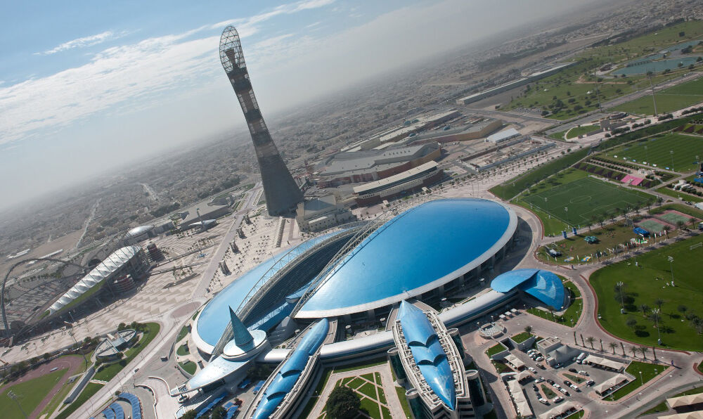
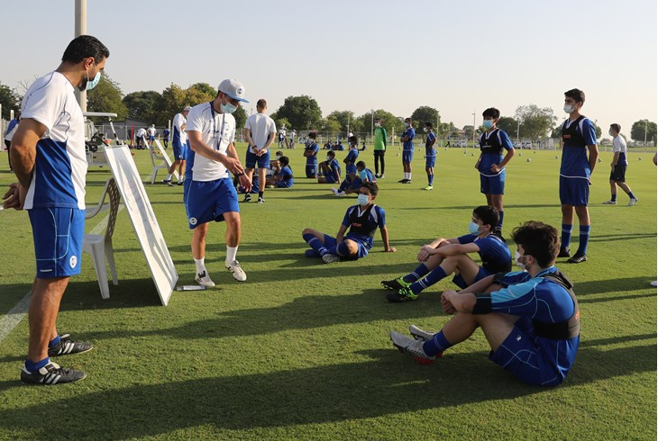
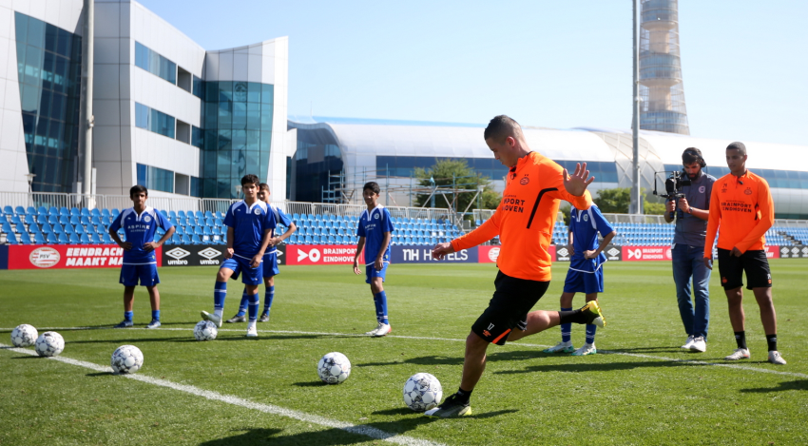
PRIVATE INVESTEMENT
.. is also important in the development of traditional sports..
This can be in the form of facilities, club ownership and finance/sponsorship. For example, The Aspire Academy in Doha, which is a sports academy that supports the development of youth athletes, mainly in football, athletics, squash, table tennis and fencing.
The participants are identified through a Talent Identification Programme and the Academy provides a host of development opportunities, including training with international coaching staff, competitions and tournaments with some of the best youth teams around the world, training at academies abroad and long-term career development into professional sports or sports-related roles and industries.
The Qatar esports Federation was established in 2021, under the umbrella of the Qatar Olympic Committee.
What can the Qatar esports Federation learn from the structure and organisation of football in Qatar?

Slide 32

GLOBAL ORGANISATIONS: GEF
The Global Esports Federation (GEF) promotes the credibility, legitimacy and prestige of esports. They convene athletes, players, and industry leaders together on one inclusive platform. Their mission is to cultivate competition along with developing communities and the connection between sport, esports and technology.
GEF has over 100 Member Federations and counts Tencent as their Founding Global Partner. Their strategic partners include UNESCO, Commonwealth Sport, Olympic Council of Asia, ITU and Face It.
GEF: CORE OBJECTIVES
Encourage and support the establishment of esports federations, establishing relevant standards, guidelines, and regulations.
Establishment of an athlete / player commission, with a focus on athlete wellness, development of standards for inclusive fair play and athlete career support.
Development of governance structures and guidelines for the GEF.
Convene and stage esports competitions, conventions, and inspiring educational development programs.
Create, develop, and stage the annual flagship Global Esports Games

Slide 33
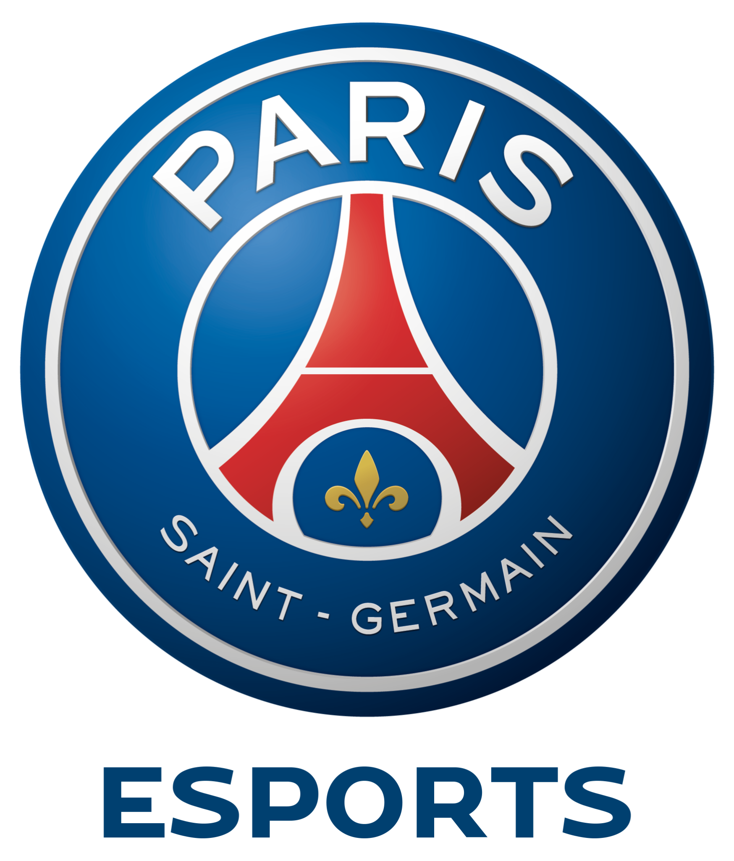
SYNERGIES
The synergies between esports and traditional sport continue to grow. For example:
Traditional sports are integrating esports into leagues and competitions to increase their fan base, e.g. FIFA (FIFA eWorld Cup), NBA (NBA 2K League), Formula 1 (F1 Esports Series).
Traditional sports clubs are also moving into esports team ownership, e.g. the NFL’s Pittsburgh Steelers have invested in professional esports team the Pittsburgh Knights and French football club Paris Saint-Germain have formed a partnership with Talon Esports to form PSG Talon.
Some esports leagues and tournaments, such as the four major League of Legends leagues, have adopted the American professional sports league system of franchising for enhanced stability by eliminating the risks of relegation.

Slide 34
WHAT CAN TRADITIONAL SPORT AND ESPORTS LEARN FROM EACH OTHER?
Digital Natives: Traditional sports fans are changing. Younger generations are digital natives, that is they are mobile-oriented, permanently connected, and likely to be operating a screen while watching the action. In other words, they are not only interested in the sporting action, but also additional content, such as behind-the-scenes action.
Online Engagement: Esports undoubtedly has better online engagement with fans. It’s common for esports teams to not only make content themselves, but also sign content creators to create a broader range of content outside of competing in events, such as interactive content on social media, behind-the-scenes and lifestyle content, e.g. broader gaming culture. This increased level of interactivity between esports players and audiences is facilitated by the built-in social elements of streaming platforms enabling fans to engage with teams, players, and other fans. This compares starkly with most traditional sports where one of the primary channels of communication with fans remains the press conference, which tennis player Naomi Osaka once explained was adversely affecting her own mental health.
Player Development: Traditional sports have different opportunities for player development, such as age-group leagues, development leagues, and scouting combines. eFuse have launched a ranking system for high-school-aged esports players called Pipeline, which gives them an opportunity to be discovered by collegiate esports coaches.

Slide 35





EXAMPLES OF NATIONAL GOVERNING BODIES IN UK SPORT (NGB)
England Football Association (The FA)
Rugby Football Union (RFU)
Lawn Tennis Association
England & Wales Cricket Board (ECB)
Basketball England

Slide 36




OTHER NGBs IN SPORTS
Sport and Recreation Alliance
National Disability Sports Organisations
Youth Sports Trust (YST)
Association for Physical Education (AfPE)
Chartered Institute for the Management of Sports and Physical Activity (CIMSPA)

Slide 37
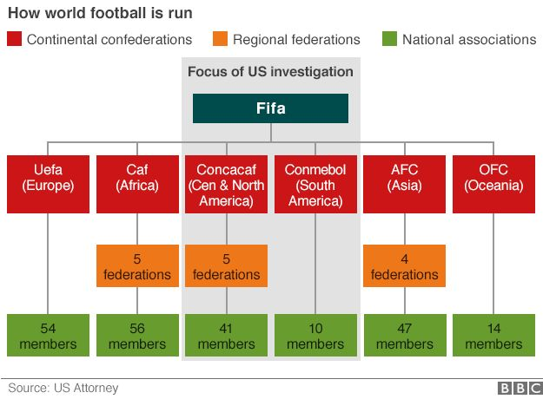
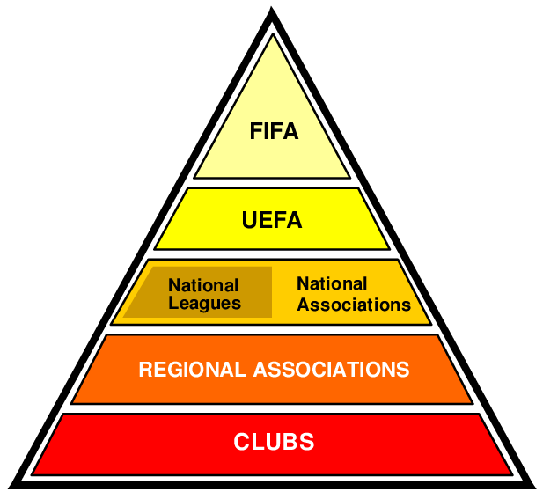
HOW FOOTBALL IS RUN & EUROPEAN FOOTBALL PYRAMIDAL STRUCTURE

Slide 38
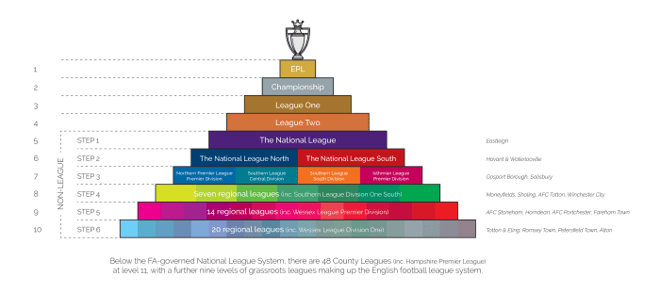
ENGLISH FOOTBALL PYRAMID

Slide 39

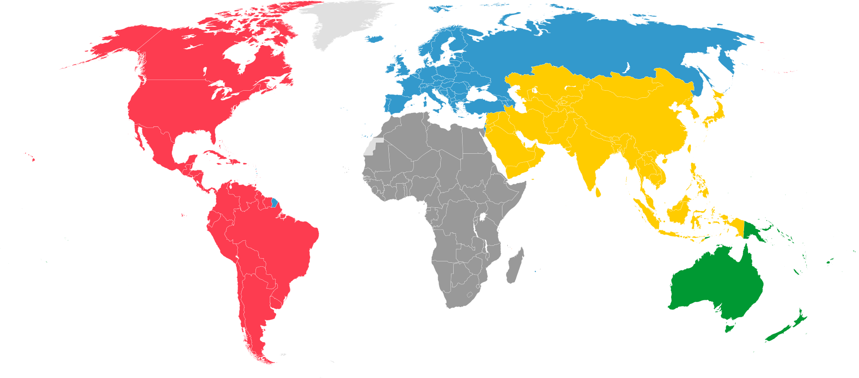

FIBA
FIBA divides the world into 5 commissions, each roughly based on a continent.

Slide 40
SUMMARY: STRUCTURE OF SPORTS AROUND THE WORLD
The global structure of sports can be complex due to the variety of sports and organisations involved. While the exact structure may vary depending on the sport, there are some common elements:
International Sports Federations (IFs): These are international non-governmental organisations that administer one or more sports at the world level. They establish rules, host tournaments and events, and promote their respective sports. Examples include FIFA (football), the International Cricket Council (ICC), the International Olympic Committee (IOC), and the World Rugby.
National Sports Federations or Associations: govern sports at the national level. They typically manage domestic competitions and tournaments and oversee the selection of national teams for international competitions. For instance, the Football Association (FA) in England, USA Basketball in the United States, and the Board of Control for Cricket in India (BCCI).
Professional Leagues: These are typically country-specific leagues where professional teams or athletes compete, such as the National Basketball Association (NBA) in the US, the Premier League in England, and the Indian Premier League (IPL) for cricket in India.
Athletes and Teams: These are the competitors who participate in various sports. They could be individuals (such as in tennis or athletics) or teams (such as in soccer, basketball, or cricket).

Slide 41
SUMMARY: STRUCTURE OF SPORTS AROUND THE WORLD…
Each sport has its specific governing bodies and structures, but the above provides a general overview of the global sports structure.
Event Organizers: These are the organisations that run sporting events, like the Olympic Games (organised by the IOC), the FIFA World Cup (organised by FIFA), or the Tour de France (organised by Amaury Sport Organisation).
Regional Sports Bodies: These govern sports at the regional level and often organise regional competitions. Examples include the Union of European Football Associations (UEFA) for soccer in Europe and the Confederation of African Football (CAF) in Africa.
Anti-Doping and Ethics Bodies: These organisations ensure fair play, ethical conduct, and a drug-free sport environment. Examples include the World Anti-Doping Agency (WADA) and various sports arbitration bodies.
Sports Clubs: These are organisations dedicated to a particular sport, providing resources, training, and competition opportunities for their members.
Broadcasters and Sponsors: Broadcasters distribute and air sports events to audiences around the world. Sponsors provide funds in return for advertising and brand exposure.

Slide 42
SUMMARY: STRUCTURE OF ESPORTS AROUND THE WORLD
The global structure of esports is a complex network of different organisations and entities. Unlike traditional sports, which typically have one global governing body per sport (like FIFA for soccer/football or the ICC for cricket), esports encompasses many different games, each with its own structure and governing bodies. However, there are some common elements:
Game Developers/Publishers: These are the companies that create and maintain the video games that are played in esports. Examples include Riot Games (League of Legends), Valve Corporation (Dota 2, Counter-Strike: Global Offensive), and Blizzard Entertainment (Overwatch, Starcraft II). They have significant control over their respective esports scenes, as they often create the rules and regulations for competitive play, organiSe tournaments, and can ban players or teams from competition.
Professional Esports Leagues and Tournaments: For each game, there are typically several professional leagues and tournaments. These can be regional (like the League of Legends European Championship or the Overwatch League's various city-based teams) or global (like Dota 2's The International or the League of Legends World Championship). These leagues and tournaments are often run or sanctioned by the game's developer.

Slide 43
SUMMARY: STRUCTURE OF ESPORTS AROUND THE WORLD…
Esports Teams and Organisations: These are the professional teams that compete in various esports. Some organisations focus on a single game, while others have teams competing in multiple games. Examples include Team Liquid, Cloud9, Fnatic, and T1. These teams employ the players, coaches, and other support staff.
International and National Esports Federations: These organisations aim to represent the interests of esports on a national or international level, often liaising with government bodies and pushing for recognition of esports as legitimate sports. Examples include the International Esports Federation (IESF) and the British Esports Federation
Broadcasters and Streaming Platforms: These entities broadcast esports competitions to viewers around the world. Traditional broadcasters like ESPN and BBC have started showing esports, but the vast majority of esports broadcasting takes place on online streaming platforms like Twitch, YouTube Gaming, and Facebook Gaming.

Slide 44
SUMMARY: STRUCTURE OF ESPORTS AROUND THE WORLD…
Sponsors and Advertisers: These are companies that sponsor esports teams, leagues, or tournaments in exchange for advertising. They can range from gaming-specific companies like Intel or Razer to general consumer brands like Coca-Cola or Mercedes-Benz.
Players and Fans: Of course, the players who compete in esports and the fans who watch them are a vital part of the esports ecosystem. Some top players have become celebrities in their own right, and esports competitions can attract millions of viewers from around the world.
It's important to note that the specific structure can vary greatly from game to game and region to region. Esports is a rapidly evolving field, and its structure is likely to continue evolving over time.

