Slide 1
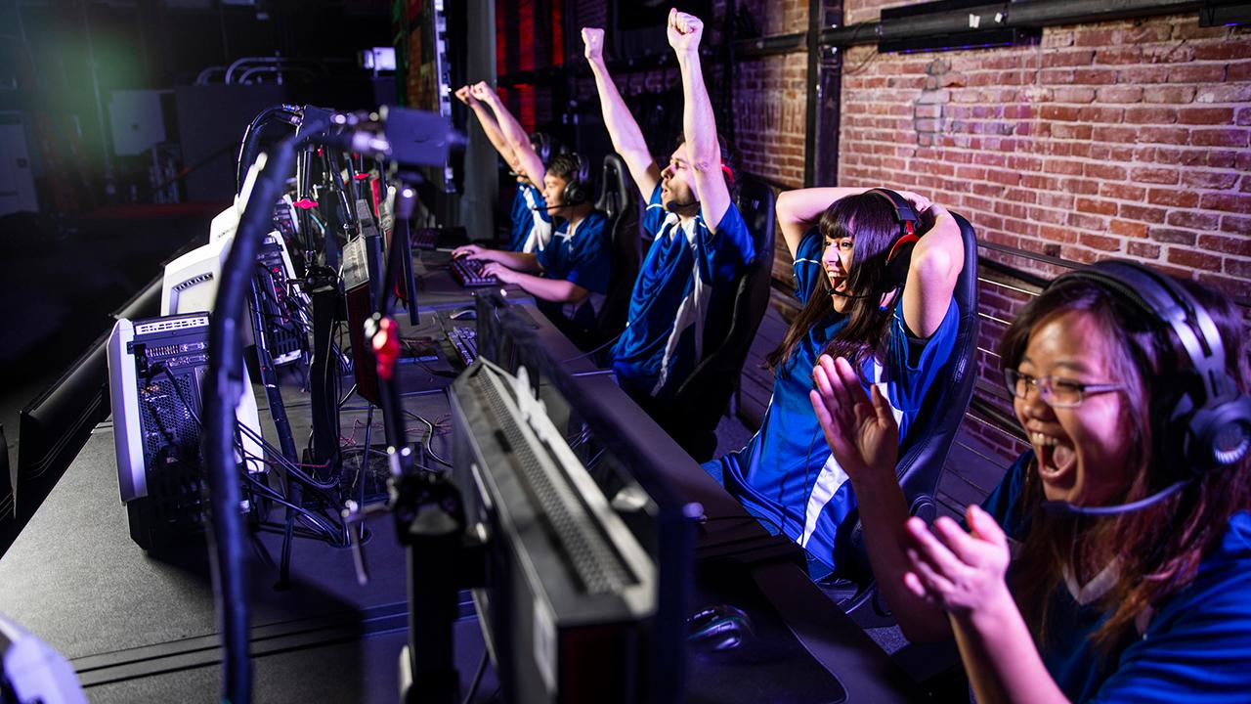
Building High-Performing Teams in Esports
Level 3 Curriculum | Framework for Students
Notes:
Welcome, everyone. Today we are looking at what separates a group of five random ranked players from an elite, high-performing esports team. In esports, mechanical skill—like your aim or your movement combos—is only the baseline. Because games move at lightning speed, true high performance is down to cognitive synchronization. Think about how fast a team fight happens in Valorant or League: if you don’t operate like a single, unified mind, a team with worse individual aim but better coordination will wipe you off the map every single time. Let's break down how real organizations build these teams.

Slide 2
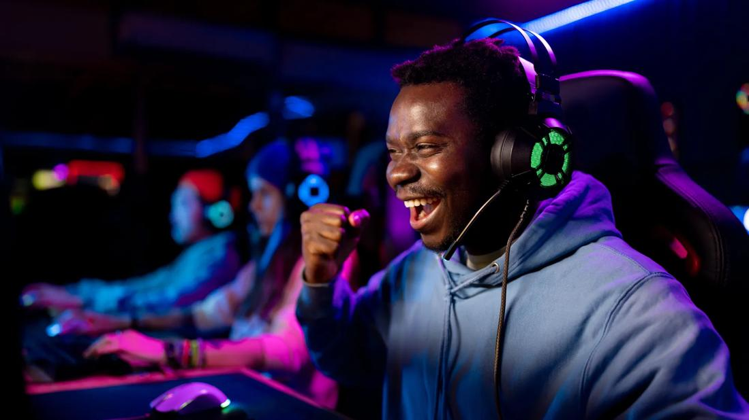
Core Elements – Communication and Trust
• Macro-communication: Overall match strategy, map rotations, economy management, and long-term positioning plan.
• Micro-communication: Real-time, rapid callouts during intense combat sequences ("Flash out", "He's one-shot!").
• The Role of Trust: Reduces cognitive friction. Players execute their specific roles without wasting energy micromanaging teammates.
• Common Pitfalls: Over-talking (cluttering comms with complaints) or falling completely silent when stressed ("tilting").
Notes:
Think about your own competitive games. When a round goes bad, does your Discord get flooded with people screaming or complaining? High-performing teams treat voice comms like a resource. Macro-comms are the calm, big-picture decisions made between rounds or when rotating. Micro-comms are the sharp, clear pieces of info given mid-fight. Crucially, this requires absolute trust. If you are constantly looking at your teammate's screen or worrying if they are covering your flank, your own reactions slow down by crucial milliseconds. If you don't trust them, you tilt. If you tilt, you lose.

Slide 3
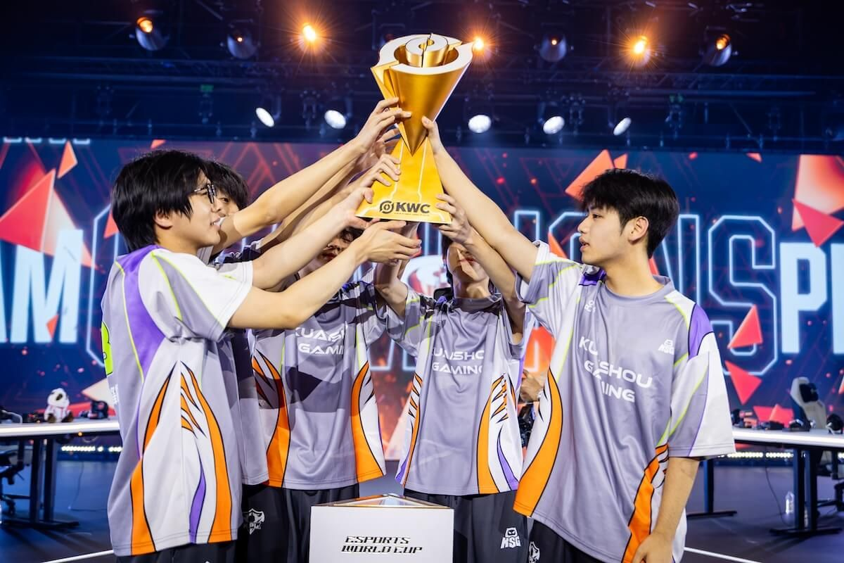
Team Culture and Shared Goals
• Collective Over Individual: A positive team culture prioritizes team victories over individual KDA ratios or personal stats.
• SMART Performance Goals: Targeting objective milestones like winning a specific regional tournament qualifier.
• SMART Process Goals: Focusing on quantifiable metrics like securing first dragon in 80% of scrims or fixing spike-plant conversions.
• Mutual Accountability: Holding every team member responsible for punctuality, practice quality, and mental professional standards.
Notes:
We’ve all played with the person who cares more about their personal KDA than actually winning the match. In a professional esports environment, that attitude gets you benched. High-performing teams build a culture where the team win is the only metric that matters. They do this by setting SMART goals. Instead of just saying 'let's win today,' an HPT sets a process goal like: 'We will secure first dragon in 80% of our scrims today.' Finally, accountability means showing up on time for practice, keeping your mental state in check, and treating your teammates like professionals.

Slide 4
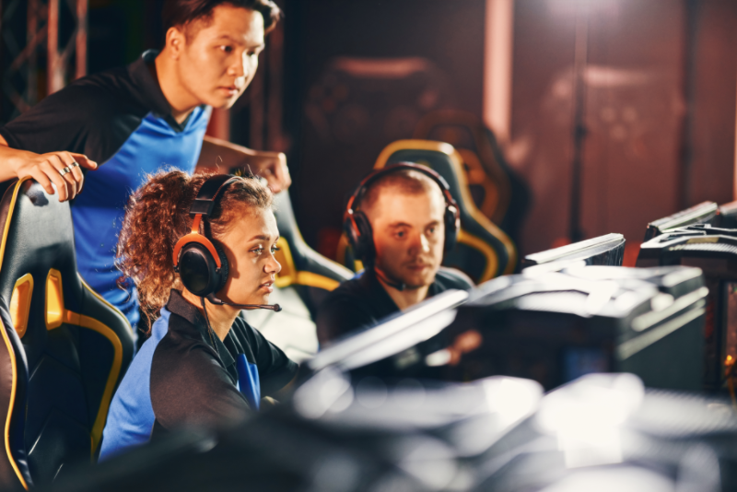
Defining Roles and Responsibilities
• In-Game Leader (IGL): Acts as the tactical general. Makes definitive mid-game calls that the roster must instantly execute together.
• Specialized Roles: Mechanical and support roles tailor-fit to the specific title (e.g., Entry Fragger, Duelist, Jungler).
• Head Coach: Builds the master strategic playbook, conducts drafts, and guides map bans.
• Performance Psychologist: Manages mental resilience, safeguards team cohesion, and trains tilt-prevention techniques.
• Data Analyst: Mines statistical gameplay trends and translates opponent data into concrete game plans.
Notes:
An esports team is much bigger than just the players on stage. In-game, roles must be crystal clear. The In-Game Leader, or IGL, is the general. When the IGL makes a call, the team follows it instantly—even if it's a bad call, executing it together is better than hesitating. Behind the scenes, professionals rely on a support ecosystem. The Coach builds the playbook; the Data Analyst finds patterns and weaknesses in the opponent's gameplay; and the Performance Psychologist keeps the players from burning out or breaking down under the pressure of playing in front of thousands of fans.

Slide 5
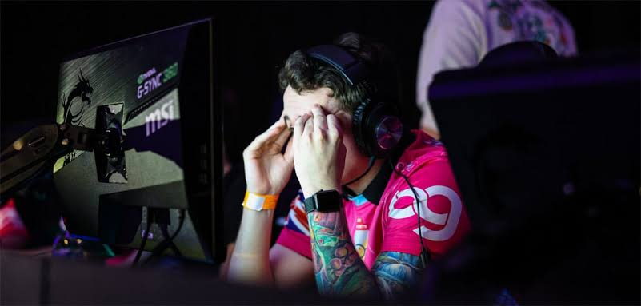
Psychological Safety & Conflict Resolution
• Psychological Safety: The environment must be safe for interpersonal risk-taking. Players can admit errors without fear of humiliation.
• Eliminate Hesitation: Safe environments ensure players play proactively and attempt clutch plays instead of playing out of fear.
• Constructive Conflict: HPTs argue frequently, but critique is kept strictly objective. Replace personal insults with structural solutions.
• Focus on Mechanics & Strategy: Critiques address exact action items ("rotation was 3 seconds slow") rather than individual player traits.
Notes:
What happens when a teammate makes a massive throw? Do people flame them, or do they lift them up? 'Psychological safety' sounds like a complicated academic term, but it simply means you aren't afraid of being insulted by your team when you make a mistake. If players are terrified of messing up, they will play passively, stop taking creative risks, and hesitate during crucial clutch moments. High-performing teams have massive arguments, but they are never personal. They don't say 'you suck.' They say, 'Your rotation to B-site was three seconds too slow, which let them plant.' It’s objective, it’s constructive, and it keeps the team from falling apart.

Slide 6
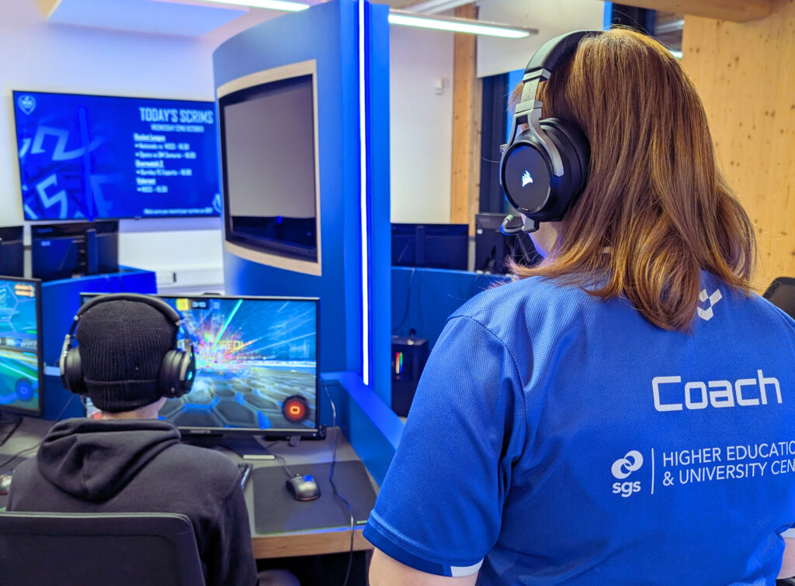
Continuous Improvement through Review
• Structured VOD Analysis: Reviewing game recordings frame-by-frame to analyze crosshair positioning, utility execution, and blindspots.
• Audio Log Auditing: Listening back to team communications during stressful skirmishes to filter out unhelpful comm clutter.
• Data-Driven Loops: Constantly updating team strategies and adapting the playbook based on scrim metrics and patch meta shifts.
Notes:
If you want to go pro, you have to spend almost as much time watching the game as you do playing it. This is where VOD reviews come in. High-performing teams sync up with their coach to review game recordings frame-by-frame. They don’t just watch the kills; they look at minion waves, crosshair placement, utility efficiency, and listen back to their own voice comms audio. This creates an ongoing feedback loop. If the data shows you are consistently losing a specific bombsite or objective, you rewrite your playbook before the next scrim.

Slide 7
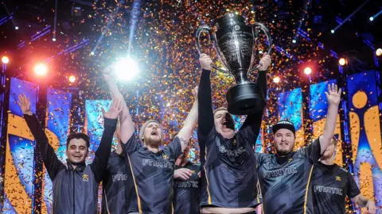
Conclusion: System Over Raw Skill
• Beyond Mechanical Talents: Championships require structural systems—raw mechanical talent is only the base filter.
• Cohesion Wins Matches: Five elite individual players operating independently will routinely fall to a well-integrated, high-performing team.
• Build Your Infrastructure: Focus on structured communication, explicit roles, psychological safety, and regular VOD review loops.
Notes:
To wrap things up: esports championships aren't won by a single star player carrying the lobby. They are won by structural systems. High-performing teams master communication, build deep trust, clearly define who does what, create an environment where it's safe to learn from mistakes, and relentlessly review their own gameplay. When you go into your next team practice or scrim, look at your squad. Are you acting like five individuals, or are you building a high-performing ecosystem? Thank you, and I’m open to any questions.

Slide 8
Student Task 1 (10 mins)
Identify 3 successful esports teams and explain their strengths.
Student Task 2 (15 mins)
Design an esports roster and assign team roles.
Student Task 3 (15 mins)
Analyse a professional esports team and evaluate performance.

