Slide 2
Objectives
Draw a diagram to show how an IT system works

Slide 3
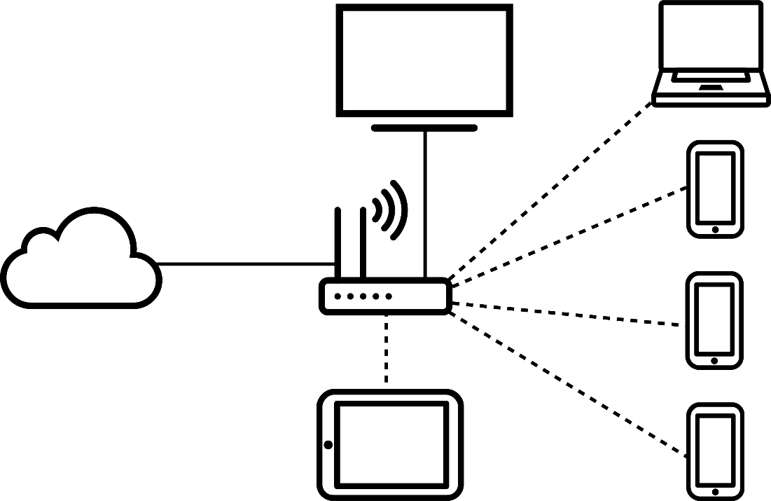
Starter
What does the following diagram of an
IT system represent?
  What are each of the devices?
  What are the connections?

Slide 4
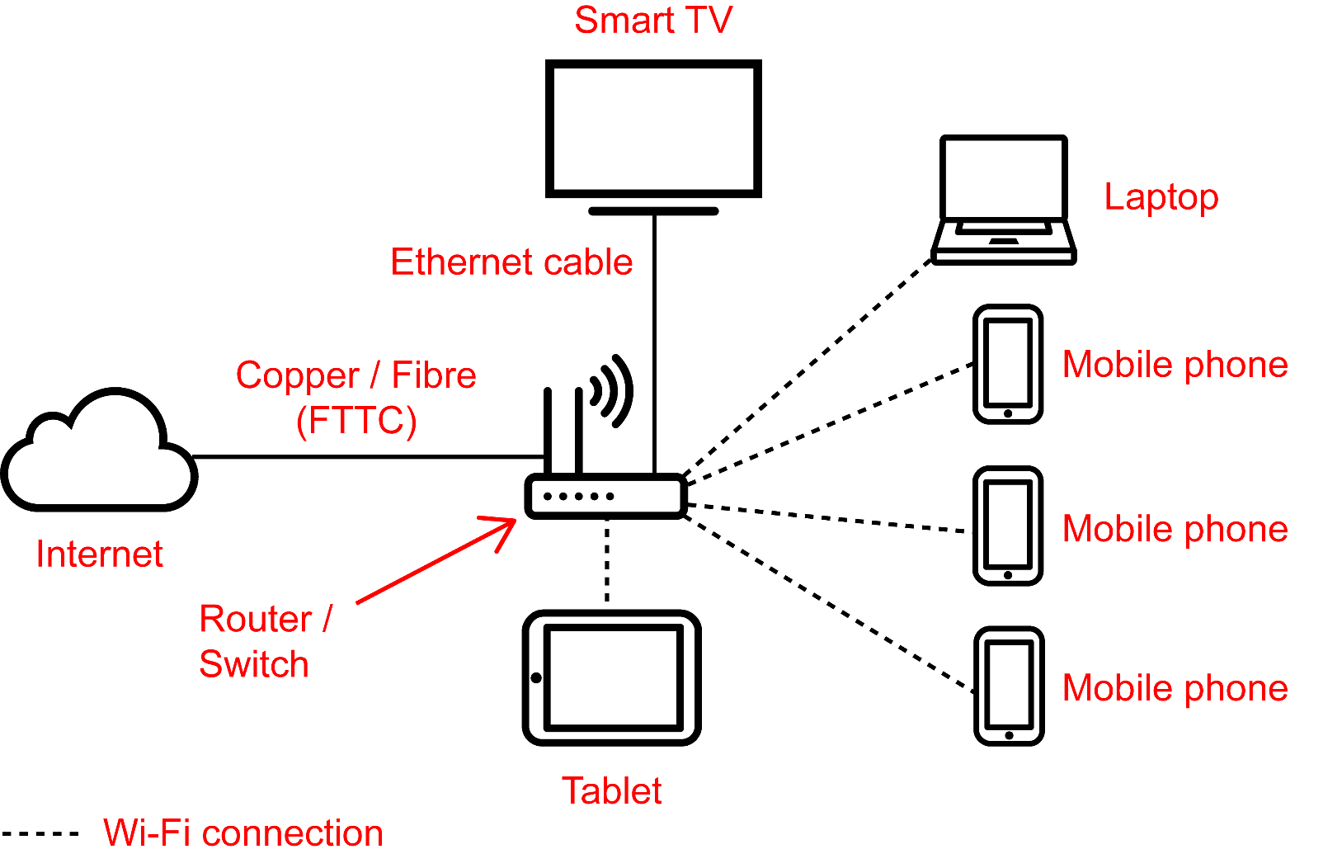
Starter
The diagram represents a home network

Slide 5
Purpose of a system diagram
A system diagram will typically show:
  Devices used
  How devices are connected
  Flow of data through the system
  Annotations showing key information such as specifications or the data that will be passed between other systems, devices and users

Slide 6


Tips for drawing a diagram
It helps when creating
system diagrams to
remember the following tips:
  Identify the users
  Identify the devices that are needed
  Space out the diagram so there is
  enough room to annotate clearly later
  Just use boxes with labels – don’t try to
  draw smartphones, delivery vehicles, routers
  and computers

Slide 7

Scenario: Mobile phone shop
Create a system diagram for a mobile phone shop that has:
  Two tills which connect to a payment server on the Internet
  One VoIP phone
  One back office computer connected to the head office LAN which has a customer database server
  5 mobile phones to try out
  One printer

Slide 8
The devices
First decide the devices that are required for
the scenario
  Draw the devices
  Include other hardware or systems which will be needed to create the network
  Give enough space for later annotation
  Use simple boxes with labels to explain what each device is
Now draw the devices for your diagram

Slide 9
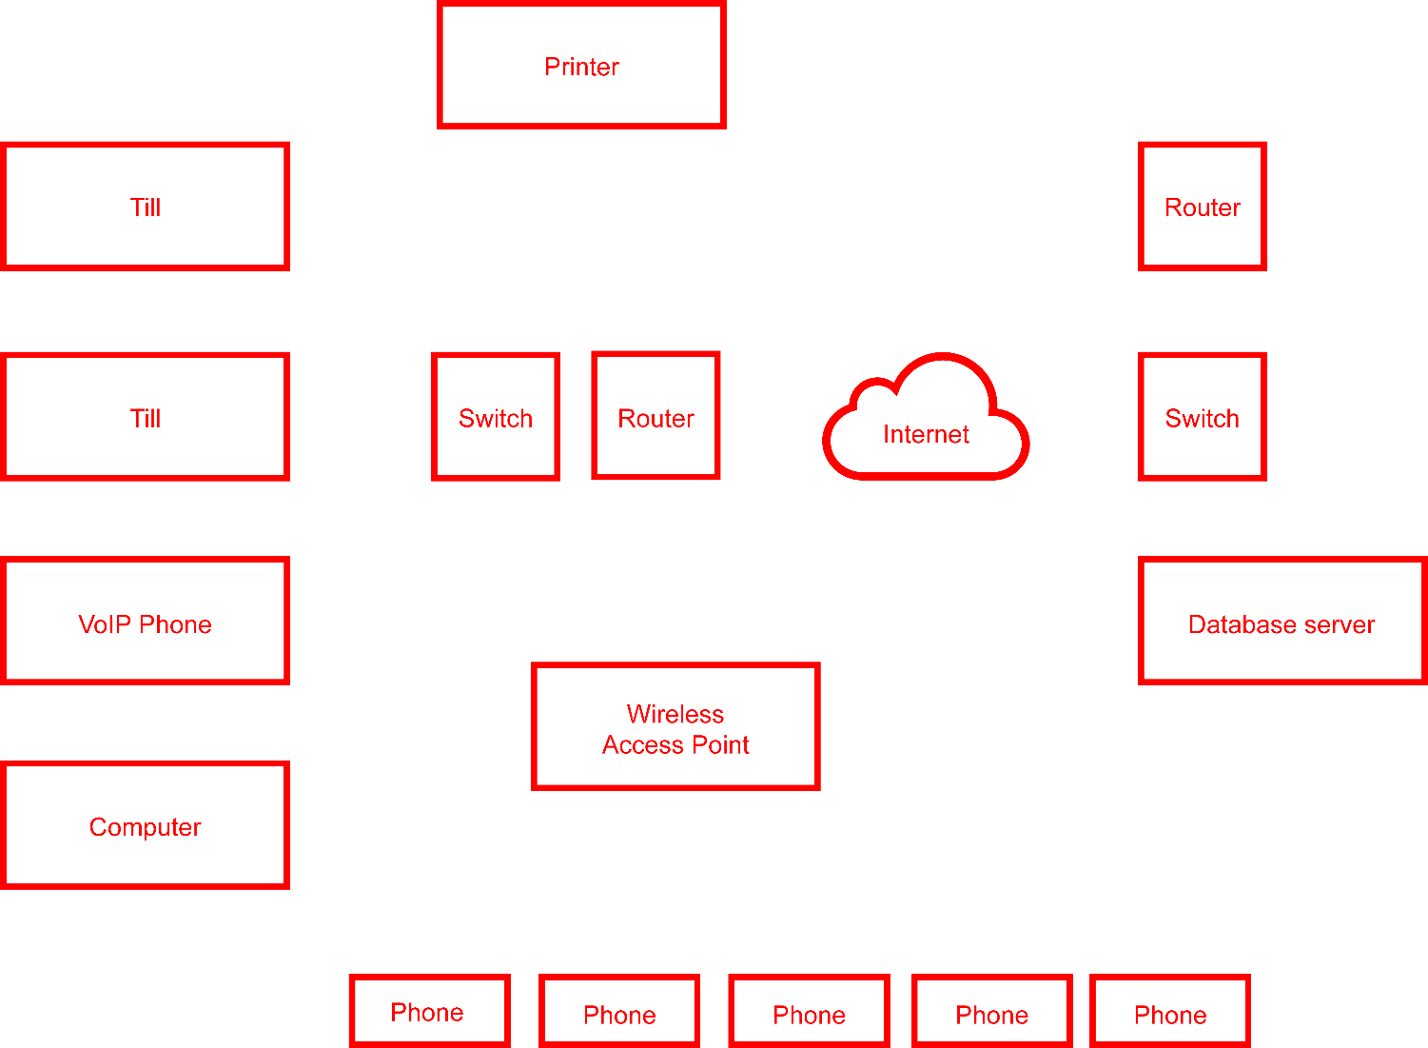
The devices

Slide 10

Connections
Now add suitable connections to your diagram
Remember to annotate the
connections and diagram
  What type of connection will
  be used?
  Identify major areas, such
  as the head office network
  Is there anything else
  important to the scenario
  that needs to be annotated?

Slide 11
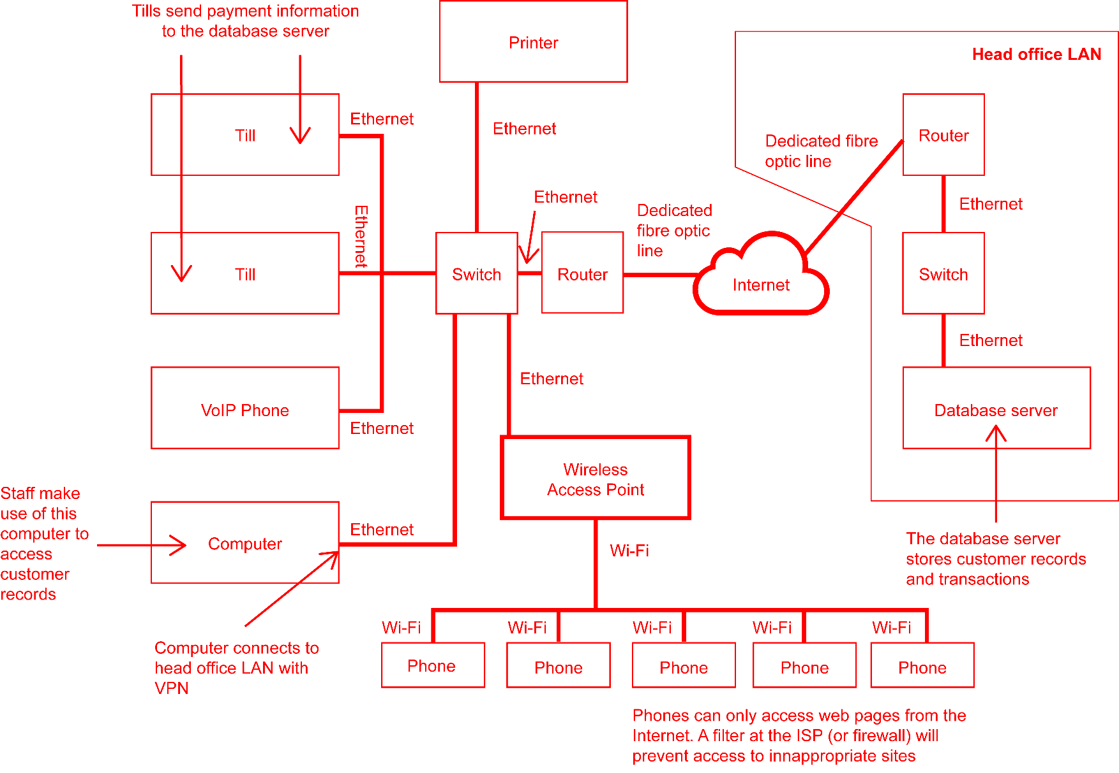
Connections

Slide 12
Worksheet 6
Now complete Task 1 and Task 2 on Worksheet 6

Slide 13

Scenario: A journalist
A journalist interviews a company director
  They take photos on a Smartphone
  Later they write their article on a laptop
  They submit the article via email to the
  newspaper editor at Head Office
  The photographs are uploaded to a
  file server located at Head Office
  The editor works on a PC which is
  part of a LAN
Create a diagram showing the
devices and servers used in this system

Slide 14
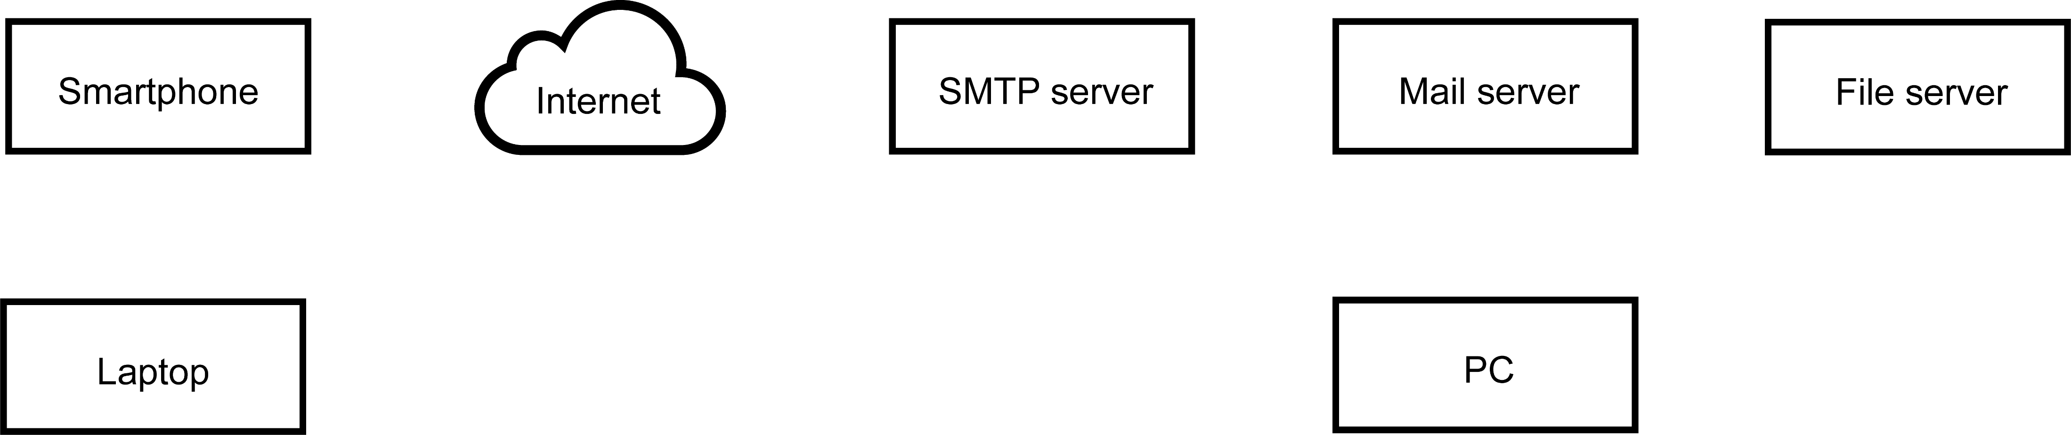
Devices and labels
Now adapt the diagram to show connections and flow of data

Slide 15
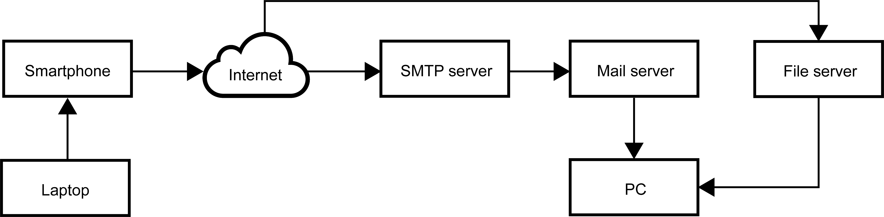
Connections and flow
Now adapt the diagram to add annotation explaining the data flow and types of connection used

Slide 16
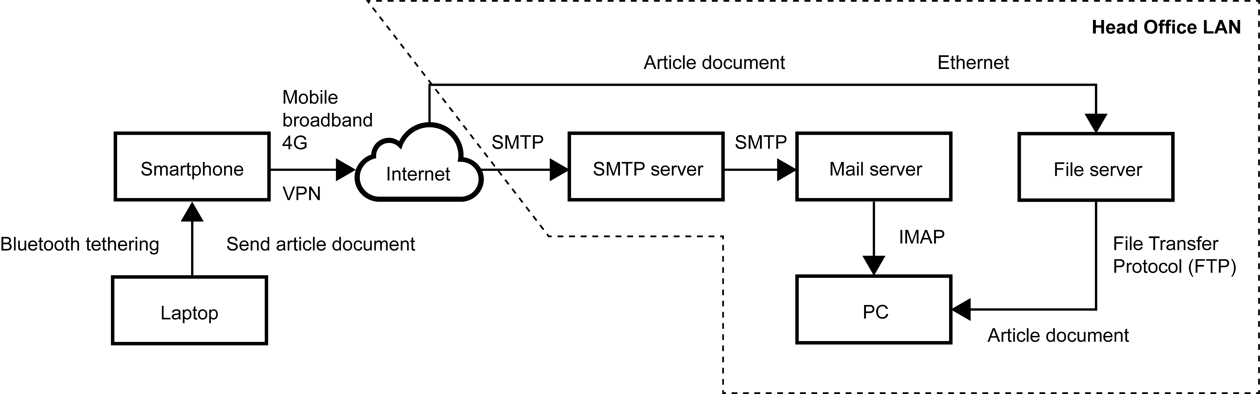
Annotation

Slide 17
Worksheet 6
Now complete Task 3 and Task 4 on Worksheet 6

Slide 18
Plenary
What are five tips for drawing system diagrams?

Slide 19
Plenary
Possible tips for drawing diagrams:
  Read the scenario carefully
  Identify devices that are needed
  Consider other hardware and systems such as servers, routers, switches and the Internet
  Space out the diagram
  Use boxes
  Label devices
  Annotate the diagram
  Arrows indicate the direction of flow of information

