Slide 1
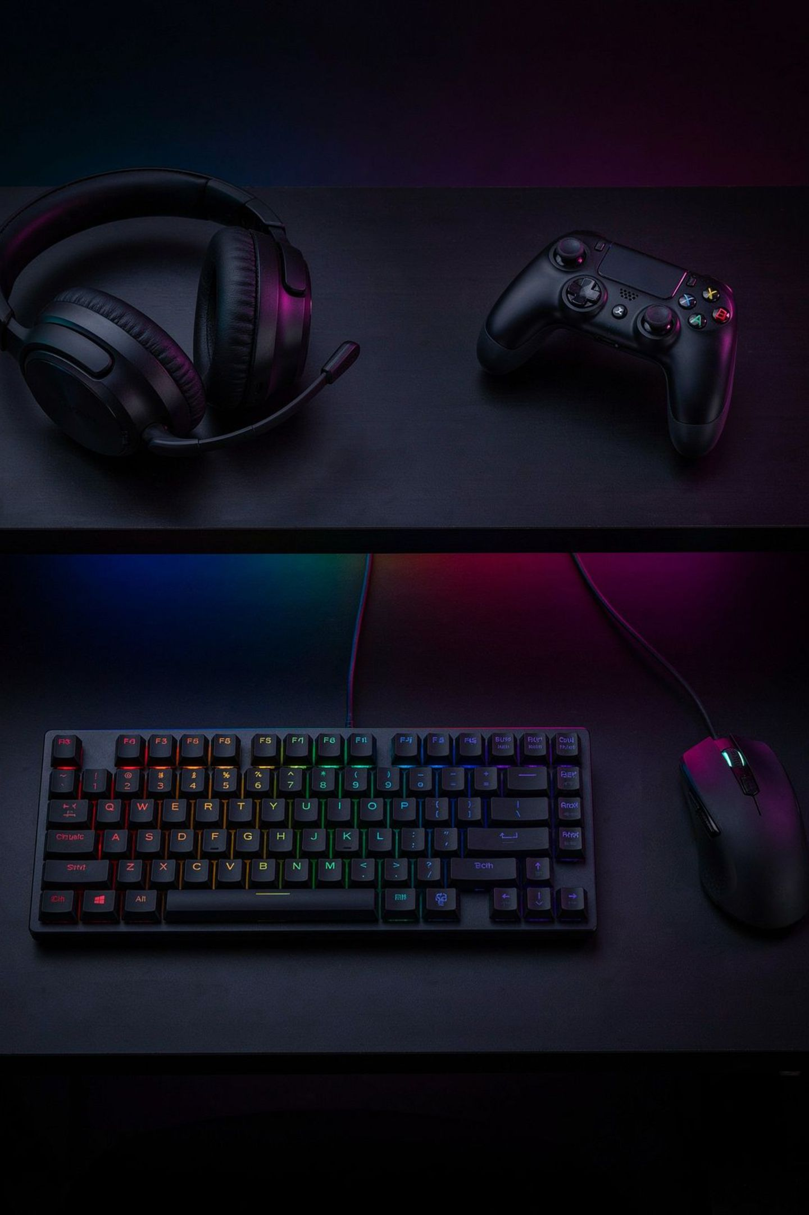
1 Hour P1 Task: Create Initial Branding Concepts
ASSIGNMENT 1 EVIDENCE
You will now apply your learning to create real branding evidence for your chosen esports or gaming-related product. Follow the four steps carefully.

Slide 2
Step 1: Product Selection
TASK STEP 1
Choose an esports or gaming-related product from the list below. This will be the product you brand throughout Assignment 1.
🎧 Gaming Headset
🎮 Controller
🪑 Gaming Chair
⚡ Energy Drink
🎙️ Streaming Microphone
⌨️ Gaming Keyboard
🖱️ Gaming Mouse

Slide 3


Step 2: Logo Planning Sheet
TASK STEP 2
Create a logo planning sheet that includes all of the following elements:
1
2
3
Product Name
Sketch 1
Sketch 2
Choose a name for your product.
First logo idea — draw it out.
Second logo idea — an alternative design.
4
5
Colours
Symbols Used
Note the colours you plan to use.
List any icons or imagery included.

Slide 4


Step 3: Strapline Development
TASK STEP 3
Create three possible straplines for your product. Consider what message you want to communicate to your target gaming audience.
"Play Without Limits"
"Unlock Your Potential"
"Victory Starts Here"
These are examples only. Create your own straplines that are relevant to your chosen product.

Slide 5
Step 4: Select Final Branding
TASK STEP 4
Choose Your Final:
Write a Short Explanation:
One logo idea
One strapline
Why did you choose this logo?
Why did you choose this strapline?
This written justification forms part of your assignment evidence.

Slide 6
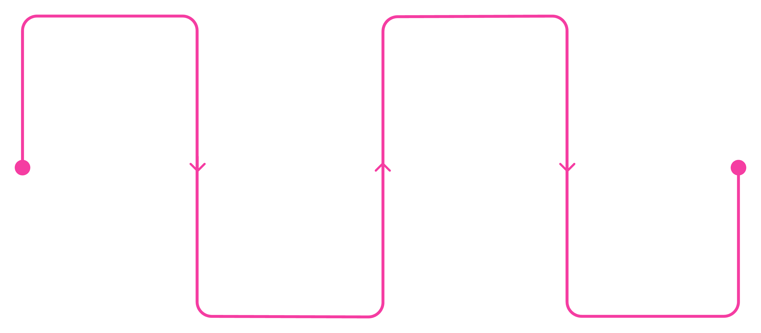
Task Overview: All Four Steps
Select Product
Draft Straplines
Choose your gaming product
Write three possible straplines
Final Choice
Logo Planning
Choose logo and strapline with explanation
Complete sheet with two sketches
Complete all four steps to produce your P1 branding evidence for Assignment 1.

Slide 7

P1 Checklist: Before You Submit
✅ I have chosen a gaming or esports product.
✅ I have created an original logo (not copied from the internet).
✅ I have created a strapline linked to my product.
✅ My logo and strapline relate to the same product and message.
✅ I have written a short explanation of my choices.

Slide 8
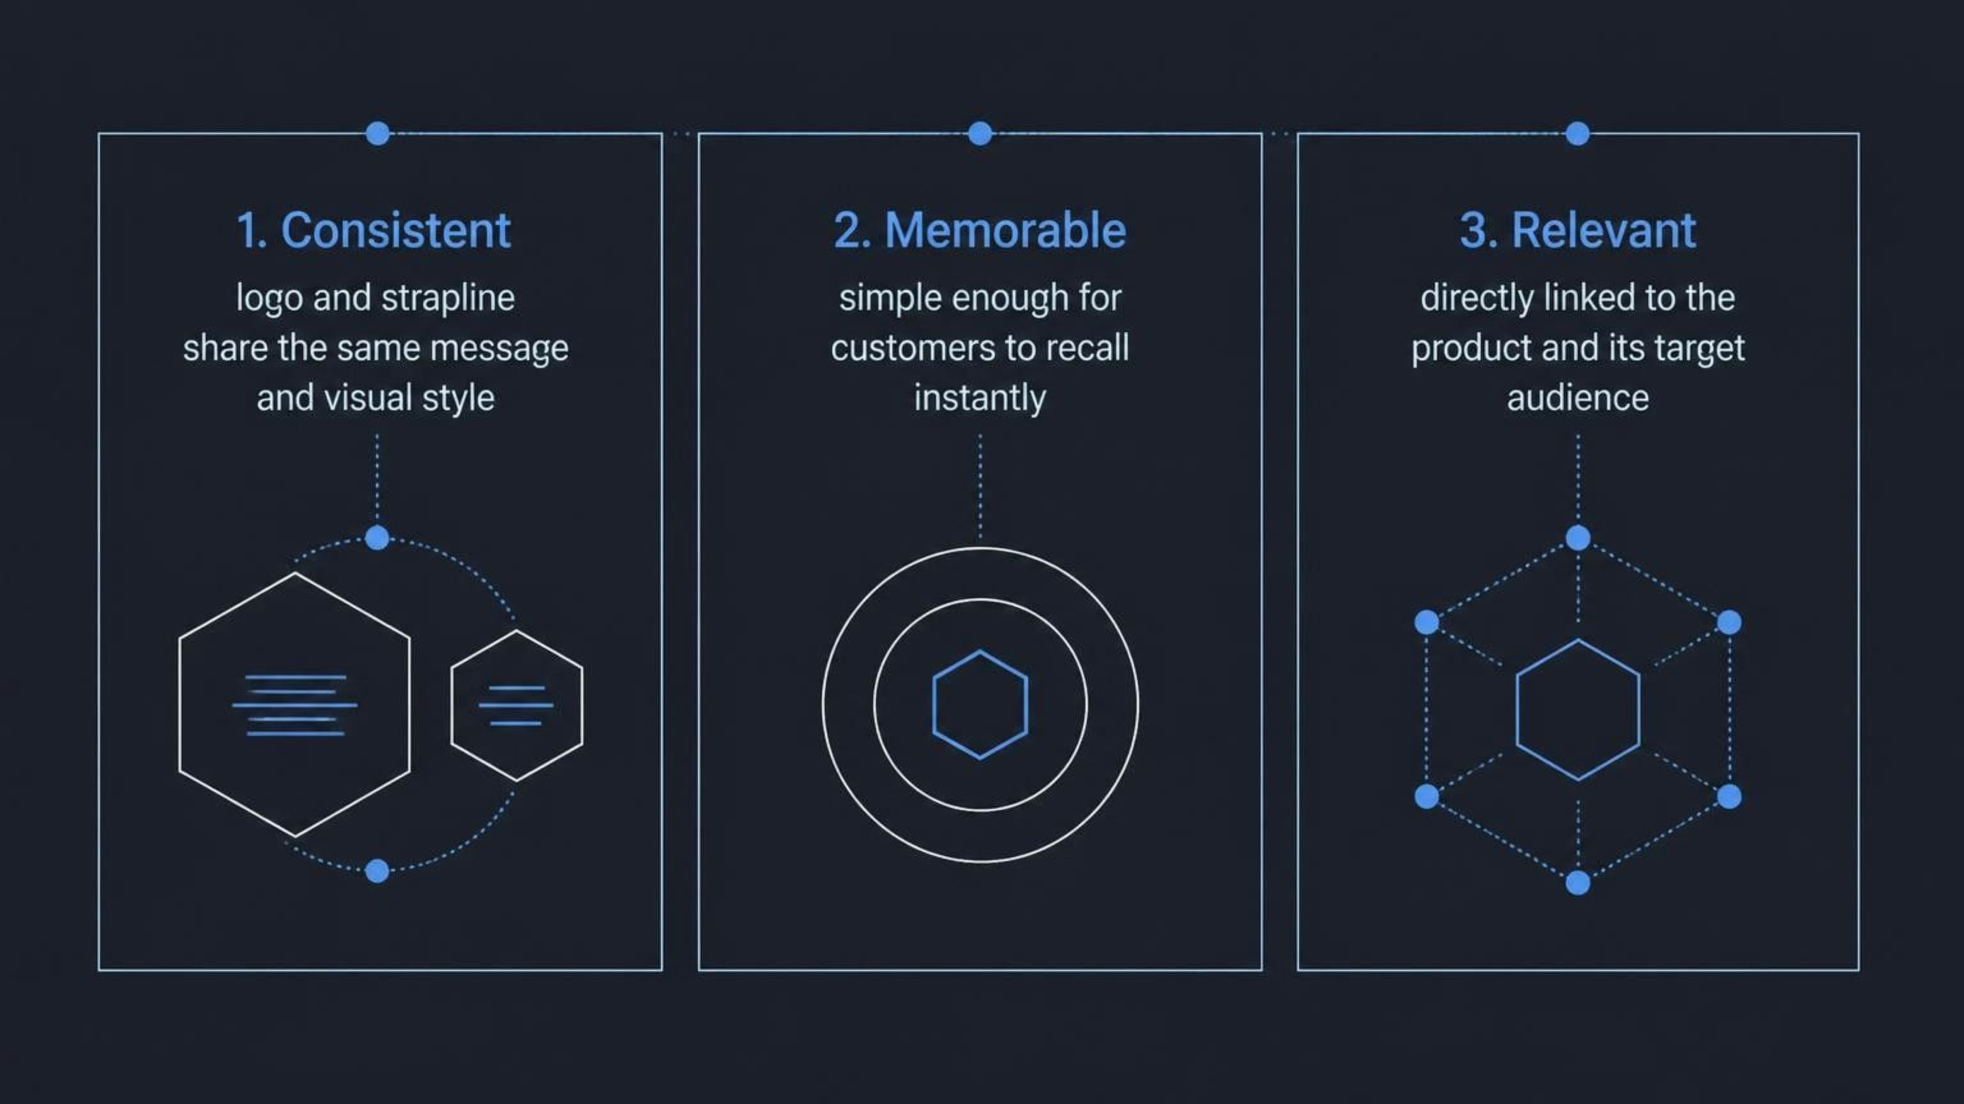
What Makes Branding Effective?

Slide 9

Logo vs. Strapline: Quick Recap
Logo
Strapline
Visual symbol
Builds recognition
Uses images, colour, and text
Identifies the product at a glance
Short phrase
Communicates a message
Short, relevant, and simple
Supports and reinforces the logo
Together, a logo and strapline create a complete brand identity. Both are required for P1.

Slide 10




Common Mistakes: Summary
Missing Element
Copied Work
No logo OR no strapline = P1 not achieved.
Logos taken from the internet are not original evidence.
No Connection
Overcomplicating
Branding must relate clearly to the chosen product.
Simple, produced branding is all that is needed for Pass.

Slide 11

Plenary: Exit Ticket
"What must be produced to achieve P1?"
Expected Answer
A learner must create a logo and a strapline for their chosen product.

Slide 12

You Are Ready to Achieve P1
✅ Understand P1
✅ Know the Features
Produce a logo and strapline for a product.
Logos use image, colour, and text. Straplines are short, relevant, and simple.
✅ Avoid Mistakes
Include both elements, keep it original, and link them to your product.
ASSESSMENT FOCUS: A.P1
UNIT B7: BRANDING A PRODUCT

