Slide 1
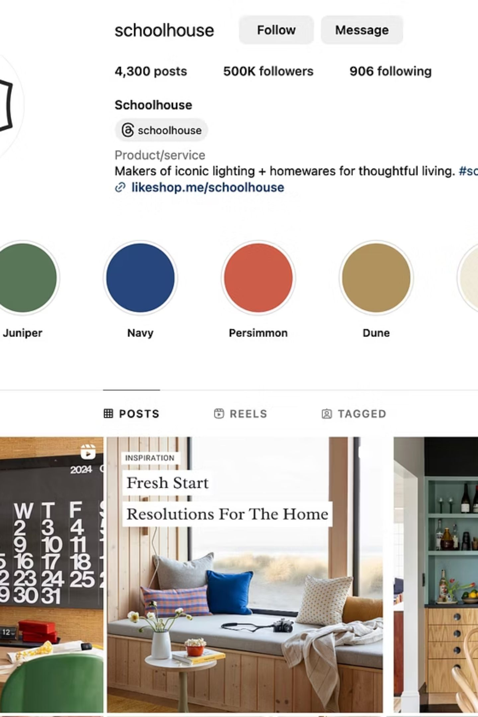
Building a Strong Brand Identity
Unit B7: Branding a Product — Lesson 6
Duration: 2 Hours | Assessment Focus: A.P1, A.P2, Working Towards A.M1 & A.M2
01
Understand
What makes a strong brand identity
02
Explore
How brands communicate messages
03
Improve
Your product branding
04
Develop
Branding evidence for Assignment 1

Slide 2

Starter: What's the Message?
Look at 4 well-known gaming and esports brands. For each one, consider the questions below.
First Impression
The Message
Target Audience
What is the first thing you notice?
What does the brand communicate?
Who is it aimed at — and how can you tell?
Key Question: Can branding communicate a message without using lots of words?

Slide 3






What is Brand Identity?
Brand identity is how a business wants customers to see its product. It is built through a combination of visual and verbal elements working together.
Product Name
Logo
Colours & Fonts
The name customers remember
The visual symbol of the brand
Create mood and recognition
Strapline
Packaging
A short memorable phrase
The physical presentation
Discussion: What identity does Xbox or PlayStation try to create? How do their visual choices reflect that?

Slide 4
Brand Personality & USPs
Brand Personality
Unique Selling Points (USPs)
Brands often have distinct personalities that connect with their audience. Common examples include:
A USP is what makes a product different from competitors. Without one, there is no reason for customers to choose your brand.
Competitive & Powerful
Professional & Premium
Friendly, Fun & Welcoming
Luxury & Exclusive
Better performance
Lower cost
Better design or easier to use
More features
What personality does your product have?
Think–Pair–Share: What makes your product different from existing products?

Slide 5
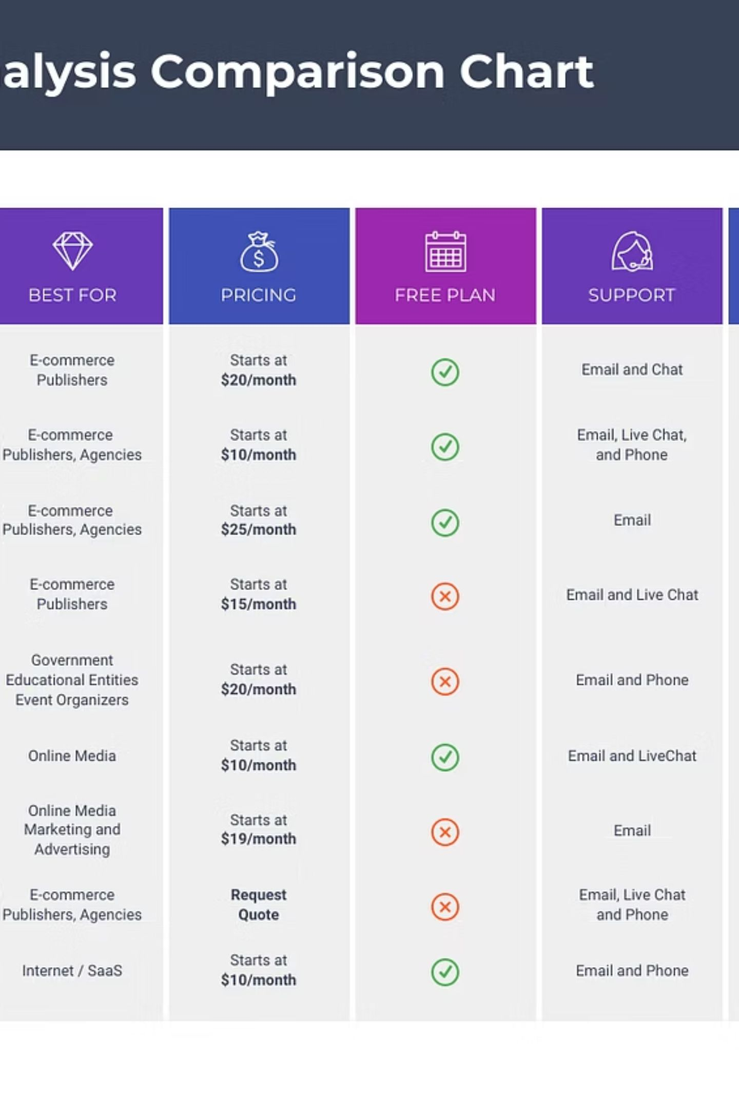
Competitor Analysis
Before launching a product, businesses investigate their competitors to avoid copying and to create something truly unique.
What does the competitor do well?
What could be improved?
How can we stand out?
What branding methods do they use?

Slide 6
How Branding Influences Customers
Strong branding does far more than look good — it shapes how customers think, feel, and behave.
Trust
Purchasing Decisions
Loyalty
Consistent branding builds credibility over time
Customers choose brands that feel right for them
Great branding keeps customers coming back
First Impressions
Recognition
You only get one chance to make an impact
Memorable brands are instantly identifiable
Would people buy from a brand they don't trust?

Slide 7
Successful Brands vs. Common Mistakes
✅ Features of Successful Brands
❌ Common Branding Mistakes
Memorable and instantly recognisable
Consistent across all materials
Visually attractive and professional
Relevant to the target audience
Too many colours
Hard-to-read fonts
Confusing or unclear logos
Weak product names
Branding that doesn't match the audience
Question: Which of these mistakes do you think is most damaging to a brand — and why?

Slide 8
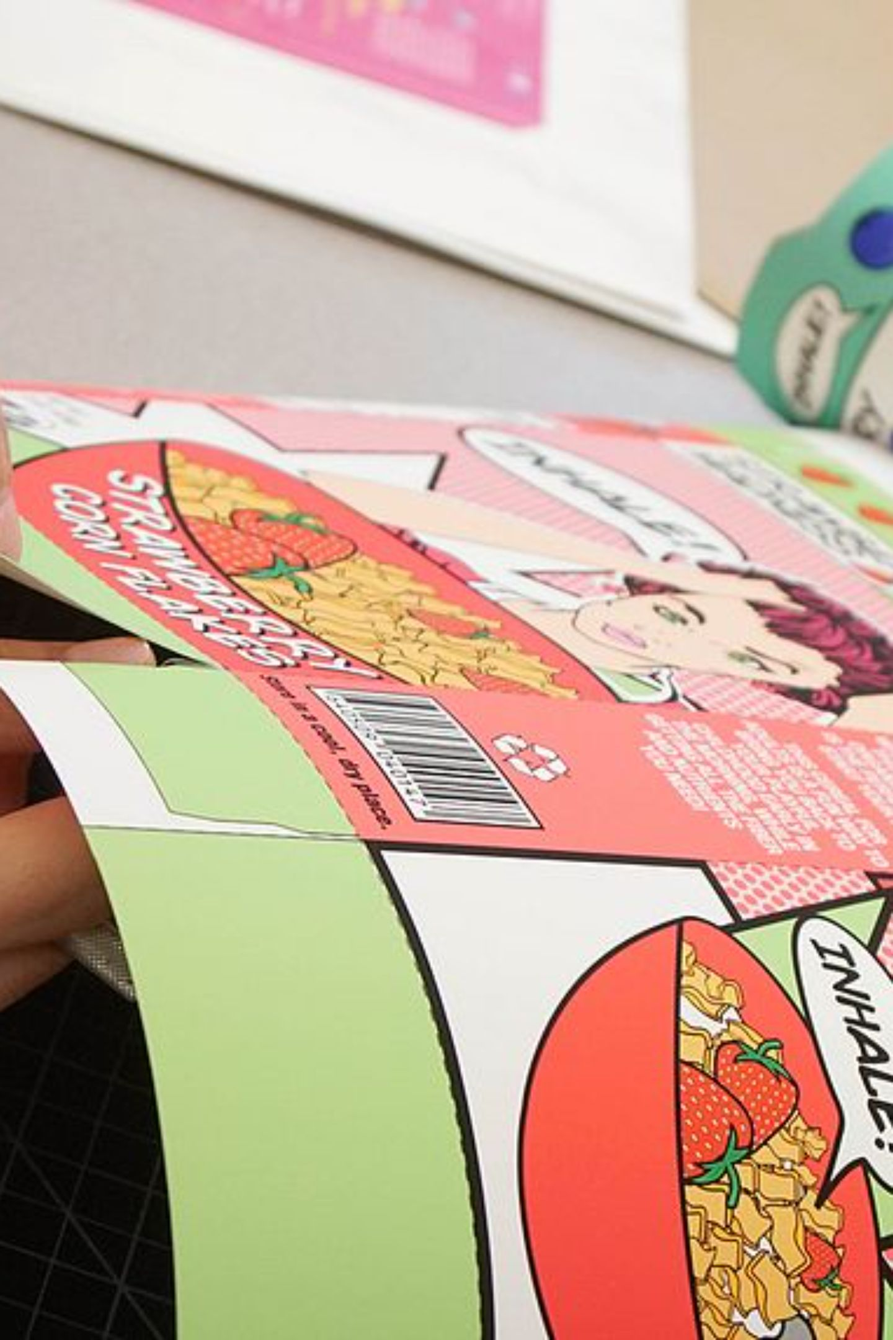

Teacher Demonstration: Product Review
Review an example student product together as a class. Evaluate each element and discuss what works and what could be improved.
1
Product Name
Is it memorable and relevant?
2
Logo
Is it clear and professional?
3
Strapline
Does it communicate the brand message?
4
Packaging
Does it appeal to the target market?

Slide 9
Main Task: Brand Improvement Workshop
60 Minutes — Continue your Assignment 1 work. Review and improve each element below, then complete your Branding Review Sheet.
Improve Your Branding
Branding Review Sheet
Product Name
Logo
Strapline
Packaging Design
Target Market Information
Marketing Ideas
What is your product?
What is your USP?
What is your brand personality?
Who is your target audience?
How does your branding appeal to them?
What improvements have you made today?

Slide 10
Stretch, Challenge & Assignment Checklist
🎯 Stretch & Challenge: Branding Consultant
✅ Assignment 1 Checklist
Evaluate your own product and write a short evaluation paragraph answering:
Product selected
Product Name, Logo & Strapline complete
What would make it more professional?
Would customers recognise it instantly?
Does it stand out from competitors?
How could you improve the packaging and logo?
Front & Back Packaging Design done
Features & Benefits included
Clear personality & USP identified
Target audience & customer needs explained
Branding is professional, consistent & relevant
Success Tip: Before finishing, ask yourself — "Would my target audience immediately understand what this product is and why they should buy it?"

